Slide 1
2019-07-20
STORM STORY 15:00-23:00

Slide 2
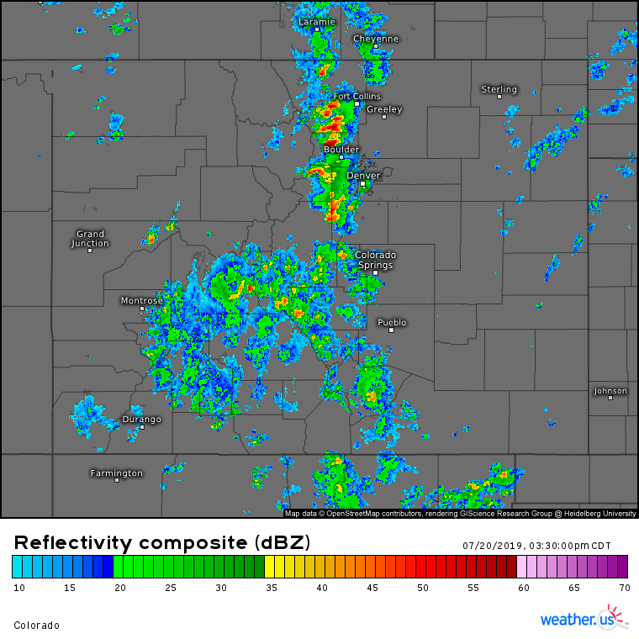
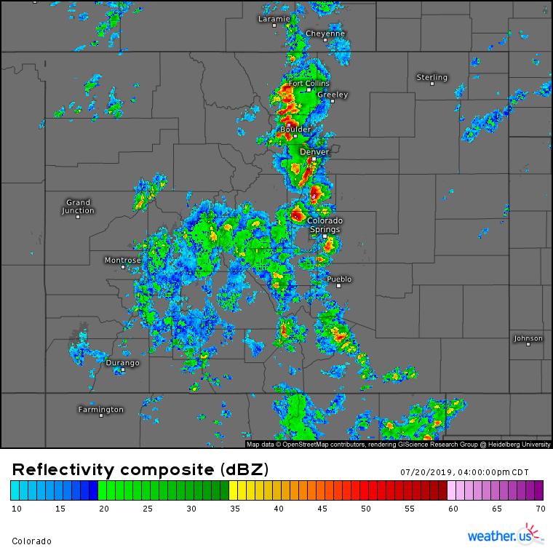
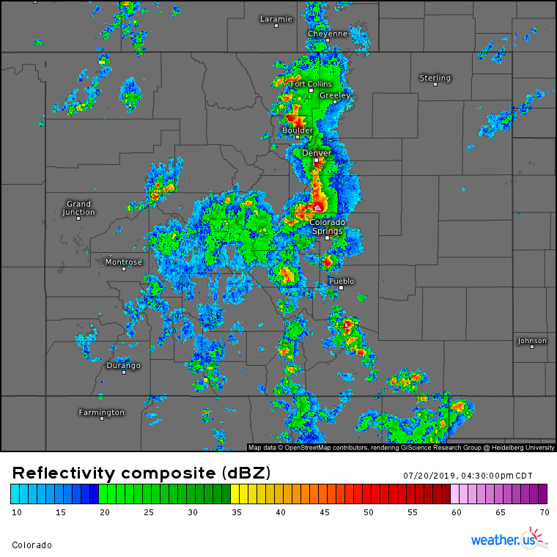
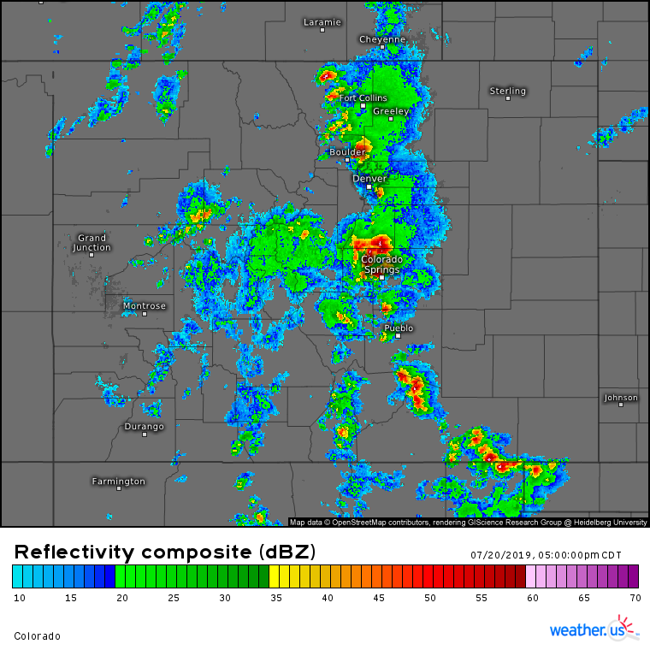
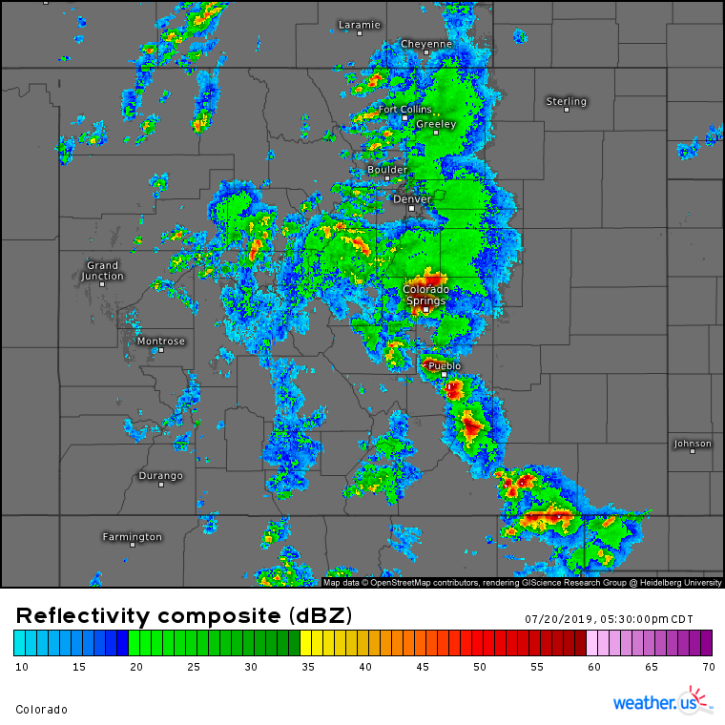
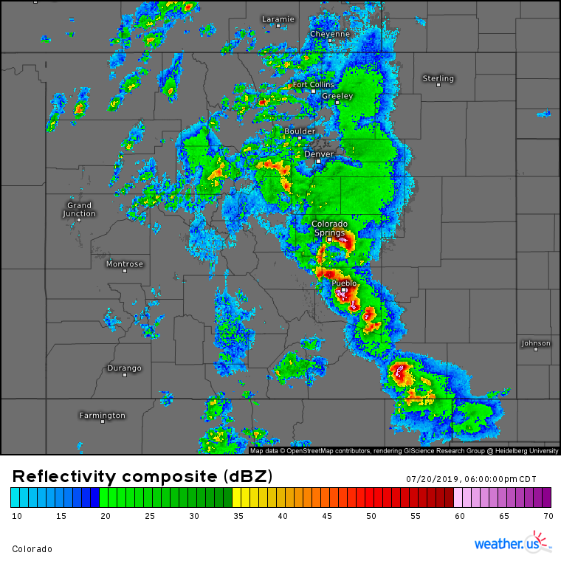
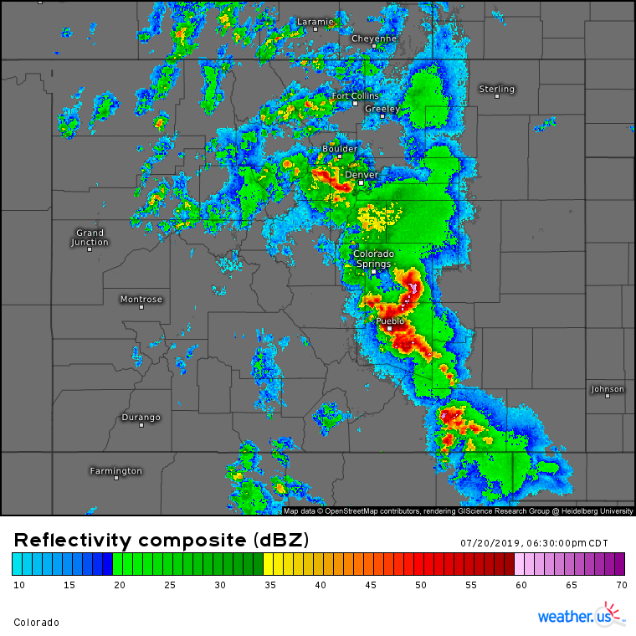
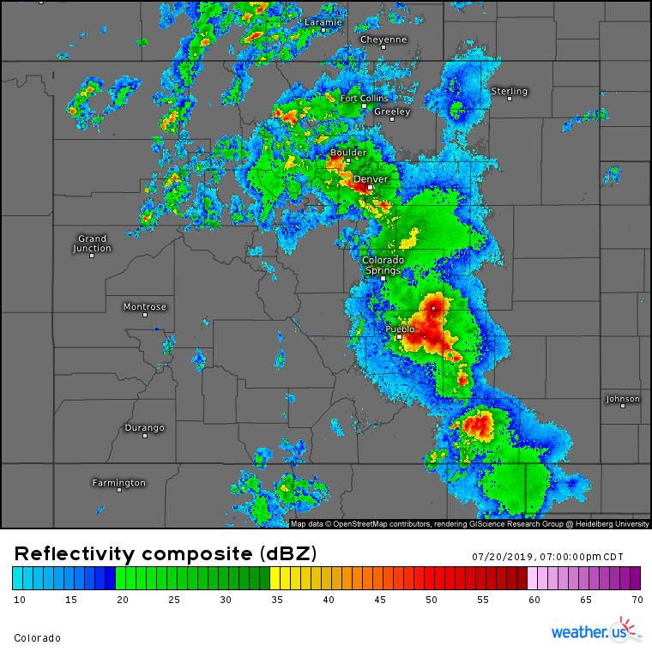
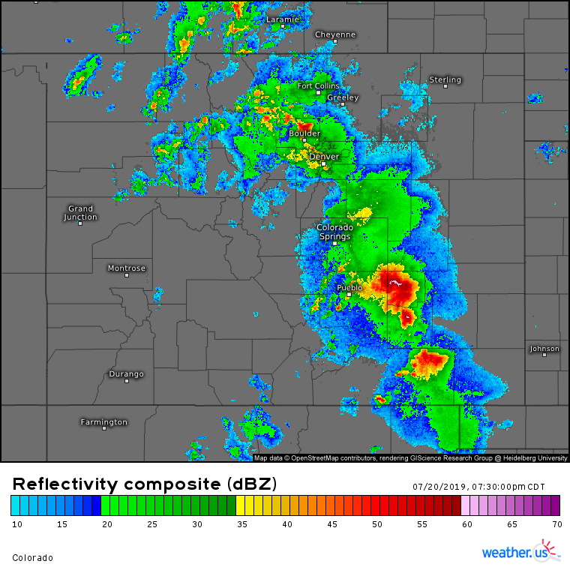
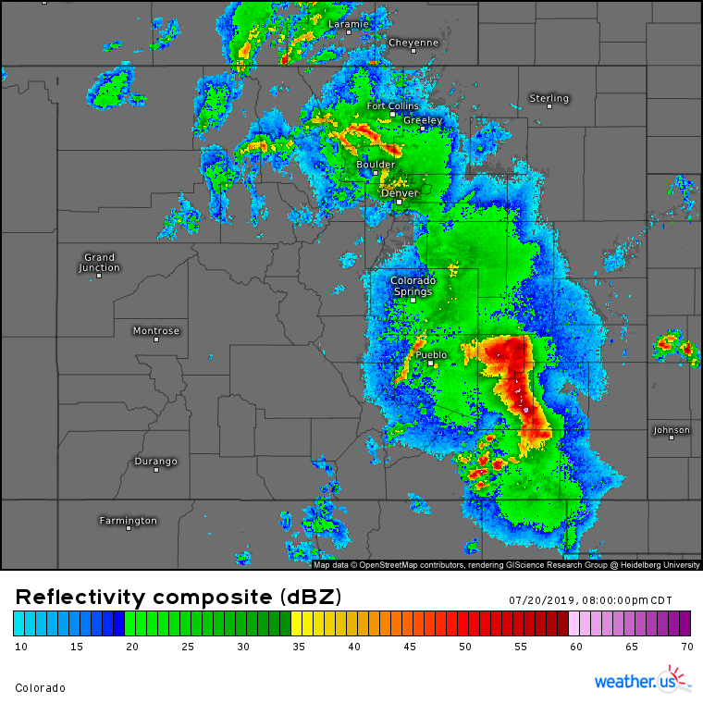
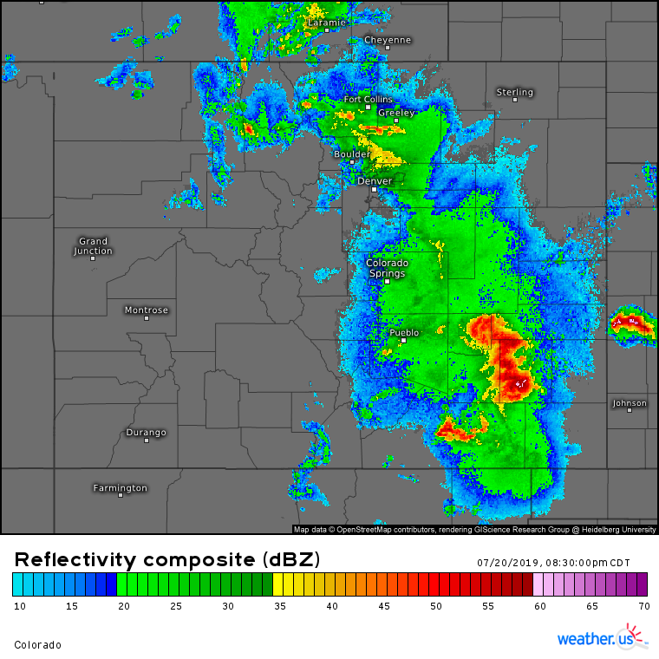
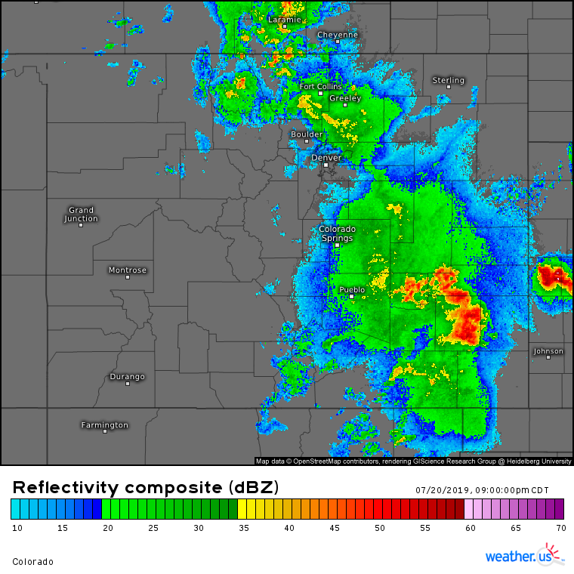
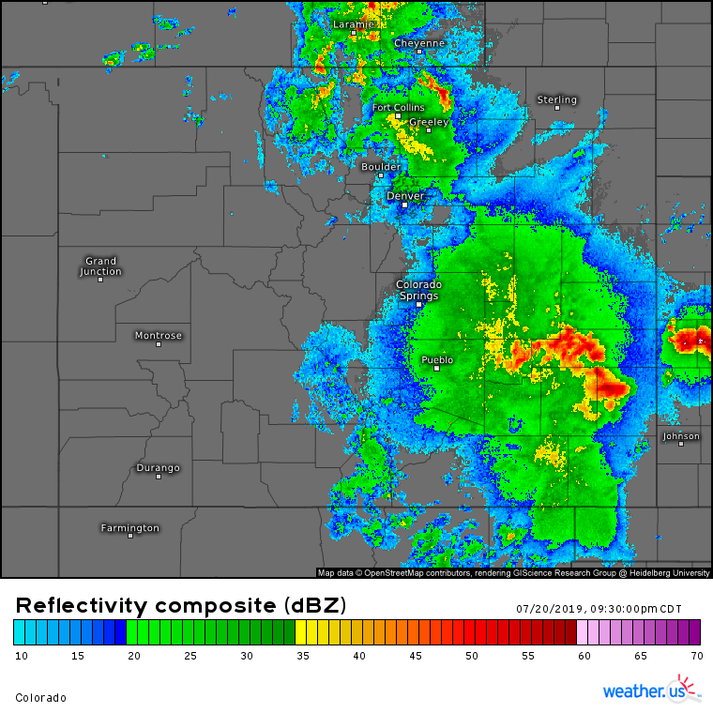
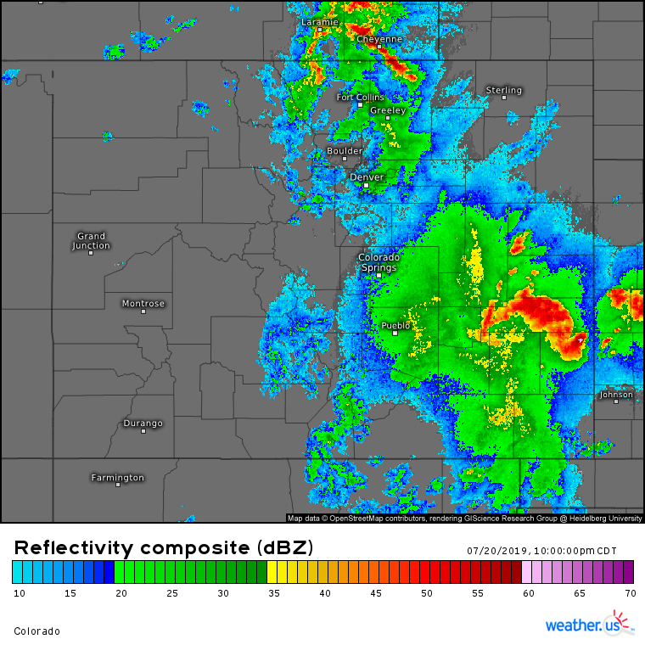
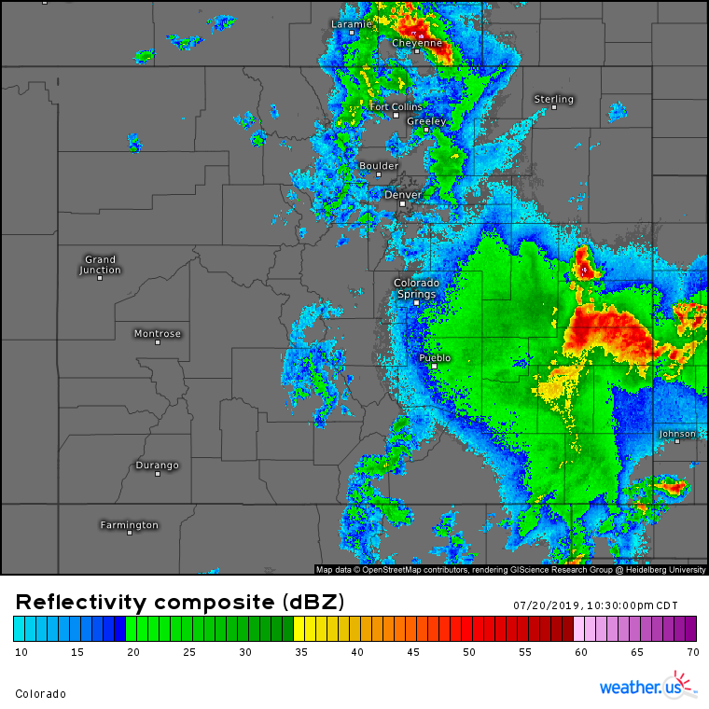
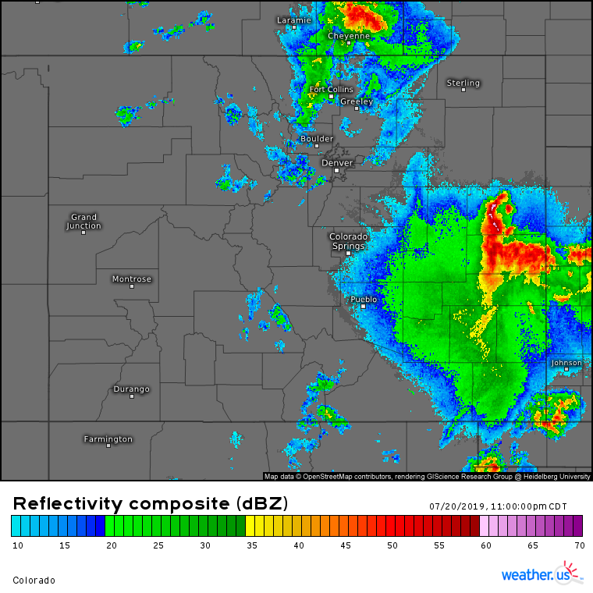

Slide 4
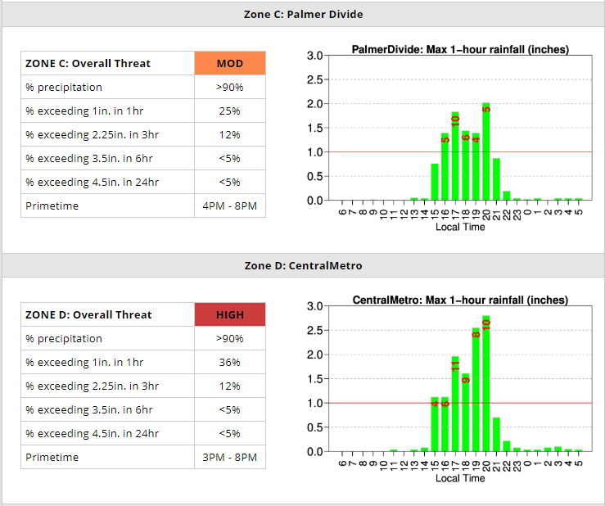
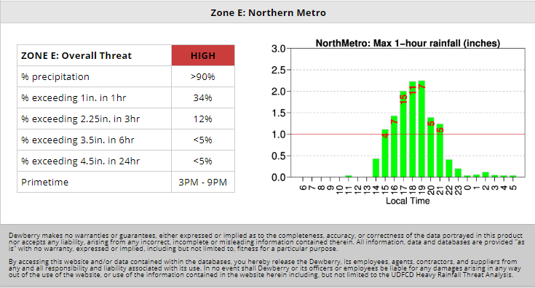

Slide 5
THE MORNING HPO

Slide 6
MESSAGES ISSUED BEFORE 1PM

Slide 8
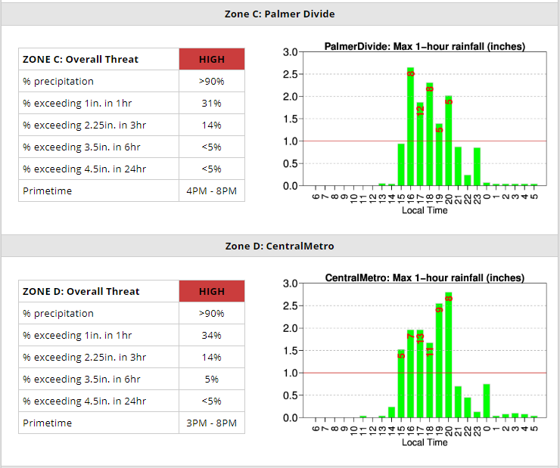
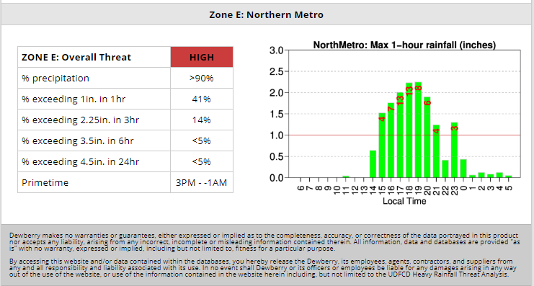

Slide 9
RAIN ALARMS
Rainfall rate alarm | 0.75 inches in 1 hour | 5880 | Hackett Mountain | 7/20/2019 14:58
Rainfall rate alarm | 1.00 inch in 90 minutes | 5860 | Cedar Mountain | 7/20/2019 14:56
Rainfall rate alarm | 0.50 inches in 30 minutes | 5880 | Hackett Mountain | 7/20/2019 14:55
Rainfall rate alarm | 0.75 inches in 1 hour | 5860 | Cedar Mountain | 7/20/2019 14:51
Rainfall rate alarm | 0.50 inches in 30 minutes | 5860 | Cedar Mountain | 7/20/2019 14:47

Slide 10
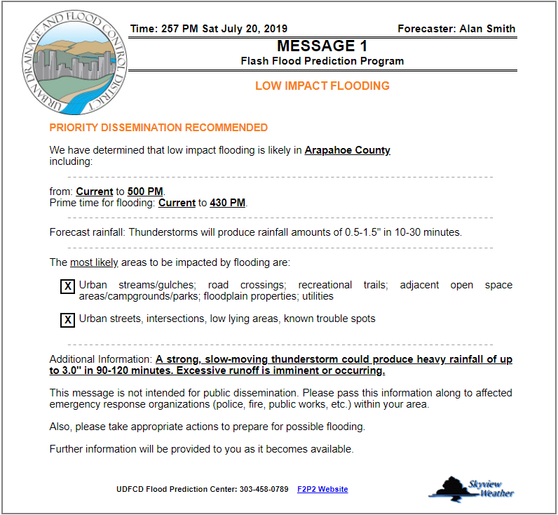

Slide 11
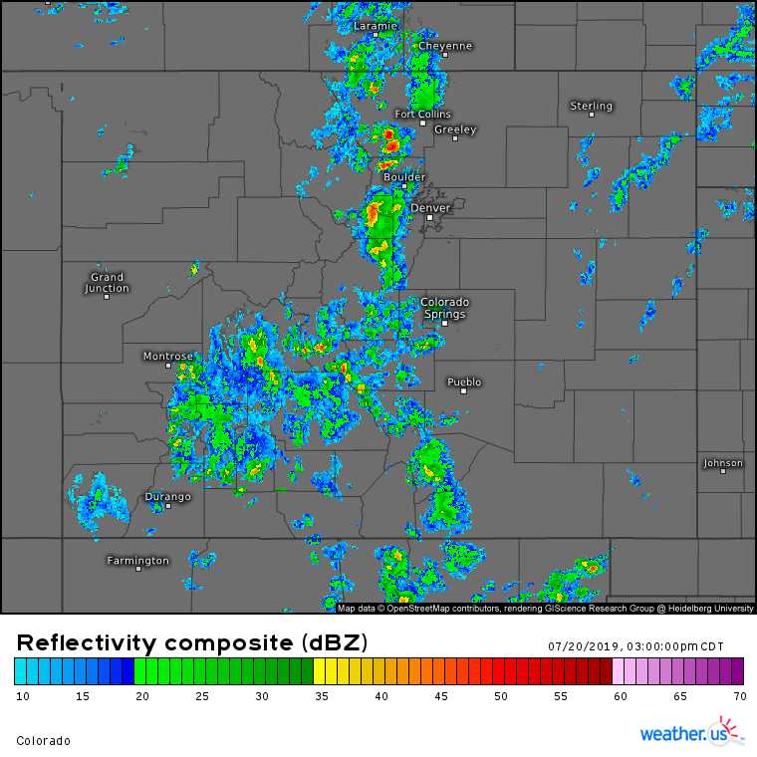

Slide 12
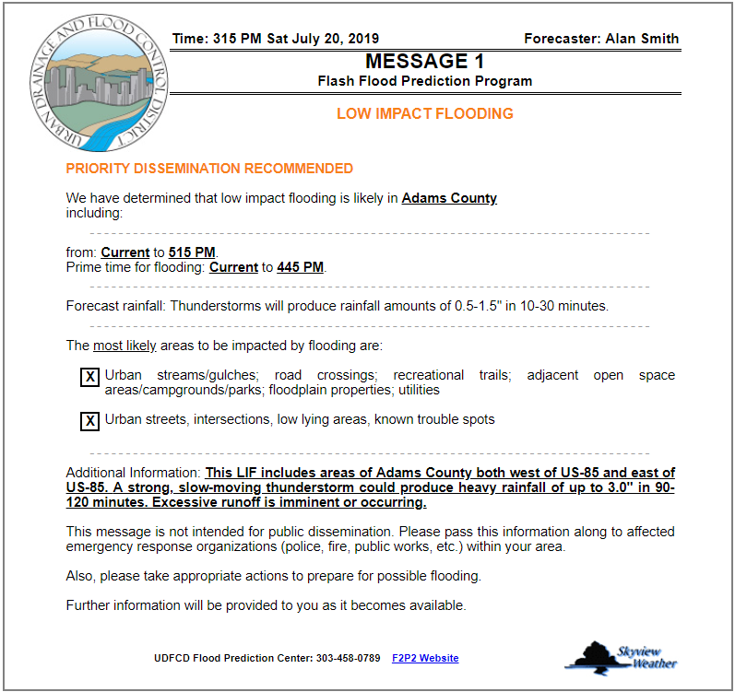

Slide 13
RAIN ALARMS
Rising rate alarm | 0.50 feet in 30 minutes | 1703 | Cherry Creek at Champa | 7/20/2019 15:25
Rainfall rate alarm | 0.50 inches in 30 minutes | 5740 | Trail Creek | 7/20/2019 15:21
Rainfall rate alarm | 0.75 inches in 1 hour | 4230 | Golden Age | 7/20/2019 15:19
Rainfall rate alarm | 0.50 inches in 30 minutes | 5880 | Hackett Mountain | 7/20/2019 15:19
Rainfall rate alarm | 0.50 inches in 10 minutes | 2980 | Dakan Road | 7/20/2019 15:14
Rainfall rate alarm | 0.50 inches in 30 minutes | 5880 | Hackett Mountain | 7/20/2019 15:06
Rainfall rate alarm | 1.00 inch in 1 hour | 2980 | Dakan Road | 7/20/2019 15:06
Rainfall rate alarm | 0.50 inches in 30 minutes | 4230 | Golden Age | 7/20/2019 15:04
Rainfall rate alarm | 0.50 inches in 10 minutes | 2980 | Dakan Road | 7/20/2019 15:02
Rainfall rate alarm | 1.00 inch in 90 minutes | 5880 | Hackett Mountain | 7/20/2019 15:01

Slide 14
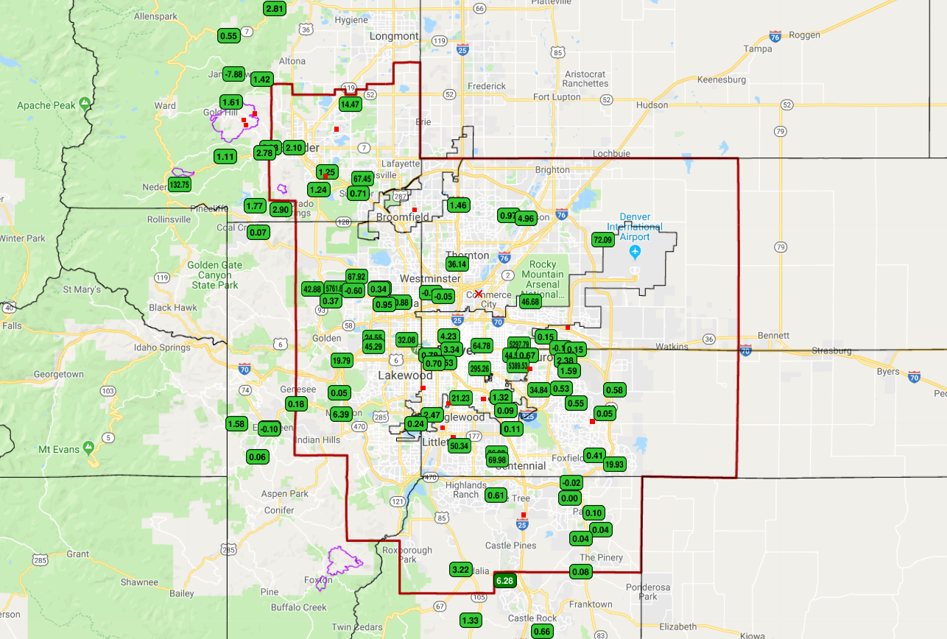
Stage
1hr Precipitation

Slide 17
ALARMS
Upper limit alarm | 5.50 feet | 1703 | Cherry Creek at Champa | 7/20/2019 15:36
Rainfall rate alarm | 1.00 inch in 1 hour | 2890 | Spruce Mountain Open Space | 7/20/2019 15:54
Rainfall rate alarm | 0.50 inches in 10 minutes | 100270 | Westcreek Fire Station Wx | 7/20/2019 15:54
Rainfall rate alarm | 0.50 inches in 30 minutes | 100270 | Westcreek Fire Station Wx | 7/20/2019 15:54
Rainfall rate alarm | 0.50 inches in 10 minutes | 100270 | Westcreek Fire Station Wx | 7/20/2019 15:54
Rainfall rate alarm | 1.00 inch in 1 hour | 2890 | Spruce Mountain Open Space | 7/20/2019 15:54
Rainfall rate alarm | 1.00 inch in 90 minutes | 100270 | Westcreek Fire Station Wx | 7/20/2019 15:50
Rainfall rate alarm | 1.00 inch in 1 hour | 100270 | Westcreek Fire Station Wx | 7/20/2019 15:50
Rainfall rate alarm | 0.50 inches in 10 minutes | 2890 | Spruce Mountain Open Space | 7/20/2019 15:50
Rainfall rate alarm | 0.50 inches in 10 minutes | 3010 | EPC at Hwy 105 | 7/20/2019 15:46
Rainfall rate alarm | 0.75 inches in 1 hour | 100270 | Westcreek Fire Station Wx | 7/20/2019 15:44
Rainfall rate alarm | 1.00 inch in 1 hour | 3010 | EPC at Hwy 105 | 7/20/2019 15:41
Rainfall rate alarm | 0.50 inches in 10 minutes | 100270 | Westcreek Fire Station Wx | 7/20/2019 15:40
Rainfall rate alarm | 0.50 inches in 30 minutes | 100270 | Westcreek Fire Station Wx | 7/20/2019 15:40
Rainfall rate alarm | 0.50 inches in 10 minutes | 100270 | Westcreek Fire Station Wx | 7/20/2019 15:40
Rainfall rate alarm | 0.50 inches in 30 minutes | 5810 | Stump Bump | 7/20/2019 15:39
Rainfall rate alarm | 0.50 inches in 30 minutes | 5740 | Trail Creek | 7/20/2019 15:35
Rainfall rate alarm | 0.50 inches in 10 minutes | 3010 | EPC at Hwy 105 | 7/20/2019 15:35
Rainfall rate alarm | 0.50 inches in 30 minutes | 5720 | Four Mile Creek | 7/20/2019 15:32
Rainfall rate alarm | 1.00 inch in 1 hour | 4310 | Johnny Park | 7/20/2019 15:30
Rainfall rate alarm | 0.50 inches in 30 minutes | 5880 | Hackett Mountain | 7/20/2019 15:30
Rising rate alarm | 1.00 foot in 30 minutes | 613 | Harvard Gulch @ Jackson | 7/20/2019 15:43
Rising rate alarm | 0.50 feet in 1 hour | 1649 | SPR at 19th Street | 7/20/2019 15:32

Slide 19
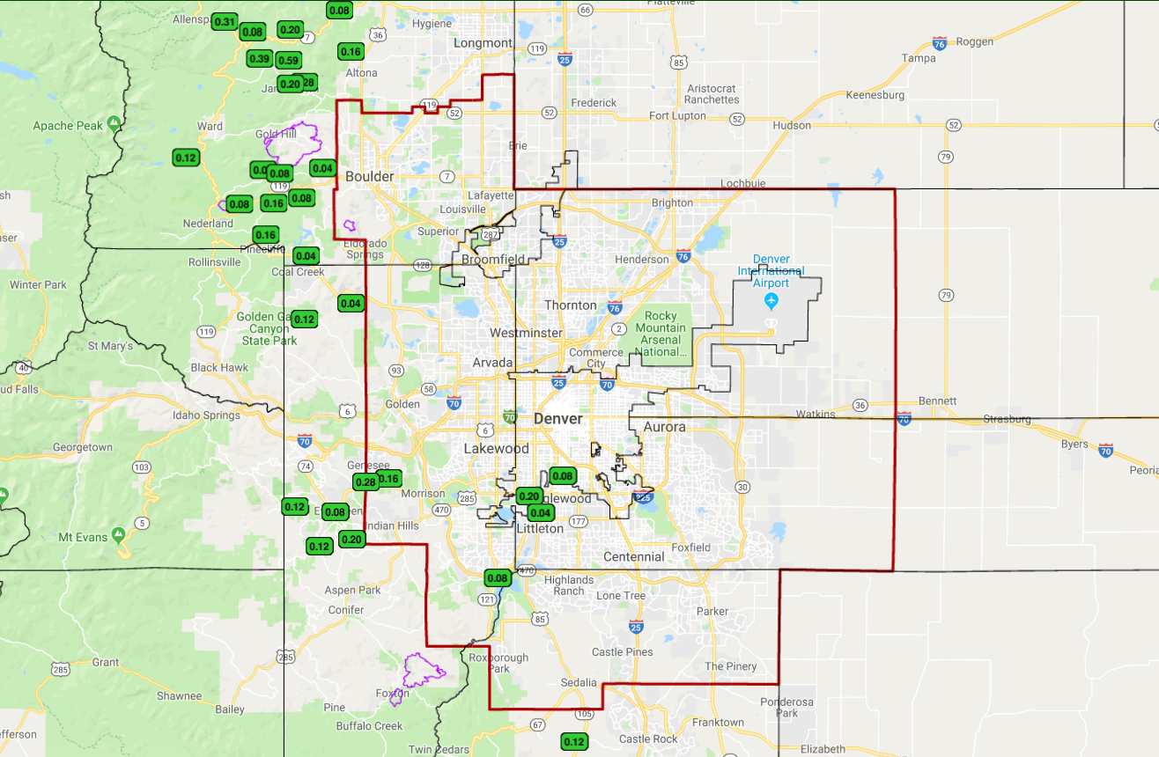
Stage
1hr Precipitation

Slide 21
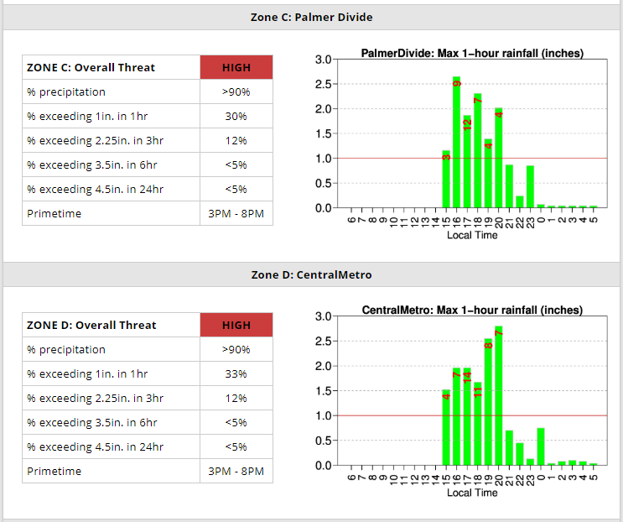
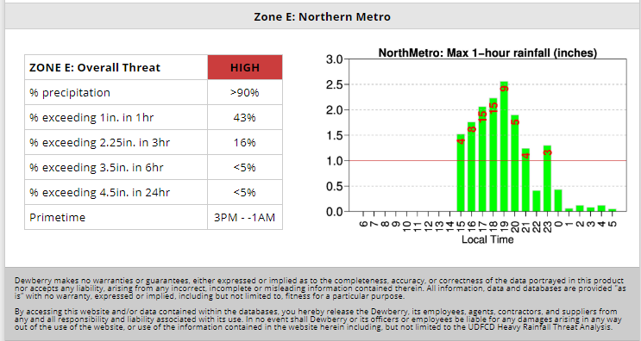

Slide 22
ALARMS
Rising rate alarm | 0.50 feet in 30 minutes | 1723 | Cherry Creek @ Steele | 7/20/2019 16:12
Rising rate alarm | 1.00 foot in 30 minutes | 653 | Goldsmith Gulch at Iliff | 7/20/2019 16:06
Rainfall rate alarm | 1.00 inch in 1 hour | 1320 | SPR at 3rd Avenue | 7/20/2019 16:25
Rainfall rate alarm | 1.00 inch in 1 hour | 2920 | West Cherry Head | 7/20/2019 16:17
Rainfall rate alarm | 0.50 inches in 10 minutes | 2920 | West Cherry Head | 7/20/2019 16:03
Rainfall rate alarm | 0.50 inches in 10 minutes | 2890 | Spruce Mountain Open Space | 7/20/2019 16:01

Slide 24
ALARMS
Rising rate alarm | 0.50 feet in 1 hour | 1649 | SPR at 19th Street | 7/20/2019 16:34

Slide 25
16:52

Slide 27
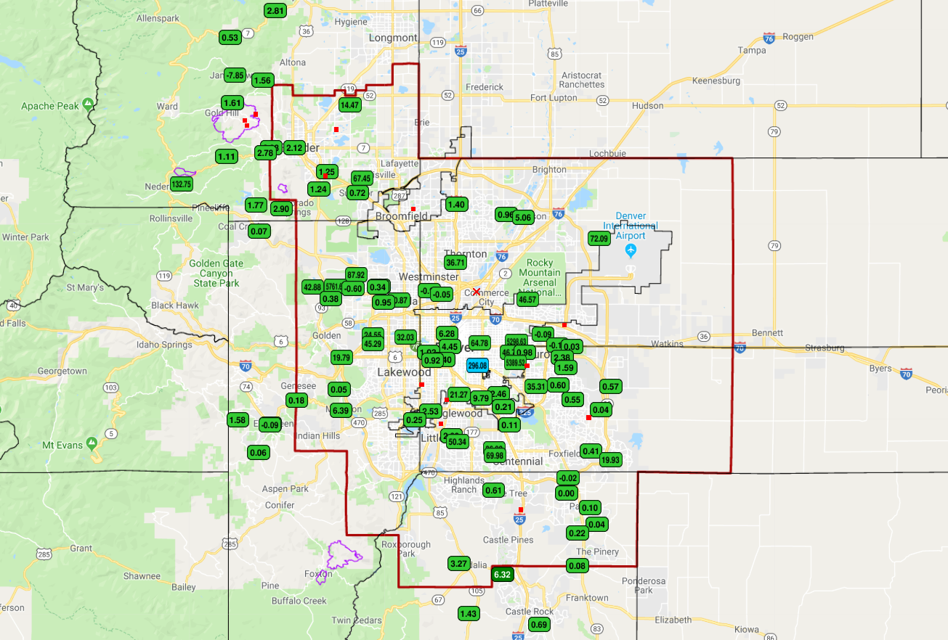
Stage
1hr Precipitation

Slide 29
ALARMS
Upper limit alarm | 20.70 feet | 1043 | Lena @ U.S. Highway 6 | 7/20/2019 17:49
Upper limit alarm | 20.70 feet | 1043 | Lena @ U.S. Highway 6 | 7/20/2019 17:43
Rainfall rate alarm | 0.50 inches in 30 minutes | 4240 | Sunset | 7/20/2019 17:59
Rainfall rate alarm | 1.00 inch in 1 hour | 1550 | Lakewood CC | 7/20/2019 17:59
Rainfall rate alarm | 1.00 inch in 1 hour | 1400 | Upper Sloan Detention | 7/20/2019 17:59
Rainfall rate alarm | 0.50 inches in 10 minutes | 1030 | NREL South Table Mountain | 7/20/2019 17:58
Rainfall rate alarm | 1.00 inch in 1 hour | 310 | Guy Hill Ranch | 7/20/2019 17:56
Rainfall rate alarm | 0.50 inches in 10 minutes | 1000 | Maple Grove Reservoir | 7/20/2019 17:56
Rainfall rate alarm | 0.50 inches in 10 minutes | 1010 | Denver West | 7/20/2019 17:54
Rainfall rate alarm | 1.00 inch in 1 hour | 1030 | NREL South Table Mountain | 7/20/2019 17:54
Rainfall rate alarm | 0.50 inches in 10 minutes | 1400 | Upper Sloan Detention | 7/20/2019 17:52
Rainfall rate alarm | 0.50 inches in 10 minutes | 1550 | Lakewood CC | 7/20/2019 17:50
Rainfall rate alarm | 1.00 inch in 1 hour | 1010 | Denver West | 7/20/2019 17:49
Rainfall rate alarm | 0.50 inches in 10 minutes | 1050 | Jeffco Fairgrounds | 7/20/2019 17:47
Rainfall rate alarm | 0.50 inches in 10 minutes | 1030 | NREL South Table Mountain | 7/20/2019 17:46
Rainfall rate alarm | 0.50 inches in 10 minutes | 1010 | Denver West | 7/20/2019 17:43
Rainfall rate alarm | 1.00 inch in 1 hour | 1050 | Jeffco Fairgrounds | 7/20/2019 17:41
Rainfall rate alarm | 1.00 inch in 1 hour | 1040 | Lena @ U.S. Highway 6 | 7/20/2019 17:41
Rainfall rate alarm | 0.50 inches in 10 minutes | 1050 | Jeffco Fairgrounds | 7/20/2019 17:36
Rainfall rate alarm | 0.50 inches in 10 minutes | 1040 | Lena @ U.S. Highway 6 | 7/20/2019 17:36
Rainfall rate alarm | 0.50 inches in 10 minutes | 310 | Guy Hill Ranch | 7/20/2019 17:36
Rising rate alarm | 1.00 foot in 30 minutes | 1563 | Lakewood Gulch @10th | 7/20/2019 17:57
Rising rate alarm | 0.50 feet in 30 minutes | 1043 | Lena @ U.S. Highway 6 | 7/20/2019 17:53
Rising rate alarm | 0.50 feet in 30 minutes | 1043 | Lena @ U.S. Highway 6 | 7/20/2019 17:49
Rising rate alarm | 0.50 feet in 30 minutes | 1043 | Lena @ U.S. Highway 6 | 7/20/2019 17:45
Rising rate alarm | 0.50 feet in 30 minutes | 1043 | Lena @ U.S. Highway 6 | 7/20/2019 17:42
Rising rate alarm | 0.50 feet in 30 minutes | 1043 | Lena @ U.S. Highway 6 | 7/20/2019 17:39
Rising rate alarm | 0.50 feet in 30 minutes | 1043 | Lena @ U.S. Highway 6 | 7/20/2019 17:37
Rising rate alarm | 0.50 feet in 30 minutes | 1043 | Lena @ U.S. Highway 6 | 7/20/2019 17:34

Slide 31
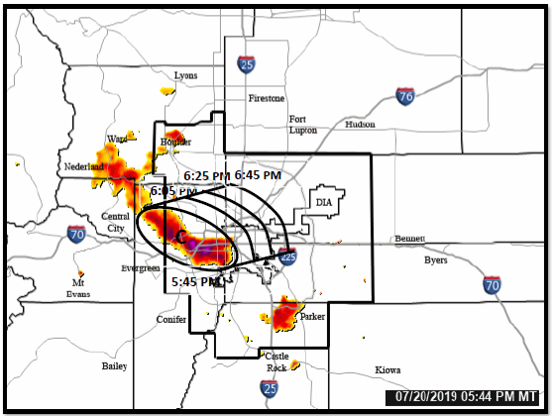

Slide 32
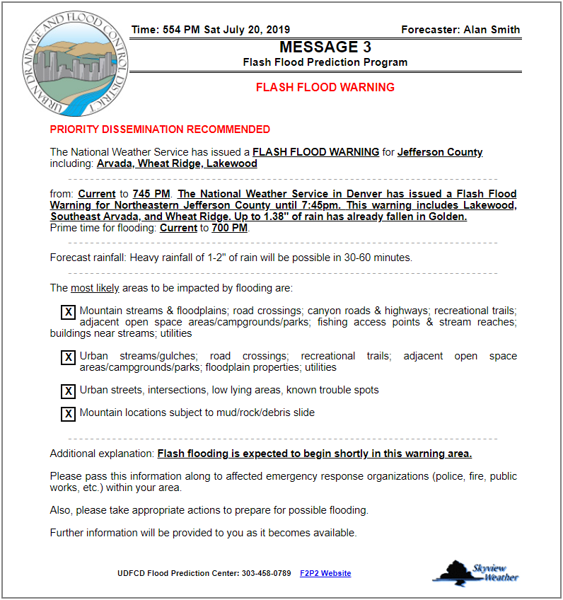

Slide 34
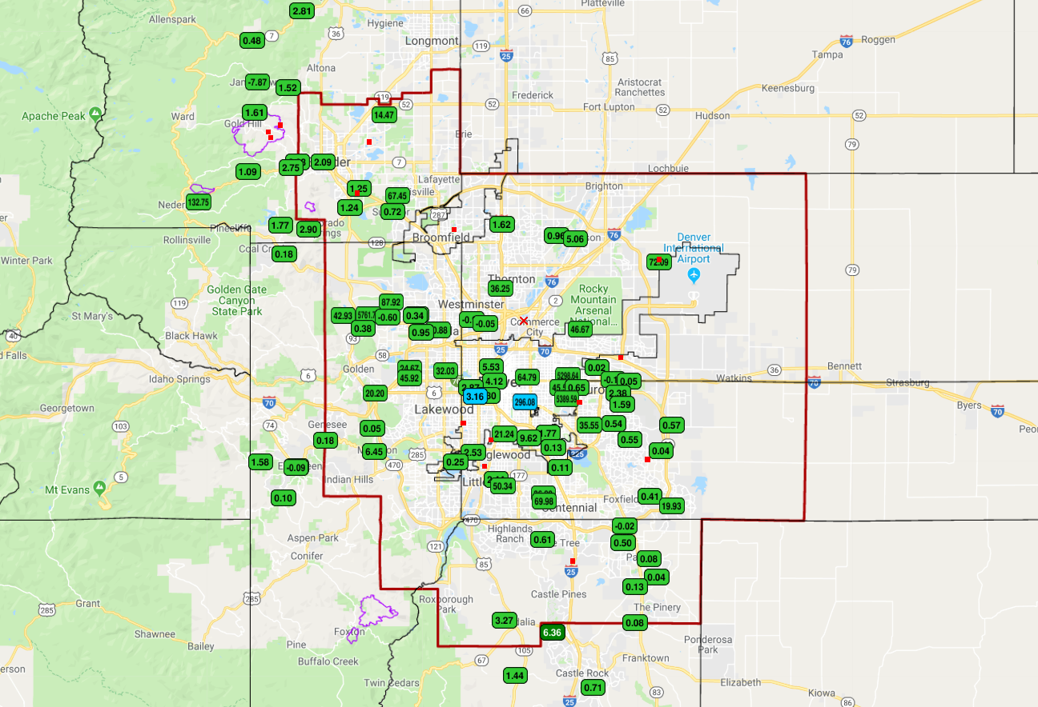
Stage
1hr Precipitation

Slide 35
ALARMS
Upper limit alarm | 3.00 feet | 1563 | Lakewood Gulch @10th | 7/20/2019 18:01
Rainfall rate alarm | 0.75 inches in 1 hour | 4190 | Slaughterhouse | 7/20/2019 18:25
Rainfall rate alarm | 0.50 inches in 10 minutes | 4250 | Geer Canyon | 7/20/2019 18:17
Rainfall rate alarm | 0.50 inches in 30 minutes | 4230 | Golden Age | 7/20/2019 18:13
Rainfall rate alarm | 0.50 inches in 10 minutes | 4850 | Porphyry Mountain | 7/20/2019 18:11
Rainfall rate alarm | 0.50 inches in 30 minutes | 4850 | Porphyry Mountain | 7/20/2019 18:11
Rainfall rate alarm | 0.50 inches in 10 minutes | 4850 | Porphyry Mountain | 7/20/2019 18:11
Rainfall rate alarm | 0.50 inches in 10 minutes | 4190 | Slaughterhouse | 7/20/2019 18:06
Rainfall rate alarm | 0.50 inches in 30 minutes | 4190 | Slaughterhouse | 7/20/2019 18:06
Rainfall rate alarm | 1.00 inch in 1 hour | 1000 | Maple Grove Reservoir | 7/20/2019 18:04
Rainfall rate alarm | 0.50 inches in 10 minutes | 1400 | Upper Sloan Detention | 7/20/2019 18:03
Rainfall rate alarm | 0.50 inches in 10 minutes | 1550 | Lakewood CC | 7/20/2019 18:00
Rising rate alarm | 0.50 feet in 30 minutes | 1703 | Cherry Creek at Champa | 7/20/2019 18:20
Rising rate alarm | 1.00 foot in 30 minutes | 323 | Sports Complex | 7/20/2019 18:19
Rising rate alarm | 1.00 foot in 30 minutes | 1023 | Lena @ Nolte Pond | 7/20/2019 18:07
Rising rate alarm | 0.50 feet in 30 minutes | 1043 | Lena @ U.S. Highway 6 | 7/20/2019 18:04

Slide 37
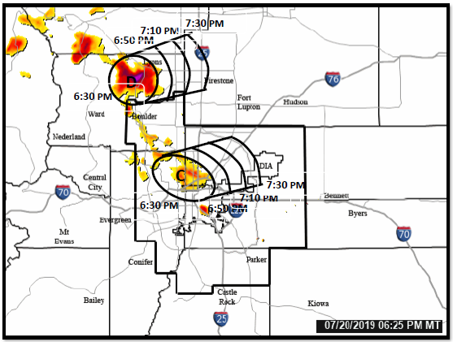

Slide 39
ALARMS
Rising rate alarm | 1.00 foot in 30 minutes | 1563 | Lakewood Gulch @10th | 7/20/2019 18:55
Rising rate alarm | 0.50 feet in 1 hour | 1103 | Louisville Dwy D | 7/20/2019 18:48
Rising rate alarm | 0.50 feet in 1 hour | 1403 | Upper Sloan Detention | 7/20/2019 18:38
Rising rate alarm | 0.50 feet in 4 hours | 1003 | Maple Grove Reservoir | 7/20/2019 18:32
Rainfall rate alarm | 0.50 inches in 10 minutes | 4290 | Red Hill | 7/20/2019 18:33
Rainfall rate alarm | 0.75 inches in 1 hour | 4850 | Porphyry Mountain | 7/20/2019 18:31

Slide 41
Stage
1hr Precipitation

Slide 42
ALARMS
Rising rate alarm | 1.00 foot in 30 minutes | 1563 | Lakewood Gulch @10th | 7/20/2019 19:27
Rising rate alarm | 0.50 feet in 1 hour | 1663 | SPR at Henderson | 7/20/2019 19:00
Upper limit alarm | 26.00 feet | 1003 | Maple Grove Reservoir | 7/20/2019 19:28

Slide 45
Stage
1hr Precipitation

Slide 48
Stage
1hr Precipitation

Slide 49
21:28

Slide 51
ALARMS
Rising rate alarm | 0.50 feet in 1 hour | 1663 | SPR at Henderson | 7/20/2019 21:52

Slide 53
Stage
1hr Precipitation

Slide 55
ALARMS
Rising rate alarm | 0.50 feet in 4 hours | 1003 | Maple Grove Reservoir | 7/20/2019 22:48

Slide 57
Stage
1hr Precipitation

