Slide 1
September 5, 2018
Nocturnal AM & Afternoon Storm Periods

Slide 2
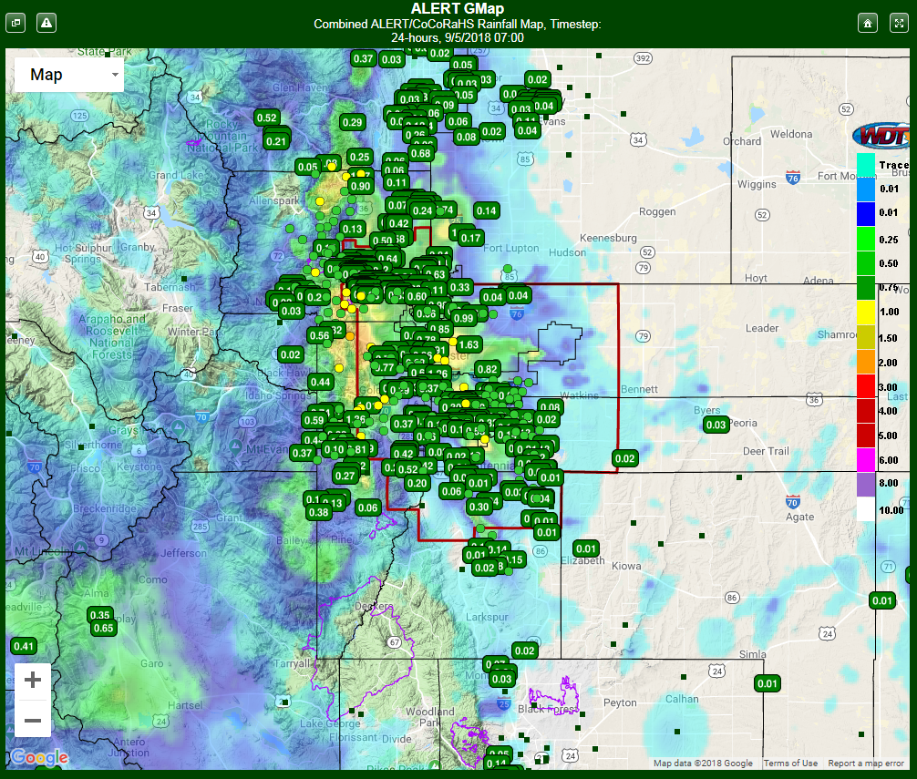

Slide 4
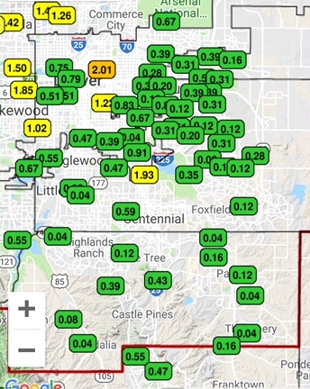
AM & PM storm totals for 9/5/18

Slide 5
AM & PM storm totals for 9/5/18

Slide 6
PM storm totals for 9/5/18

Slide 7
24-hr RainVieux totals for September 5, 2018
X
X
X

Slide 8
RainVieux for September 5, 2018 Montbello

Slide 9
RainVieux for September 5, 2018 Central Denver

Slide 10
RainVieux for September 5, 2018 SW Denver

