Slide 1
July 24, 2018
Rainfall Assessment

Slide 2
X

Slide 3
July 24, 2018 Rainfall (~1-hour storm duration)
Englewood (4600 S. Acoma Street)
RainVieux GARR
X
Notes:
50-100 year event
0.9” in 10 minutes between 6:20 & 6:30PM
~2” in <1hr (~50min) between 6&7PM

Slide 4
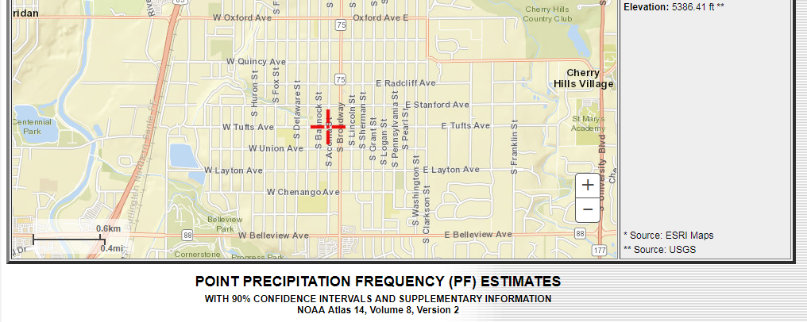

Slide 8
July 24, 2018 Flash Flood
News Video
Flash Flood Fatality in Englewood
https://denver.cbslocal.com/2018/07/25/englewood-flooding-death-rachael-haber/

Slide 9
Subsequent look at the Dartmouth/Downing Area

Slide 10
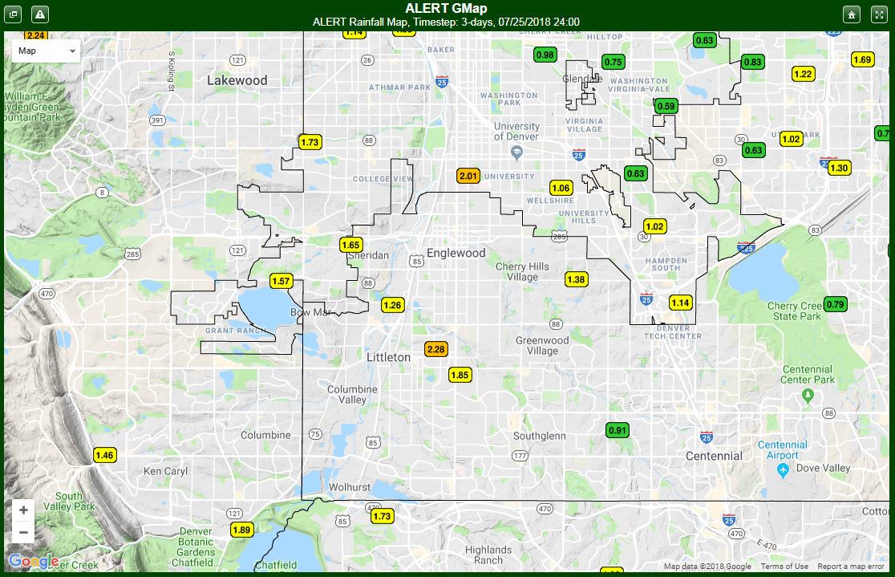
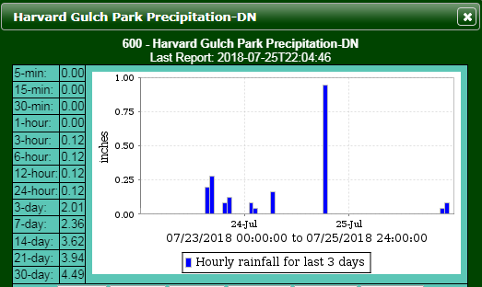

Slide 11
Jefferson County
Dutch Creek area per conversation at CASFM w/John Conn

Slide 12
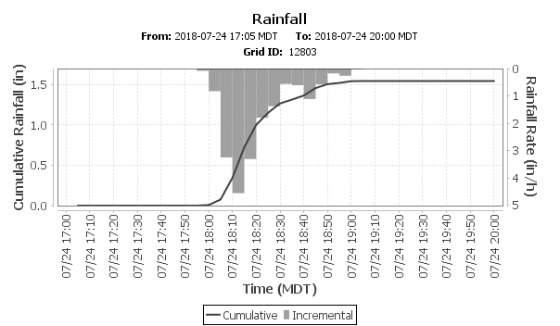
X

