Slide 1
August 14, 2018

Slide 5
5:35 PM

Slide 6
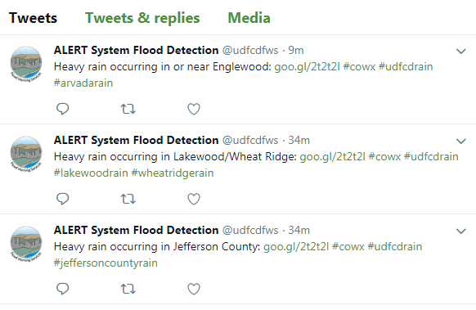
6 PM (wrong Hashtag reported)

Slide 7
12 in/hr rainfall???

Slide 8
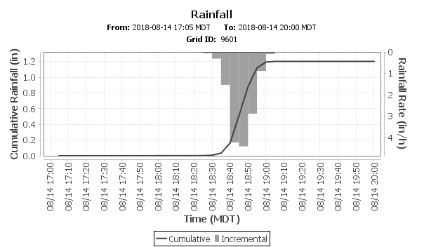
RainVieux for August 14, 2018 Montbello Area
X

