Slide 1
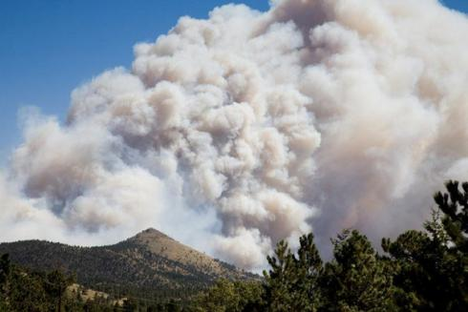
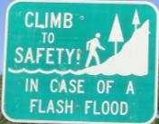
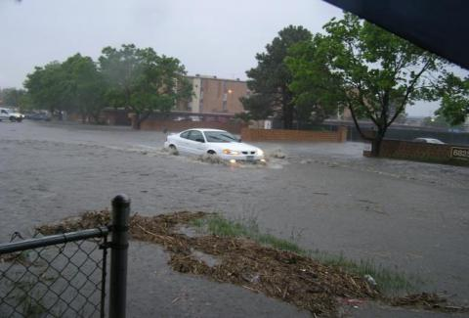
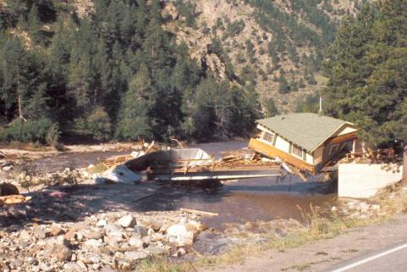
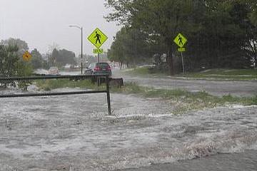
Urban Drainage & Flood Control District Flood Warning Program
A Federal/Regional/Local Early Warning Partnership
Serving the greater Denver/Boulder metropolitan area since 1979 in cooperation with NOAA’s National Weather Service
Notes:
33 years of service, 3-way partnership, relationships to maintain

Slide 2
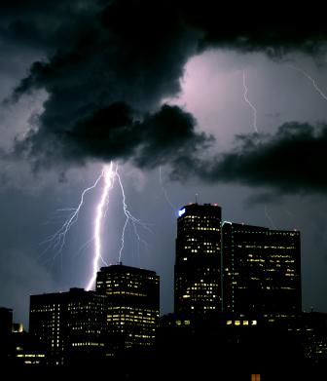
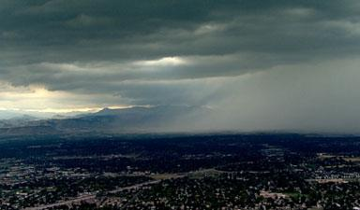
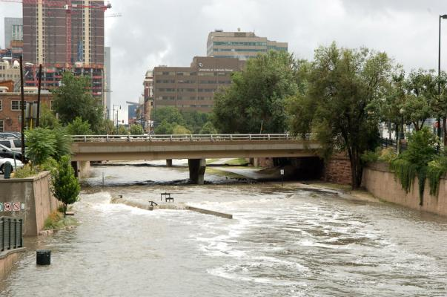
Flood Warning Program
Primary Mission
Provide local governments with early notifications of potential and imminent flood threats (primarily flash flood threats) in time to take appropriate defensive actions…
…to protect lives and property

Slide 3
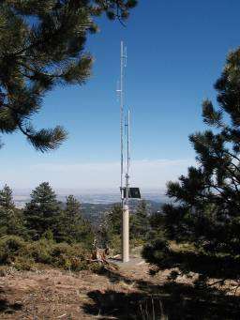
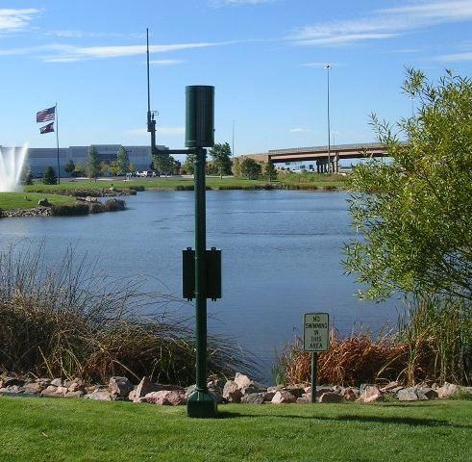
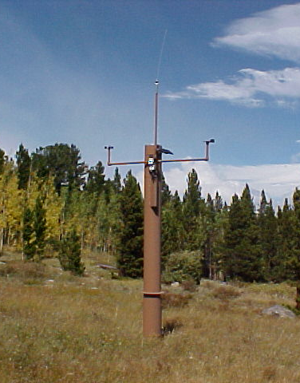
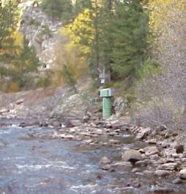
Early Flood Detection
UDFCD’s ALERT System
Notes:
3

Slide 4
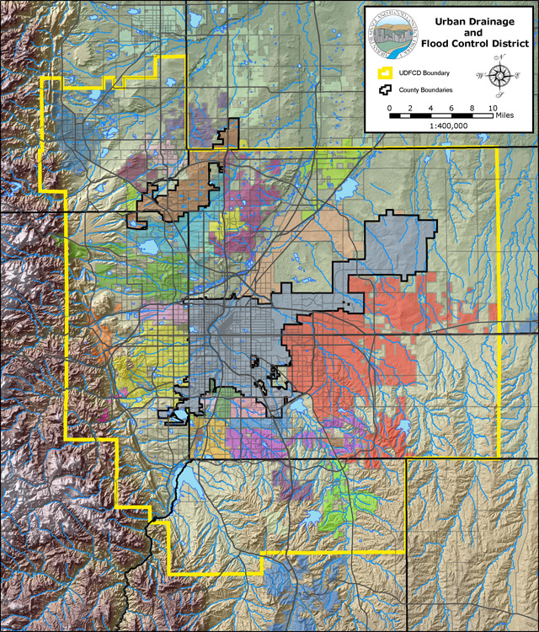
Boulder
Broomfield
Established in 1969
1,608 square miles
1,600 miles of major drainageways
7 counties
39 local governments
2.7 million people
Website: www.udfcd.org
Adams
Denver
Arapahoe
Jefferson
Douglas

Slide 5
BOULDER COUNTY’s FLOOD RISK
Do you agree with the next slide?

Slide 7
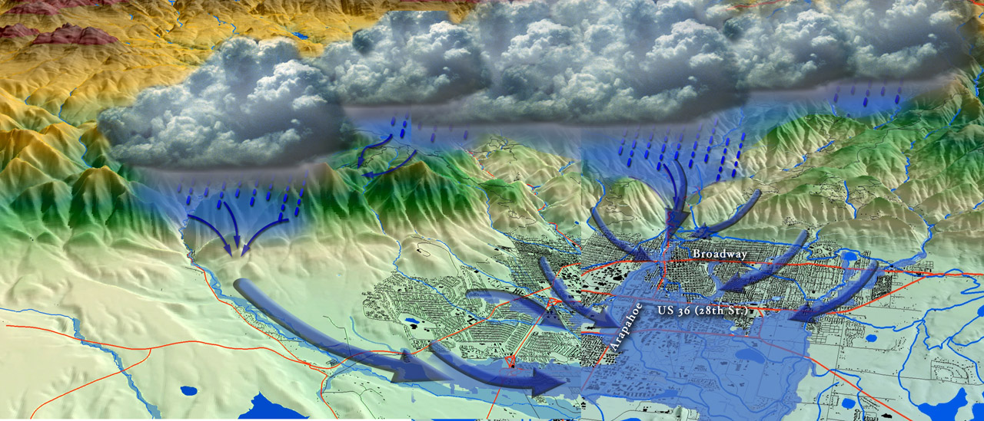
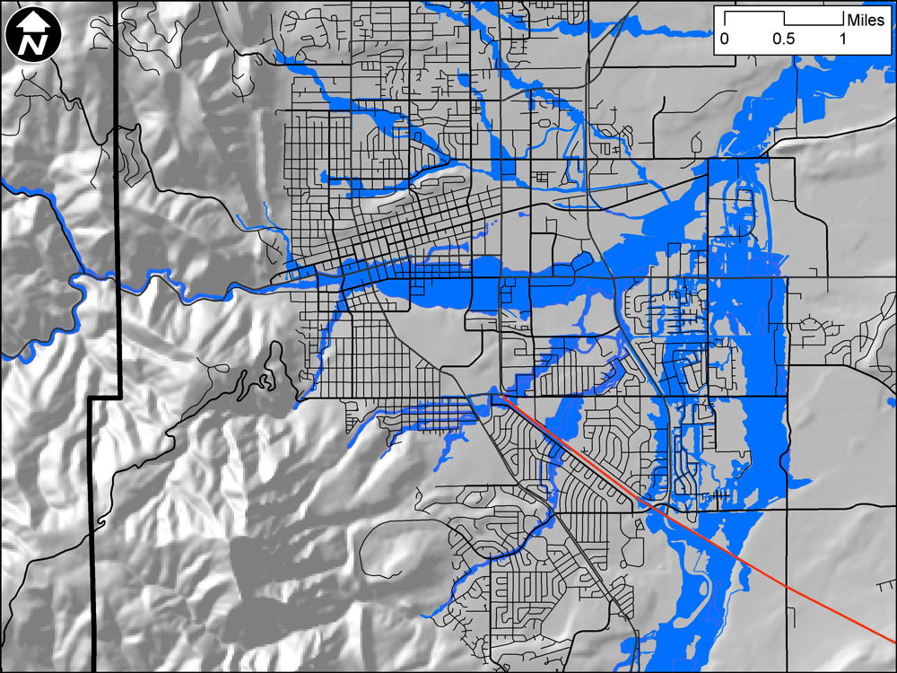
City of Boulder 13 major drainageways with floodplains that cover more than 20% of the city
Boulder Creek
Fourmile Canyon Creek
South Boulder Creek
Wonderland Creek
Goose Creek
Elmers Twomile Creek
Twomile Canyon Creek
Bear Canyon Creek
Skunk Creek
Bluebell Canyon Creek
Kings Gulch
Gregory Creek
Sunshine Canyon Creek
WVO “West Valley Overflow”

Slide 8
SOME LESSONS FROM THE PAST
What do we know for sure about floods in Boulder County?

Slide 9
BOULDER COUNTY’s GOOD FORTUNE… Very Few Flood-Related Deaths
Year | Date(s) | Brief Description
1894 | May 29 -June 2 | RECORD FLOOD on Boulder Creek, 4.5” to 6” totals west of Boulder, many bridges lost, extensive property and agricultural damage, one death, slow onset, South Boulder, Left Hand, Four Mile Canyon and St. Vrain also impacted.
1896 | August 19 | Fourmile Creek flash flood, storm center near Magnolia, rain amount unknown, road and property damage at Salina.
1914 | June 1-2 | Snowpack 50% above normal; heavy rain in mountains; worst Boulder Creek flood since 1894; damage to bridges, farms and Boulder’s water system.
1921 | June 2-7 | Record flow since 1916 at Orodell stream gage on Boulder Creek (June 6); 5-days of general rainfall over 520 sq. mi. of SPR basin, Longmont recorded 4.3” in 6 hours.
1929 | July 31 | Storm center near Bummers Gulch, heavy rain also in Boulder, flooding on Boulder, S. Boulder, Four Mile Canyon and Gregory Creeks; 4.8” rain, damage to streets, lawns, bridges, RR and at 9th & Arapahoe
1938 | September 2 | Record flood on South Boulder Creek; extensive damage at Eldorado Springs; 6” rains reported west of town.
1969 | May 7 | Long duration storm (May 4-8); 7.6” to 9.3” rain totals; most notable flooding along South Boulder Creek and Thunderbird Lane (Foothills Parkway area)—also downstream.

Slide 10
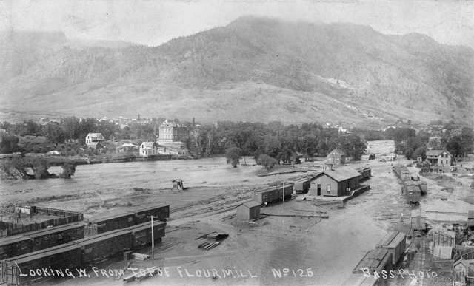
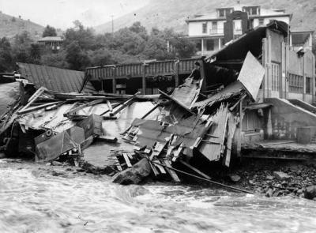
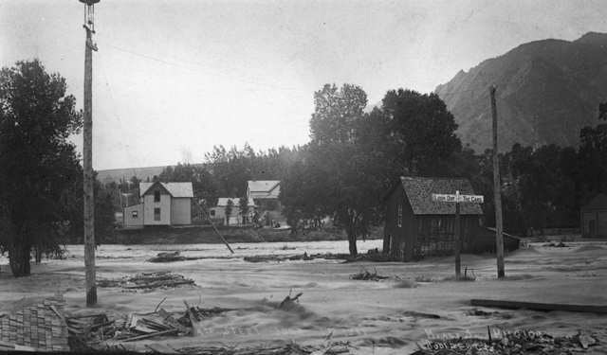
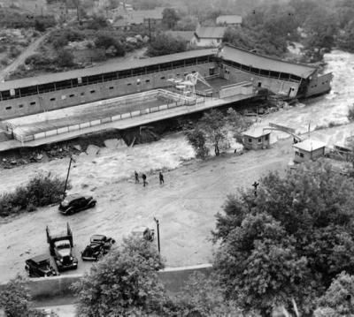
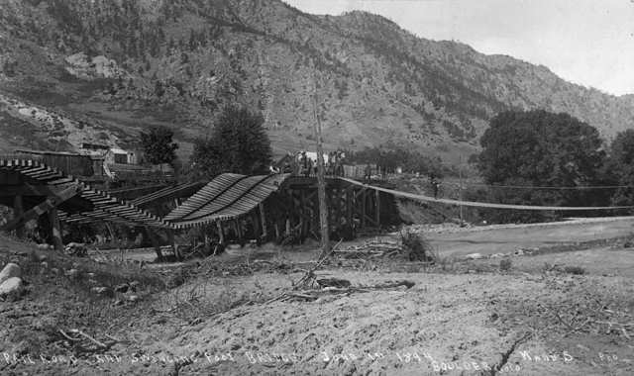
1894 Boulder Creek
1938 South Boulder Creek

Slide 11
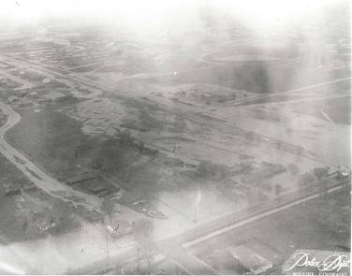
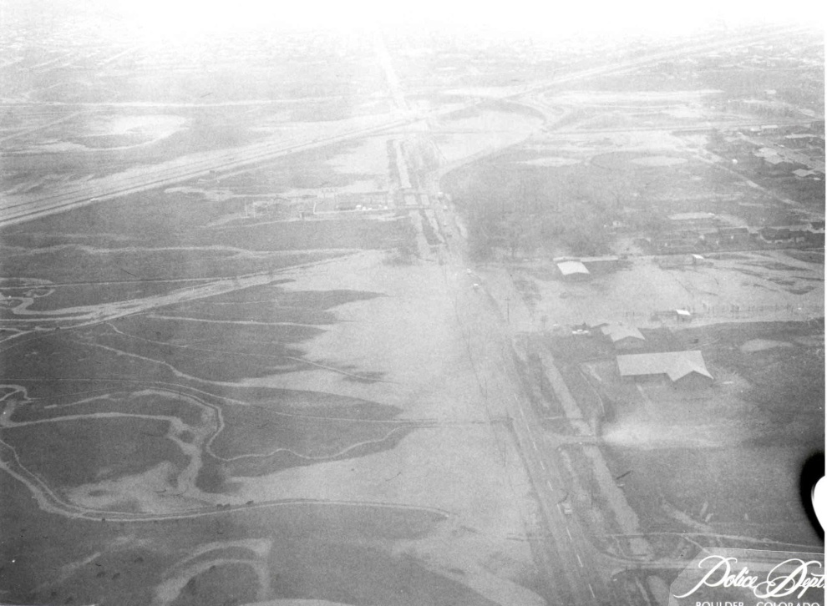
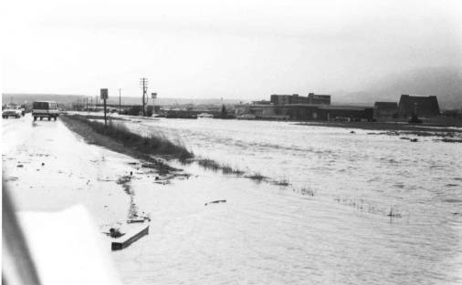
South Boulder Creek May 7, 1969
Baseline and Foothills Parkway
South Boulder Road Looking West
Thunderbird Lane at the Meadows Center

Slide 12
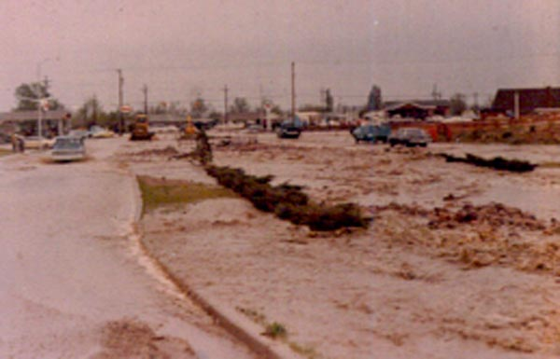
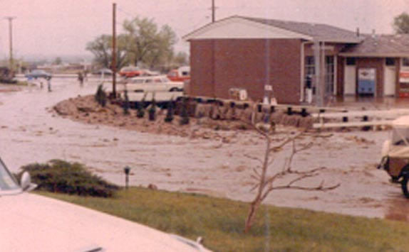
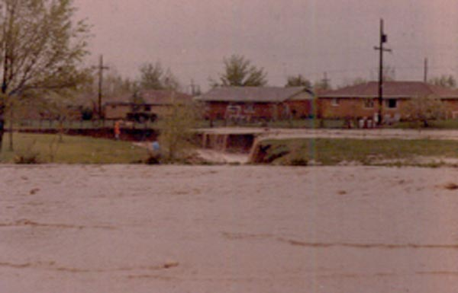
Bear Canyon Creek May 7, 1969
Table Mesa Drive Near Broadway
Table Mesa Exxon in 1969 - Since
Acquired for Broadway Underpass
Bear Canyon Creek in Martin Park 1969

Slide 13
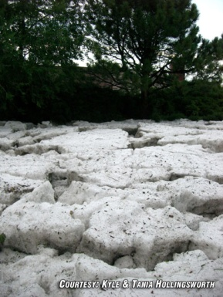
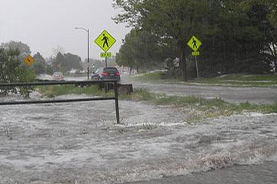
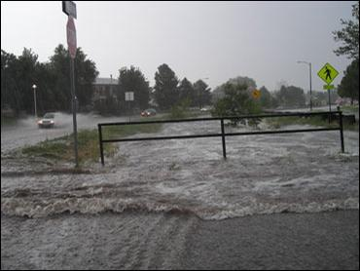
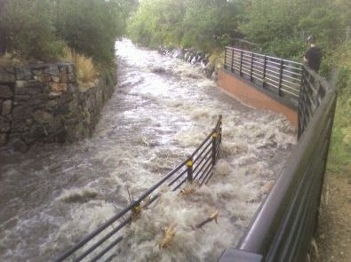
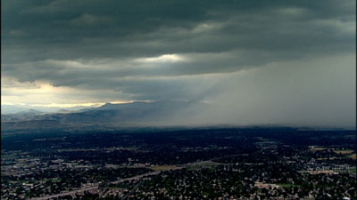
Bear Canyon Creek August 15, 2007
Table Mesa Drive Near Broadway
near Martin Park

Slide 14
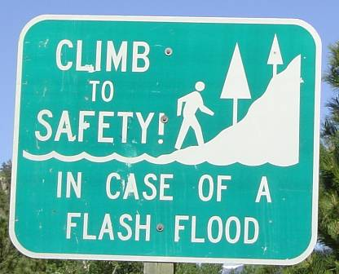
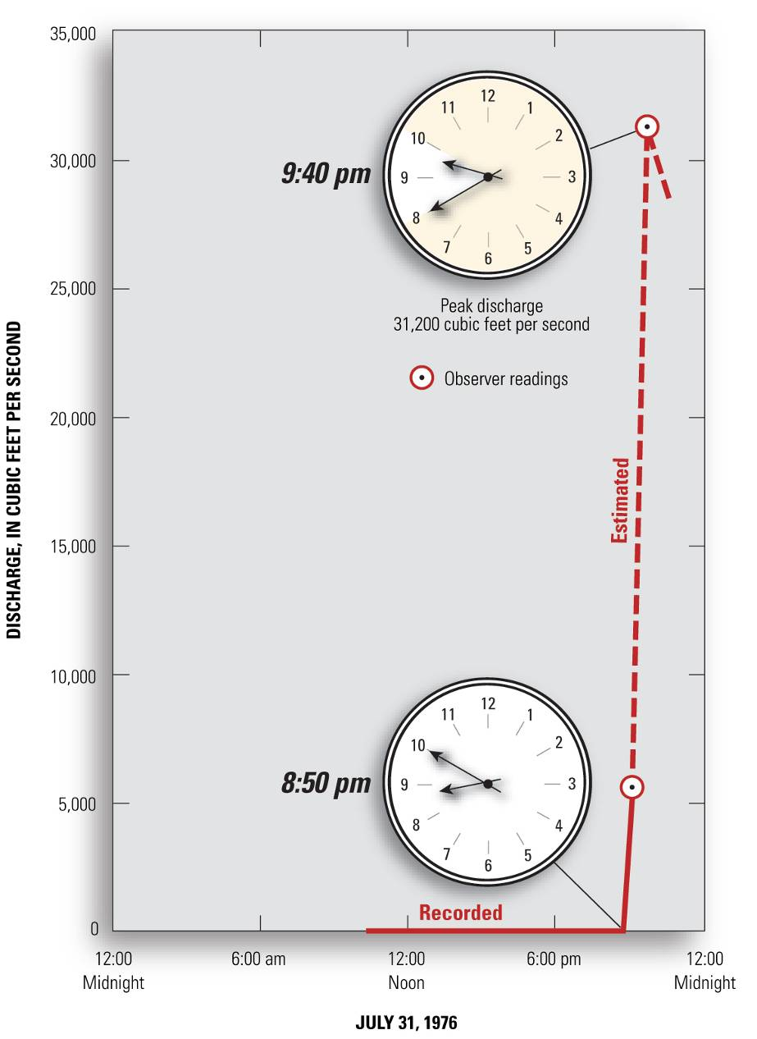
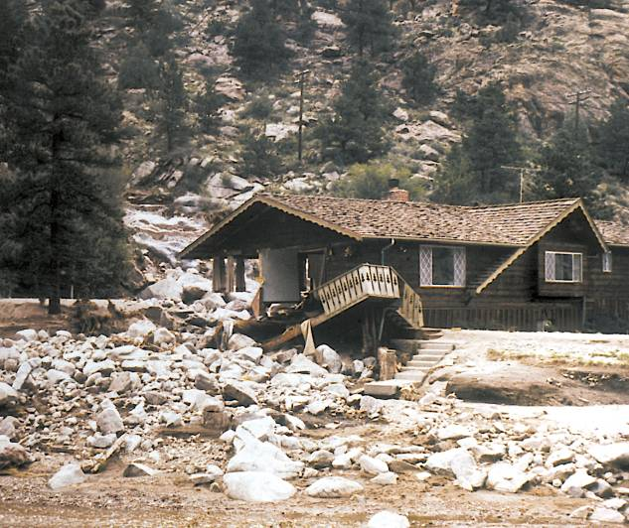
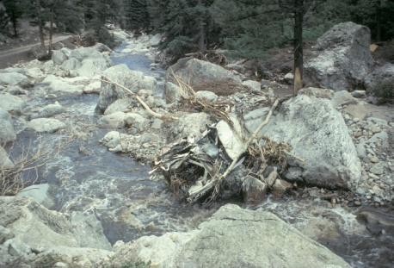
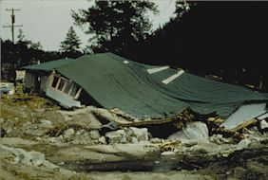
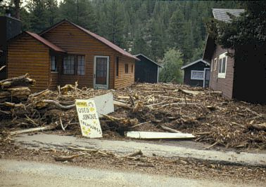
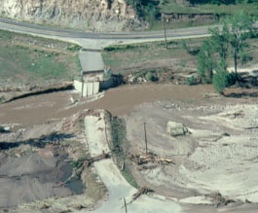
Warning lead times are short and walls of water are not a myth.
19-foot flood depth
Big Thompson River
at Canyon Mouth
July 31, 1976

Slide 15
Monsoon

Slide 16
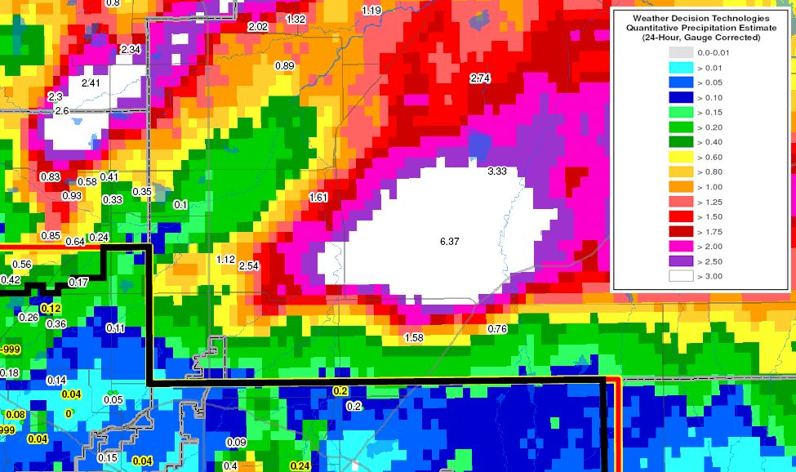
Big rains are not uncommon. August 2, 2007 northeast of Brighton
August 2, 2007

Slide 17
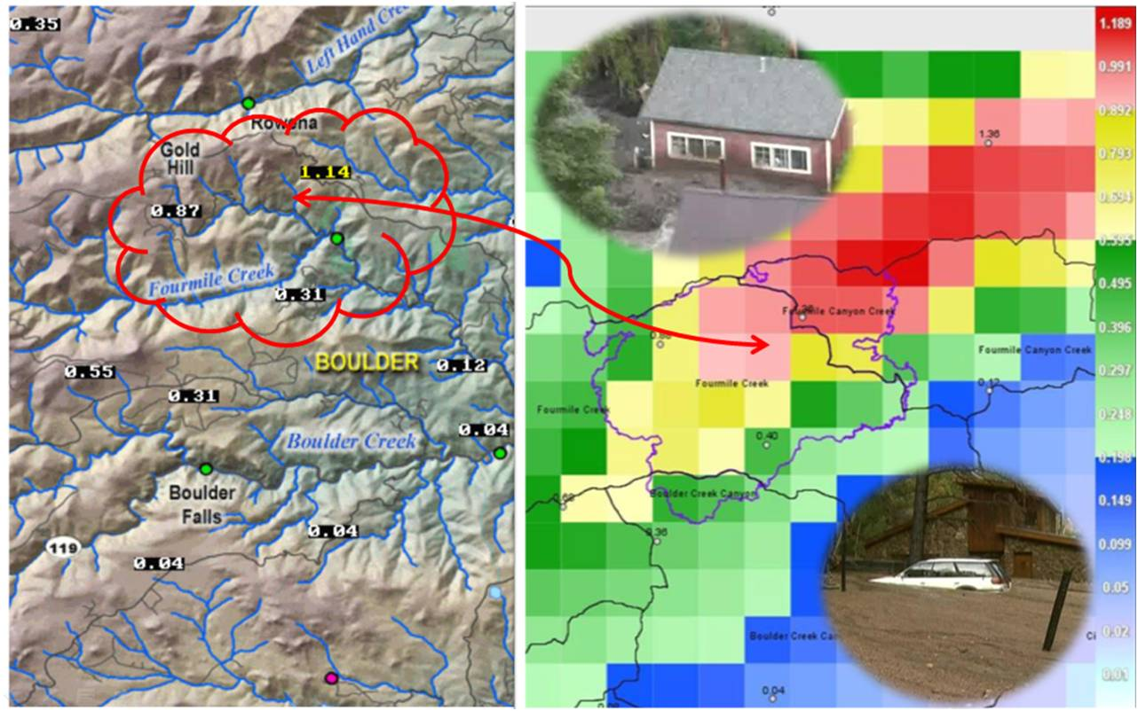
The July 13, 2011 Flash Flood A relatively small event with serious impacts

Slide 18
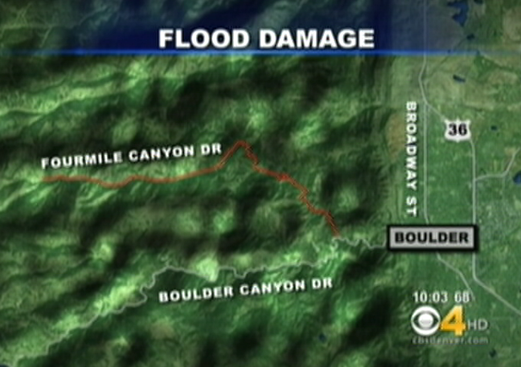
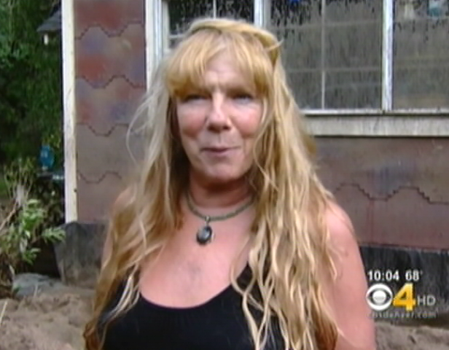
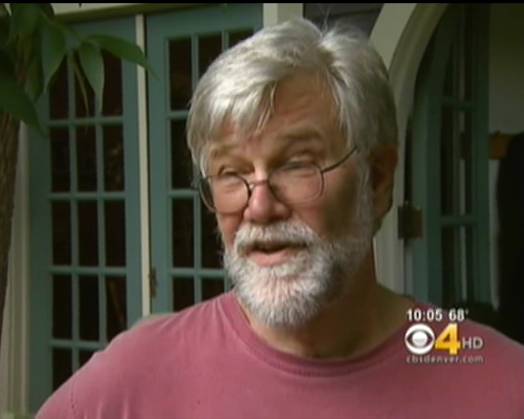
RESIDENTS TELL THEIR STORIES
The July 13, 2011 Flash Flood

Slide 19
UDFCD 2013 RECOMMENDED FLASH FLOOD THRESHOLDS FOR FMBA
Fourmile Creek & Fourmile Canyon Creek: GARR-pk > 0.75" with one BA-corresponding ALERT-pk > 1" and with one ALERT rainfall alarm rate alarm > 3 in/hr, i.e. 0.5" in 10-min
Fourmile Creek BA-GARR > 0.4"
Fourmile Canyon Creek BA-GARR > 0.7"
GARR-pk represents maximum gridded ‘gauge adjusted radar rainfall’ estimate
BA-GARR represents the basin-average ‘gauge adjusted radar rainfall’ estimate

Slide 20
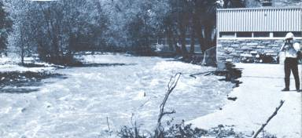
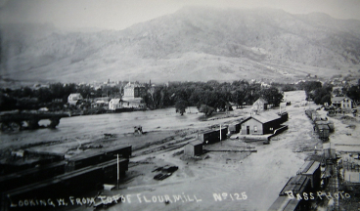
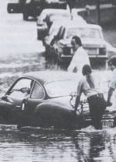
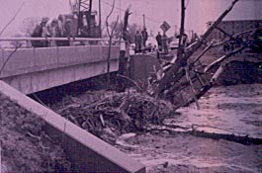
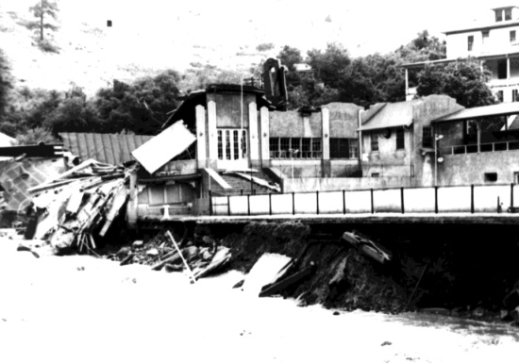
Memories fade quickly

Slide 21
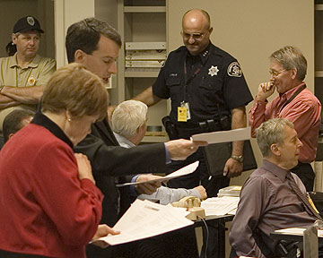
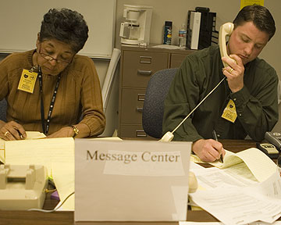
The EOC Where critical decisions are made.
Gaining situational awareness, a common operating picture, leaning forward & using plain language.

Slide 22
The Good News
More believers now

Slide 23
Your Questions
What are the different types of floods?
What causes floods?
Where is Boulder County’s greatest flood risk?
What does our flood warning system look like?
What is the outlook for 2013?
What are some common misconceptions about floods?
What are important key messages for Boulder County citizens to know about floods?

