Slide 1
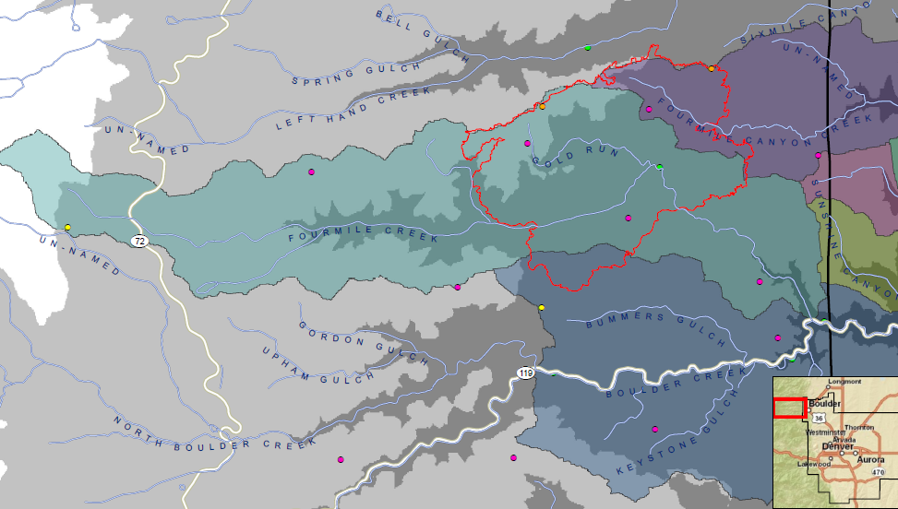
Resolution No. 6 Authorization to Develop Flood Warning System Improvements for Boulder Creek and Fourmile Creek
1-HR PCP | Q_{p} CFS
0.5” | 200
0.75” | 1,100
1.0” | 1,900
1.25” | 3,100
1.5” | 4,100
1.75” | 5,300
2.0” | 6,500
2.5” | 8,700
3.0” | 11,400
Note: Peak discharge estimates relate only to runoff
from the FMC Burn Area.
Notes:
Peak discharge estimates based on unit peaks (cfs/acre) contained in WWE memo dated January 20, 2011. Drainage basin size used for calculation equals 60% of the portion of the FMC Burn Area tributary to Fourmile Creek, i.e. (0.6 * 4,577). All values rounded to nearest 100 cfs.

Slide 2
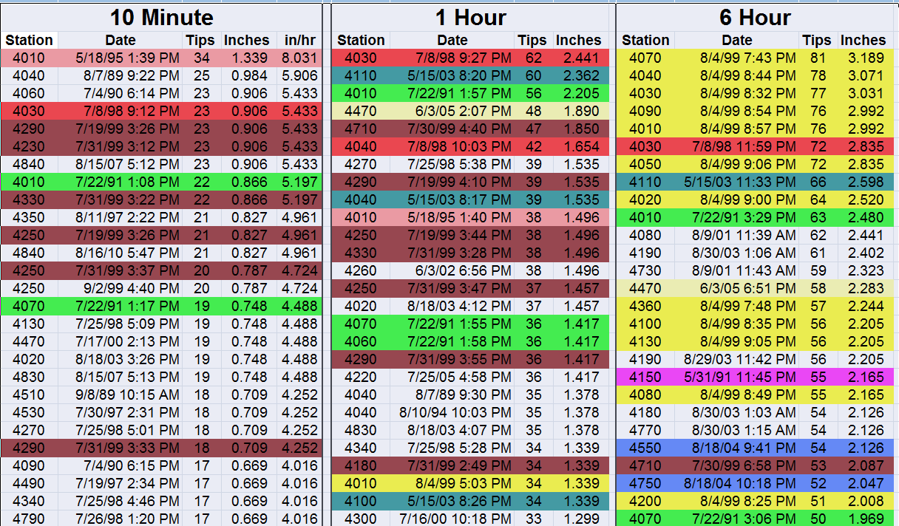
Intense Rain Events in Boulder County 1990-2010
Notes:
Analysis by Water & Earth Technologies, Inc. of Fort Collins.

Slide 3
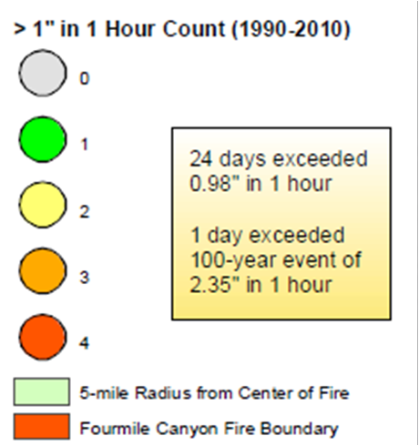
ALERT System
Rainfall Record
Analysis
by
Water & Earth
Technologies, Inc.

Slide 4
