Slide 1
June 24, 2018

Slide 2
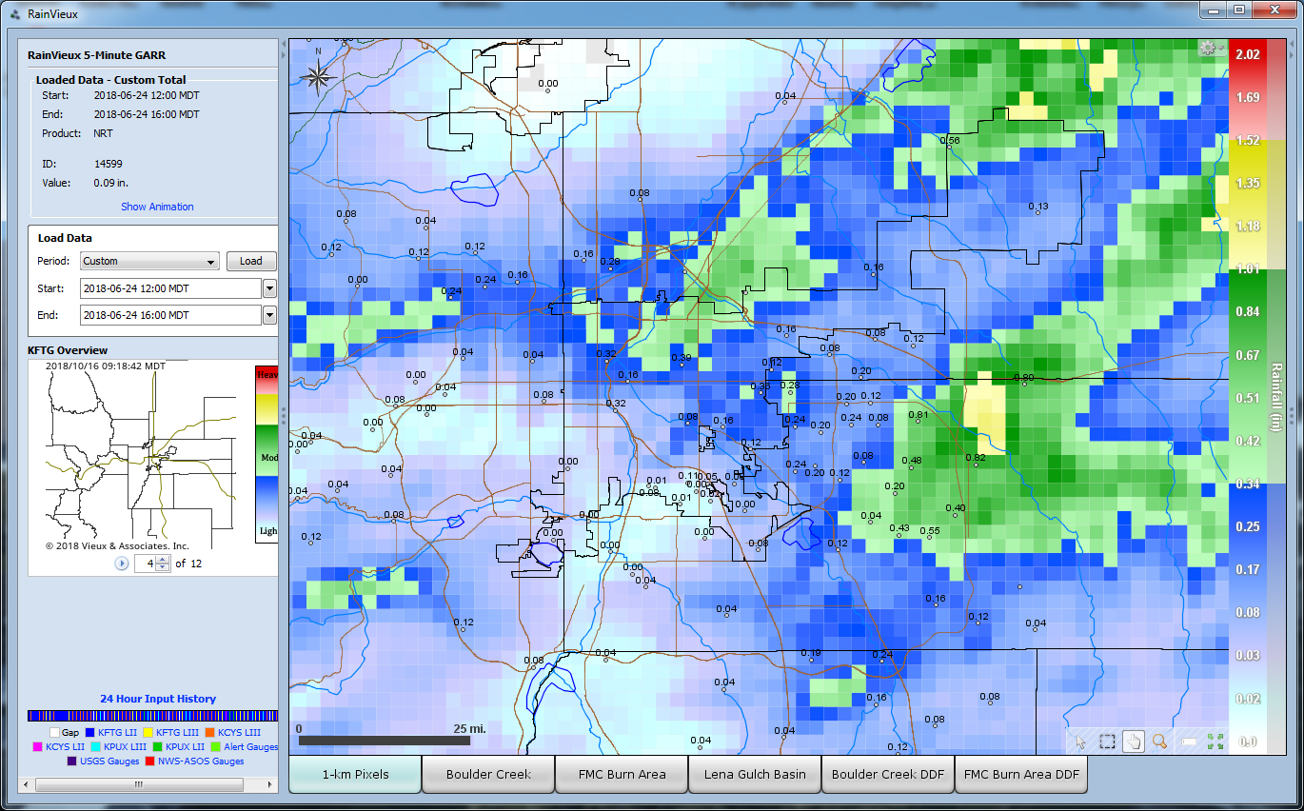
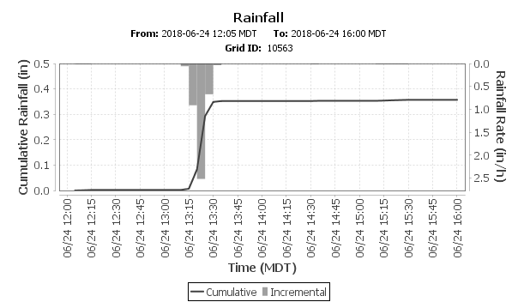
RainVieux estimates for 6/24/2018
X

Slide 3
Rainfall Rate Alarms in Aurora
Rainfall rate alarm | 1.00 inch in 1 hour | 870 | Murphy Creek Golf Course | 6/24/2018 13:53
Rainfall rate alarm | 0.50 inches in 10 minutes | 870 | Murphy Creek Golf Course | 6/24/2018 13:47
Rainfall rate alarm | 0.50 inches in 10 minutes | 830 | Side Creek Park | 6/24/2018 13:46
Rainfall rate alarm | 0.50 inches in 10 minutes | 730 | No Name @ Quincy | 6/24/2018 13:45
Rainfall rate alarm | 0.50 inches in 10 minutes | 750 | Quincy Reservoir | 6/24/2018 13:42
Rainfall rate alarm | 0.50 inches in 10 minutes | 100230 | Havana Pond | 6/24/2018 13:32

