Slide 1
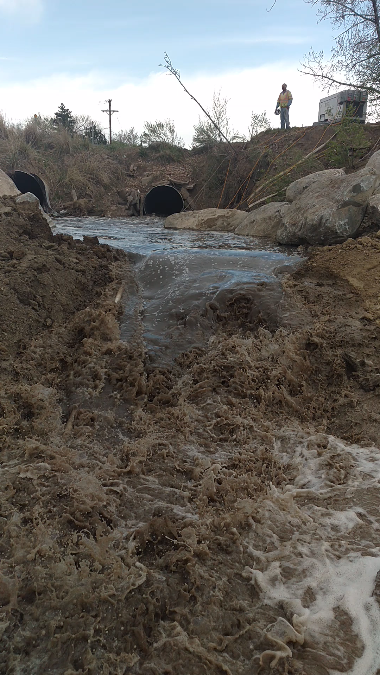
May 1, 2018
Video by Scott Dirschl
UDFCD
May 1, 2018 at 1:23 PM
Construction site on Hoffman Way Drainage in Thornton.
Small rainstorm hits Thornton area.

Slide 2
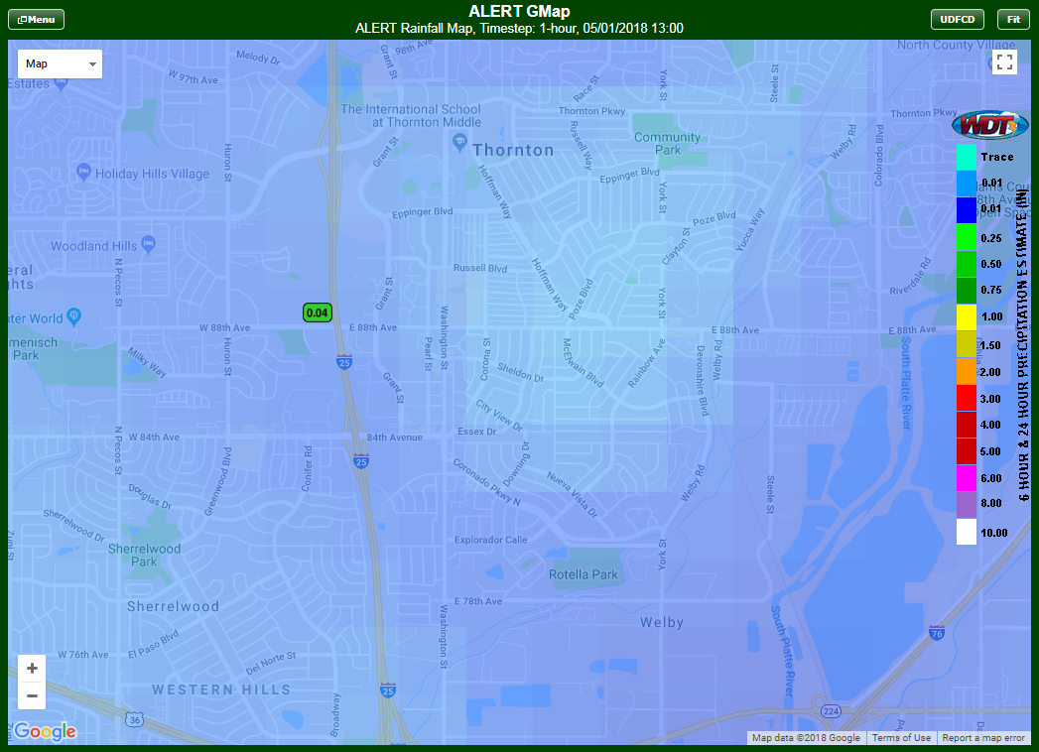
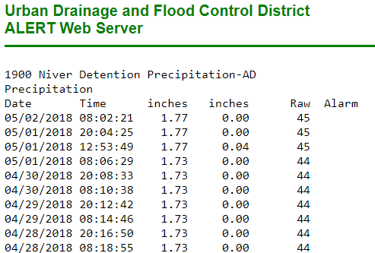

Slide 3
