Slide 1
June 24, 2015

Slide 2
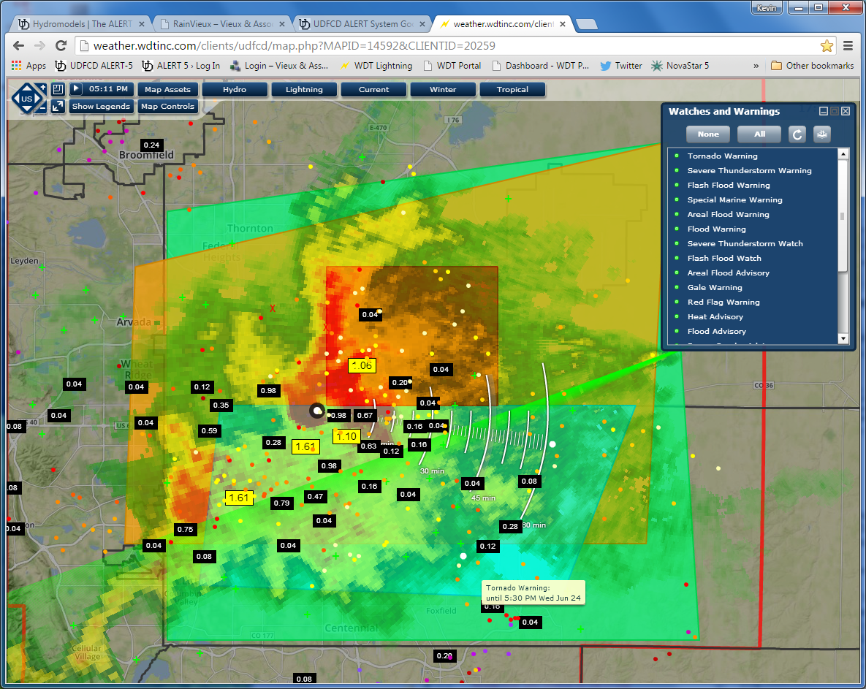

Slide 3
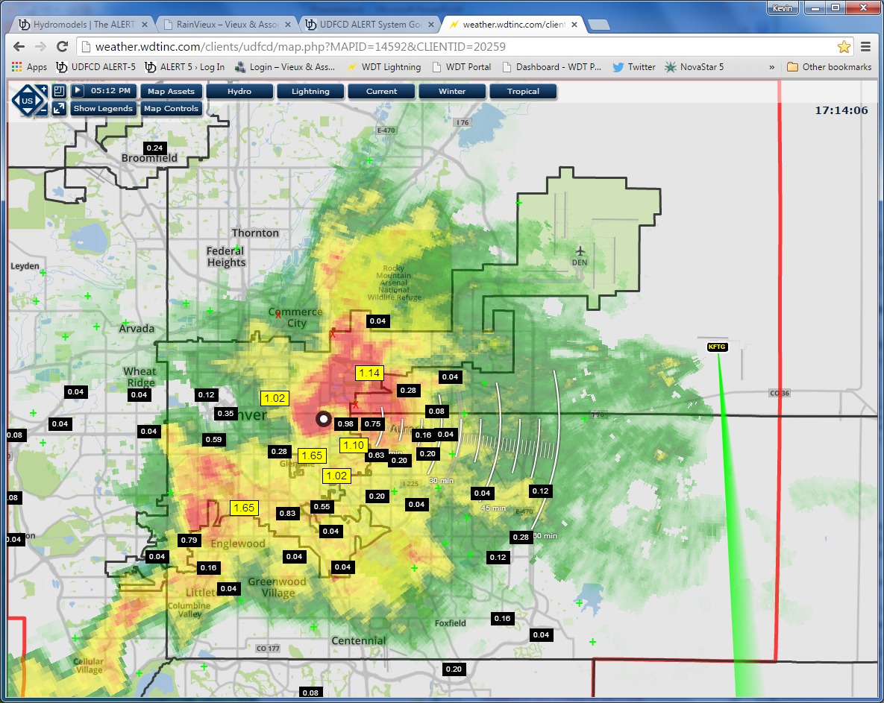

Slide 4
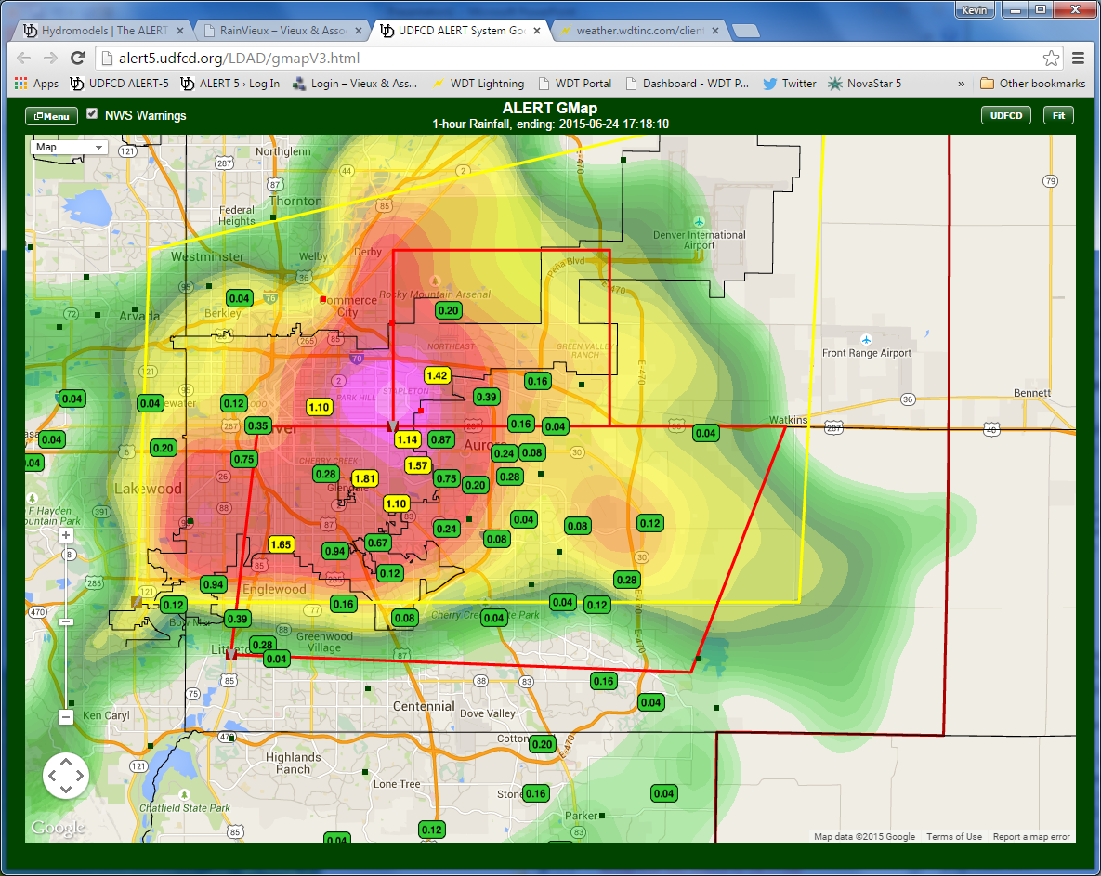

Slide 5
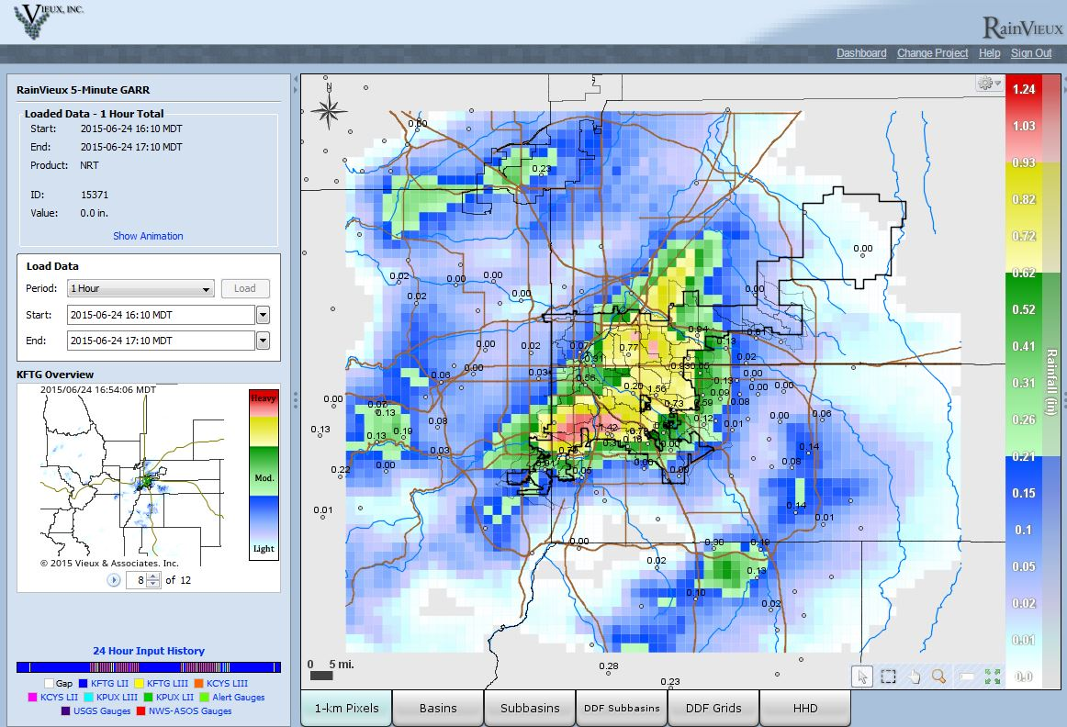

Slide 6
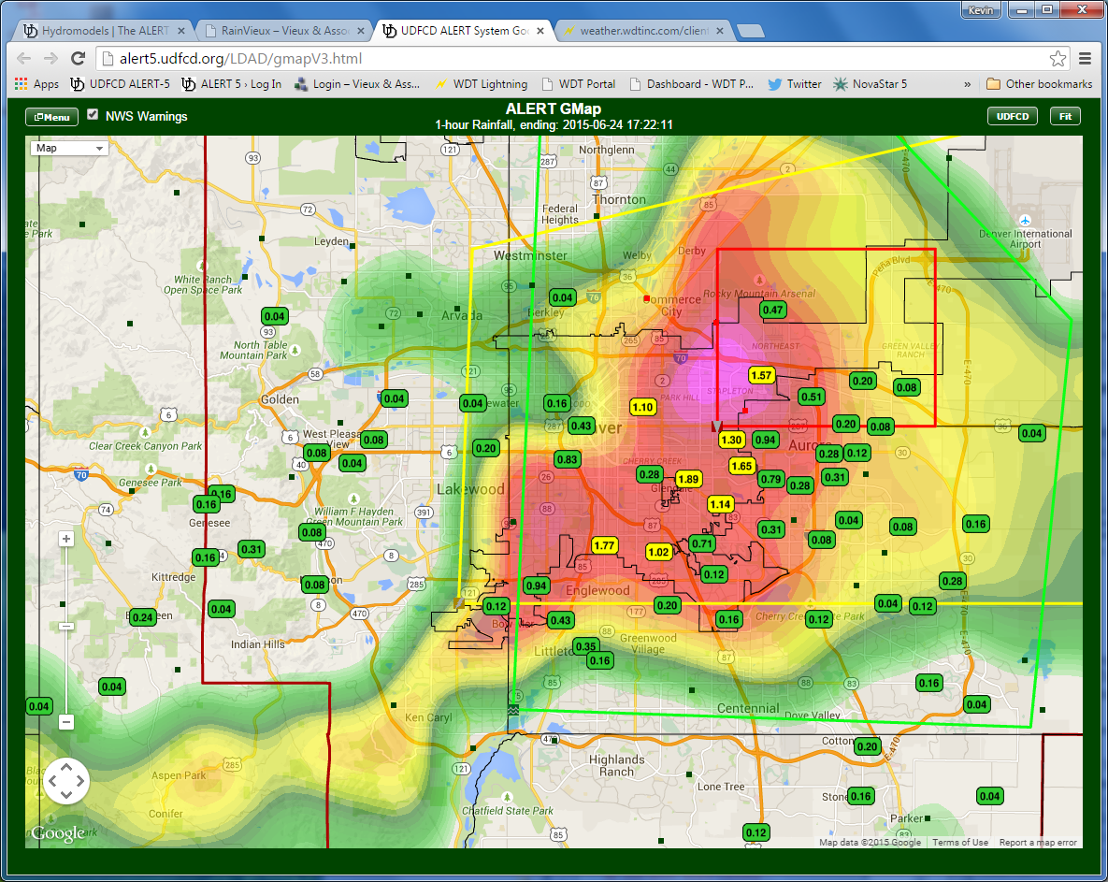

Slide 7
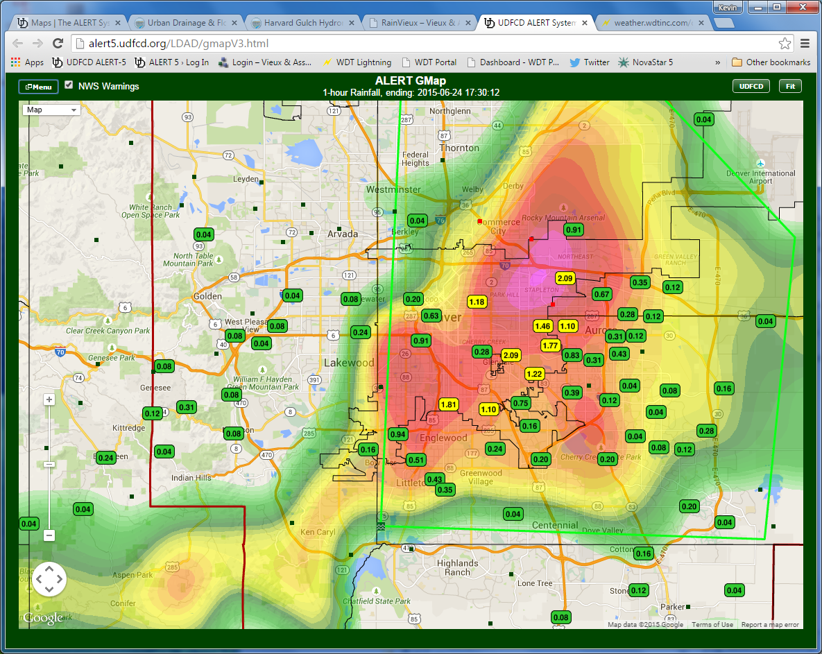

Slide 8
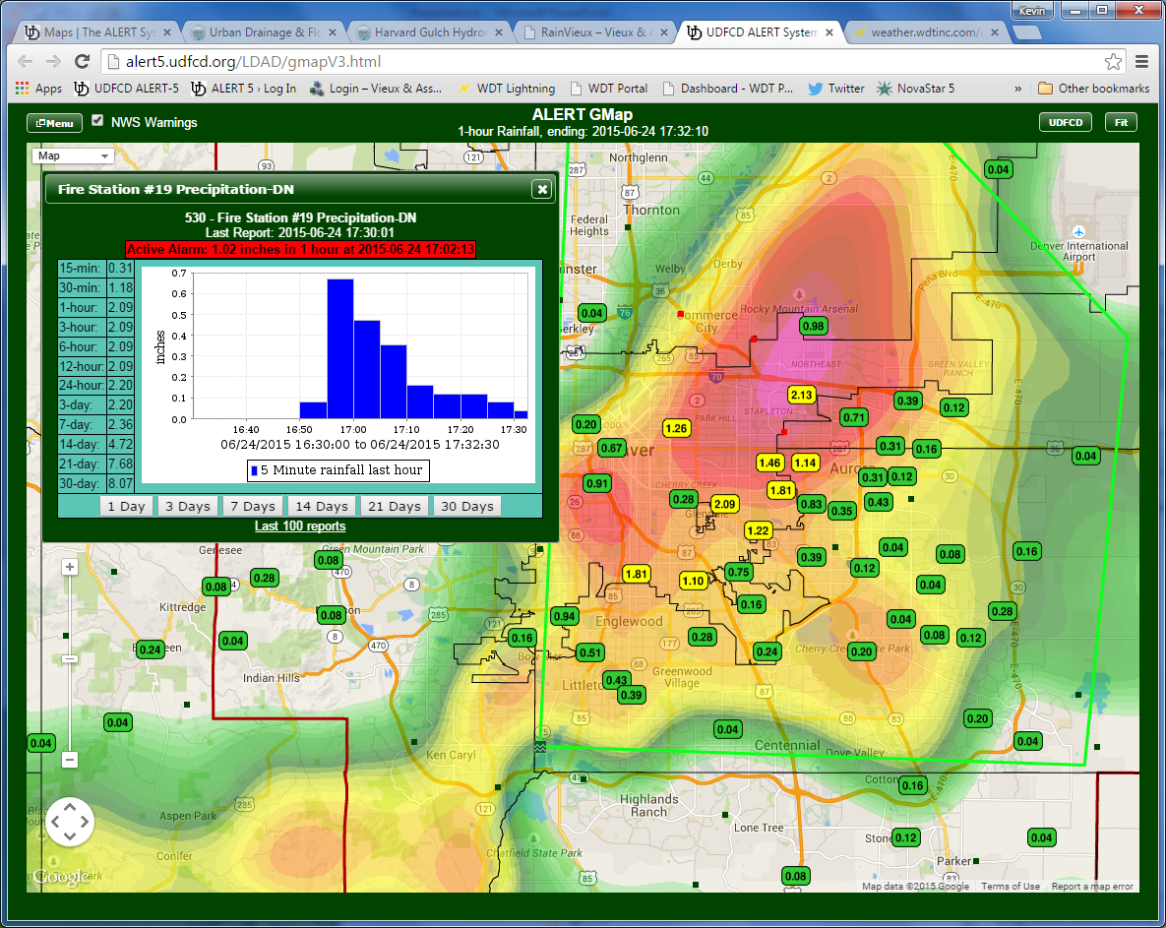

Slide 9
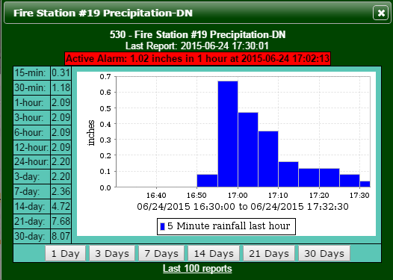
8 in/hr rainfall rate

Slide 10
SPR water Levels & Streamflow

Slide 11
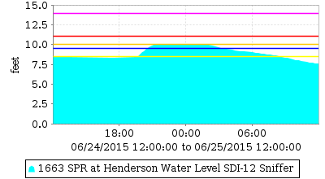
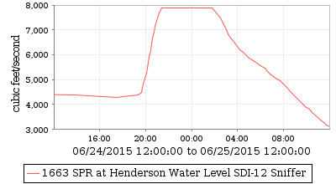
SPR at Henderson
ALERT Sniffer capped at 10-ft, hydrograph cutoff, see DWR extended rating hydrograph

Slide 12
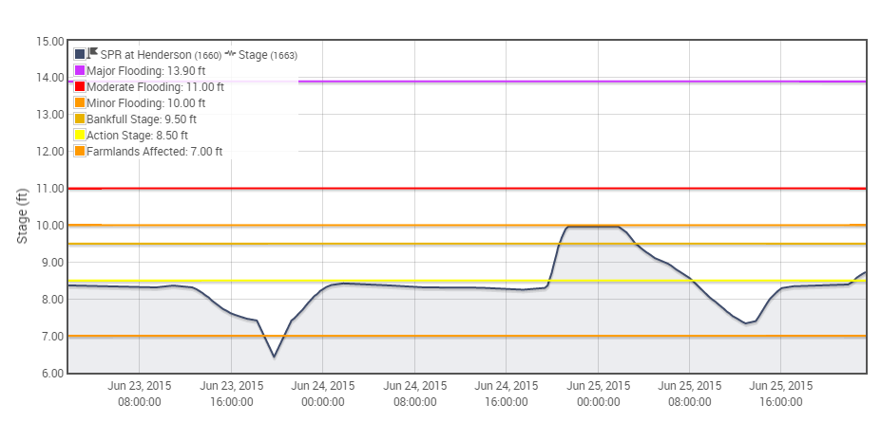
ALERT Sniffer capped at 10-ft, hydrograph cutoff, see DWR extended rating hydrograph

Slide 13
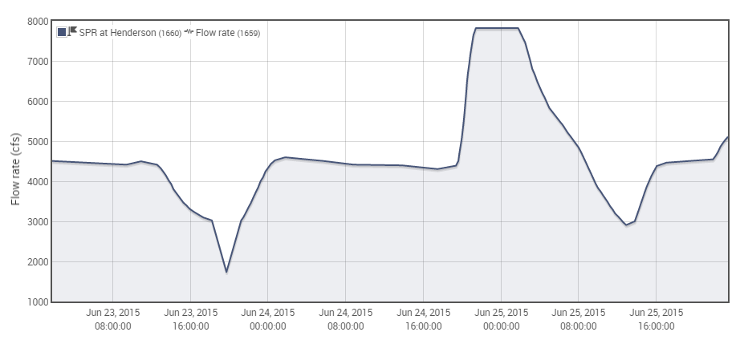
ALERT Sniffer capped at 10-ft, hydrograph cutoff, see DWR extended rating hydrograph

Slide 14
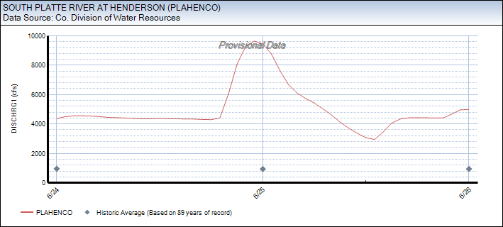
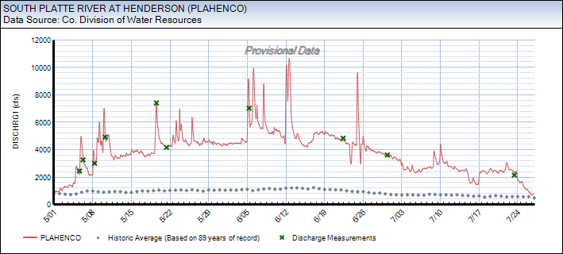
2015 SPR Streamflow Measurements by Colorado DWR
6/24 Peak (~9,700 cfs @ 23:30)
May 1 thru July 27 hydrograph
10,700 cfs peak at 1445 on 6/12
9,970 cfs peak at 0315 on 6/6

Slide 15
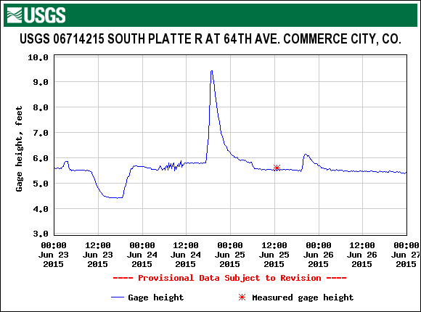
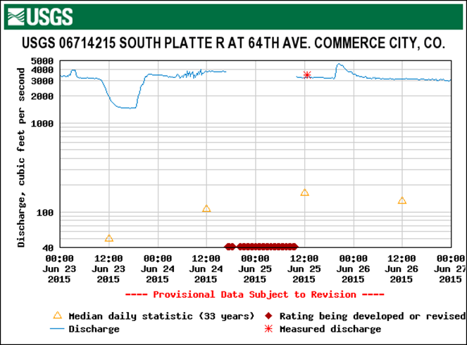
No extended rating provided by USGS

Slide 16
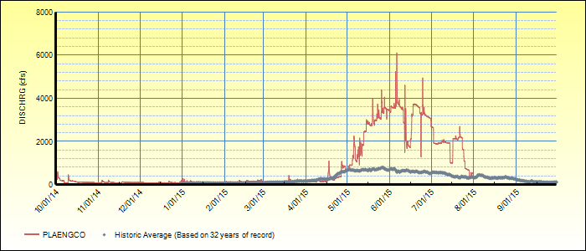
SPR at Englewood (Union Ave.)

Slide 17
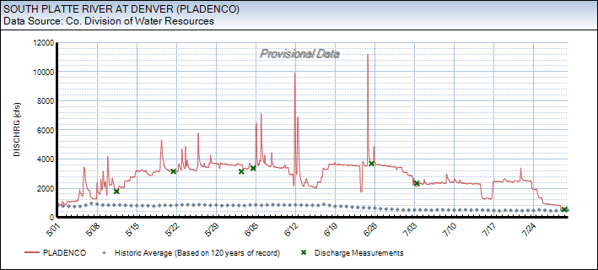
SPR at 19th Street/Denver

Slide 18
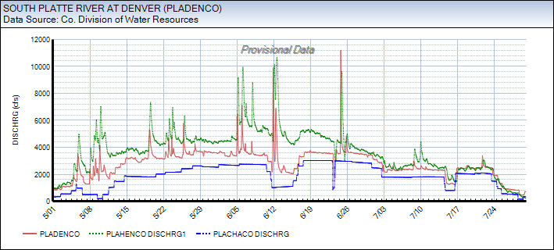
Chatfield to Henderson

Slide 19
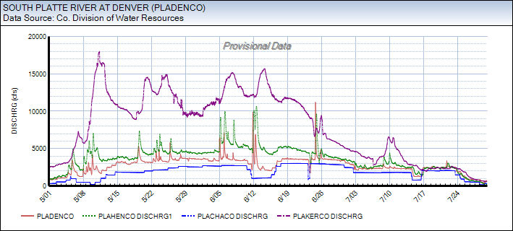
Chatfield to Kersey

Slide 20
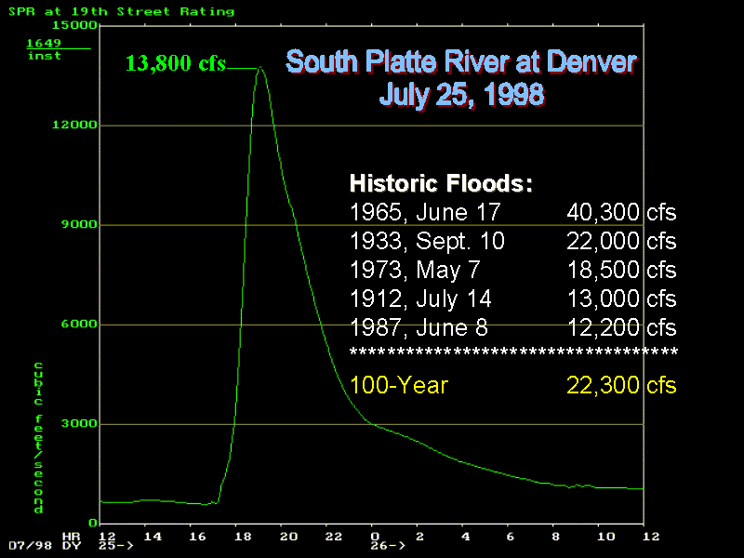
Figure from 1998 Flood Hazard News article by Kevin Stewart
The 9/10/33 flood date is suspect. The Castlewood Canyon Dam on Cherry Creek in Douglas County failed on
August 3, 1933. The year and peak may be correct, but the September date is unlikely and should be verified.

