Slide 1

June 24, 2015
14,300 cfs peak flow for
South Platte River at Denver
PLADENCO/ALERT ID 1649
Slides prepared by: Kevin Stewart, P.E., UDFCD Information Services and Flood Warning Program Manager

Slide 2
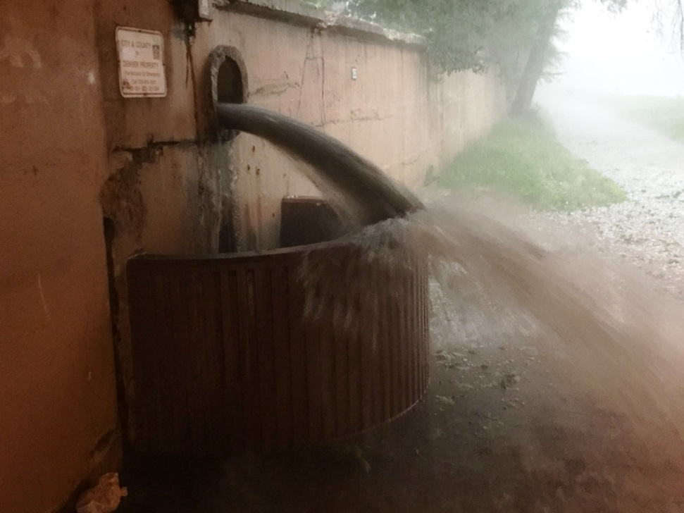
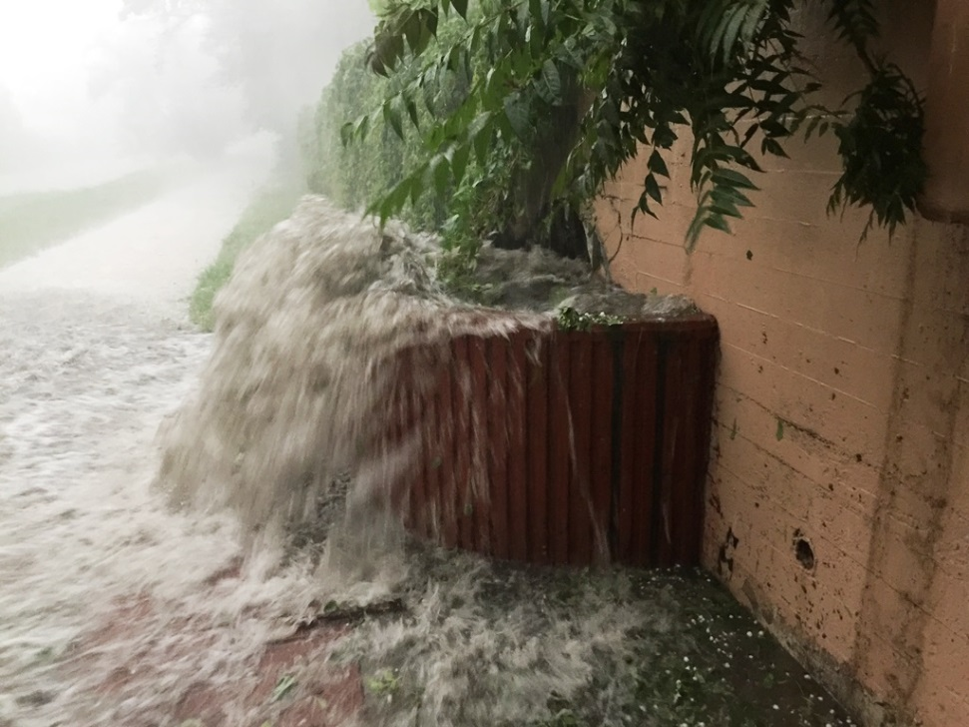
Cherry Creek photos provided by Shea Thomas, UDFCD
June 24, 2015

Slide 3
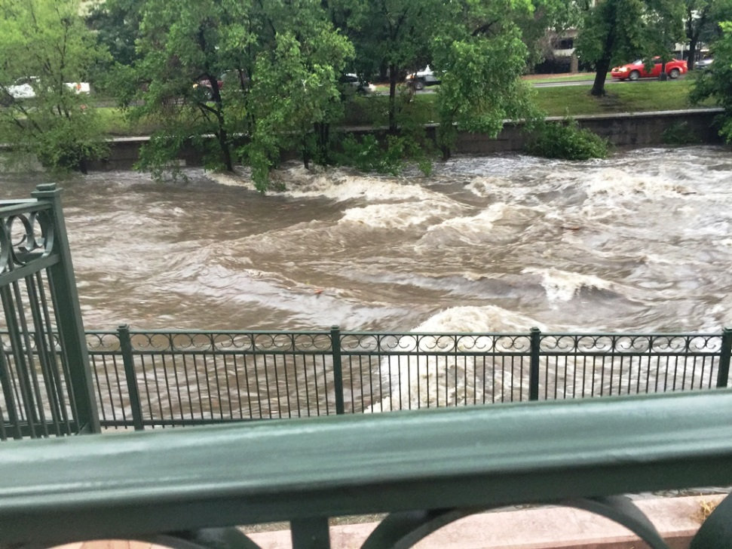
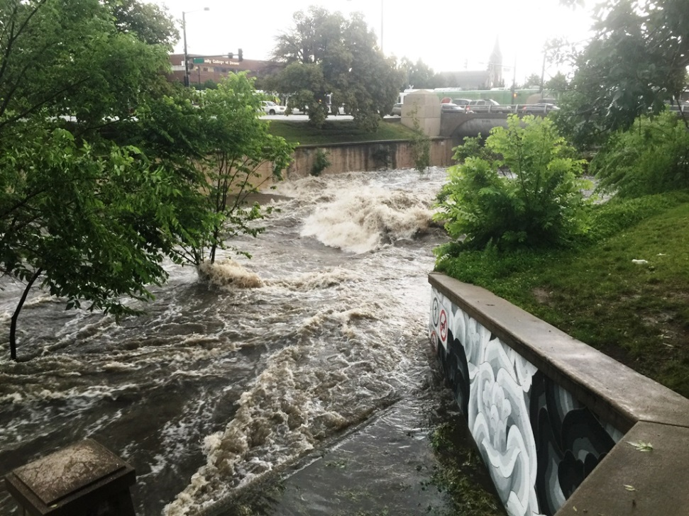
Cherry Creek photos provided by Shea Thomas, UDFCD
June 24, 2015

Slide 4
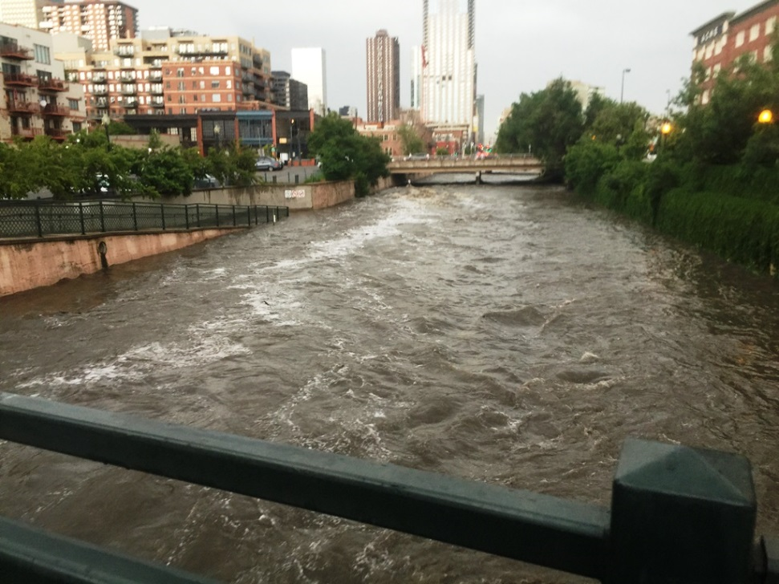
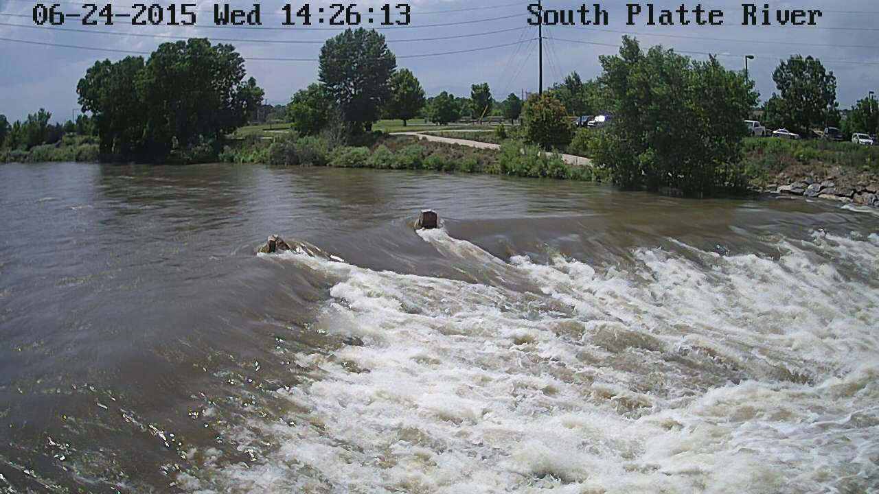
Cherry Creek photo provided by Shea Thomas, UDFCD
South Platte River video provided by Water & Earth Technologies
June 24, 2015

Slide 5
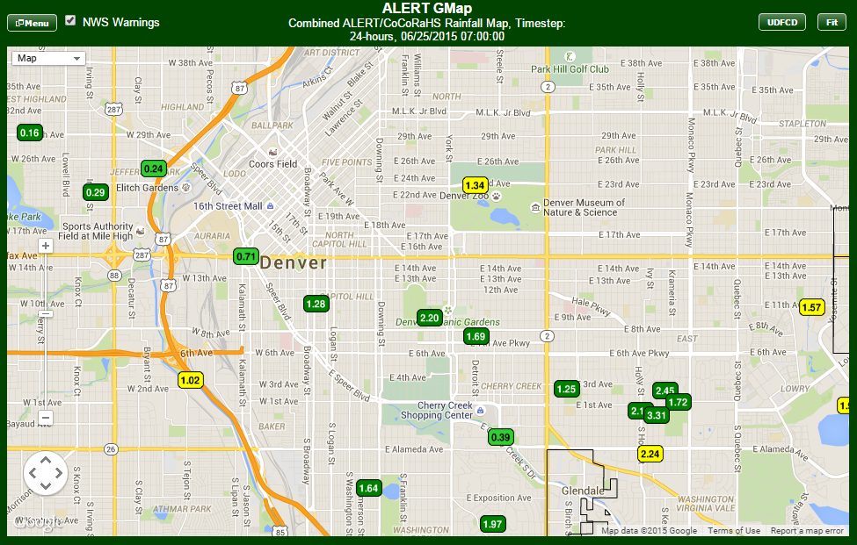
Rain Gauge Measurements for June 24, 2015 Event
(for 24-hour period ending at 7AM, 6-25-15)
X
‘X’ represents the approximate point of interest for AG inquiry.

Slide 6
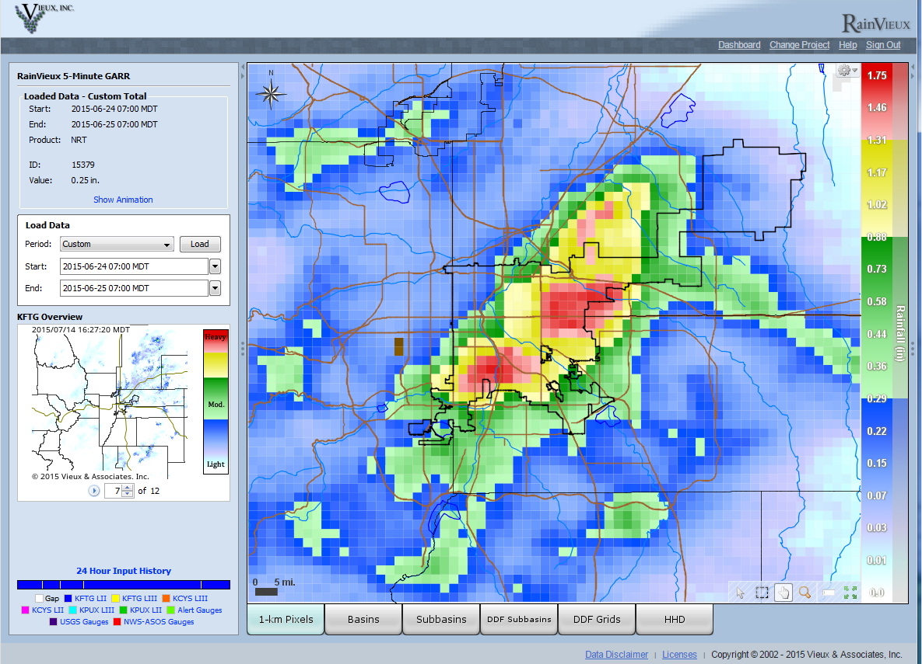
Gage-Adjusted Gridded Radar-Rainfall Estimate near 8th and Corona in Denver
X
for 24-hour period ending at 7AM on June 25, 2015
‘X’ represents the approximate point of interest for AG inquiry.

Slide 7
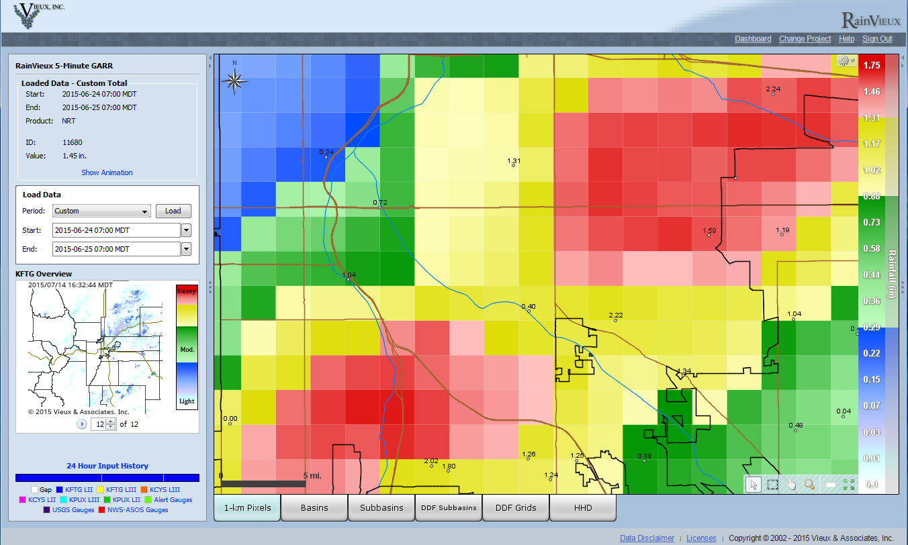
Gage-Adjusted Gridded Radar-Rainfall Estimate near 8th and Corona in Denver
X
for 24-hour period ending at 7AM on June 25, 2015
‘X’ represents the approximate point of interest for AG inquiry.

Slide 8
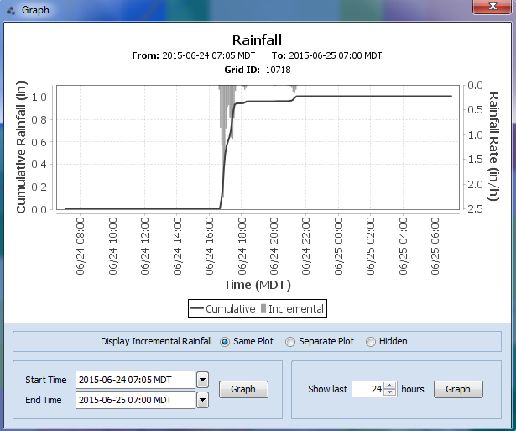
Gage-Adjusted Gridded Radar-Rainfall Estimate near 8th and Corona in Denver
24-hour plot ending at 7AM on June 25, 2015

Slide 9
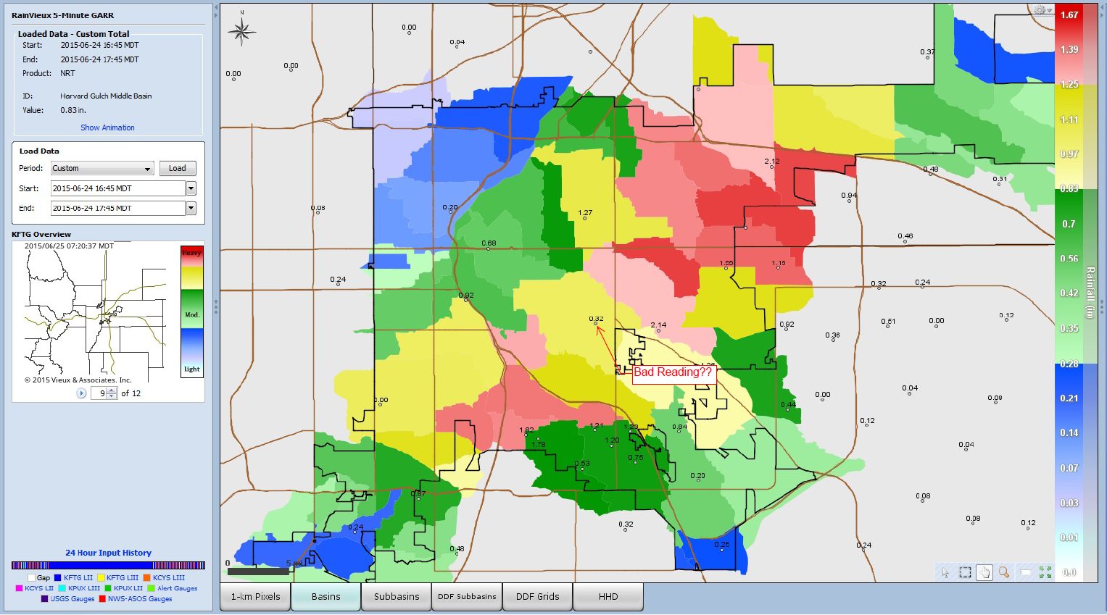
Radar-Estimated 1-hour Rainfall Totals
(between 4:45 & 5:45 p.m., June 24, 2015)
X
from Mike Anderson w/Denver Public Works Wastewater Management Division
‘X’ represents the approximate point of interest for AG inquiry.

Slide 10
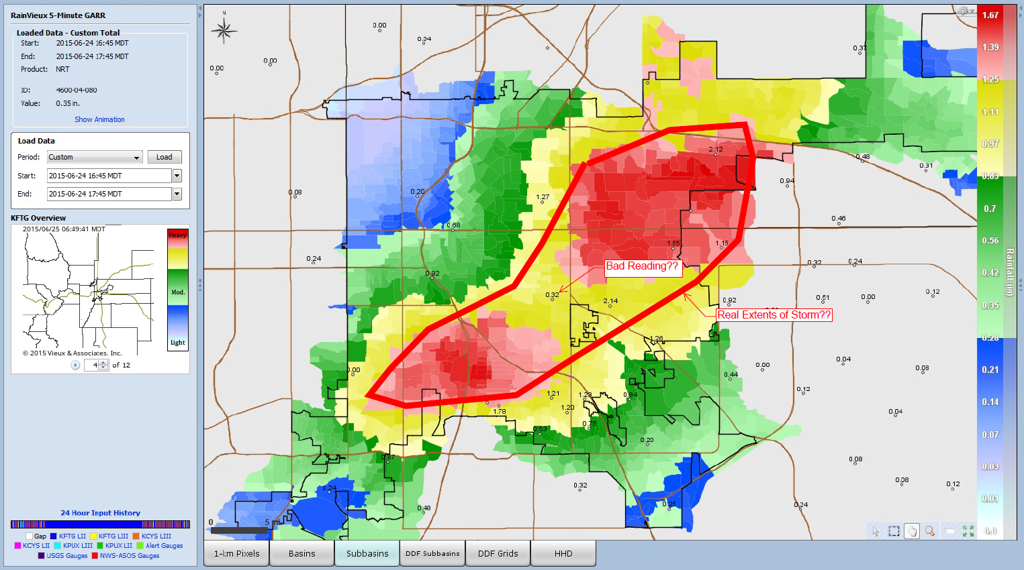
Radar-Estimated 1-hour Rainfall Totals
(between 4:45 & 5:45 p.m., June 24, 2015)
X
from Mike Anderson w/Denver Public Works Wastewater Management Division
‘X’ represents the approximate point of interest for AG inquiry.

Slide 11
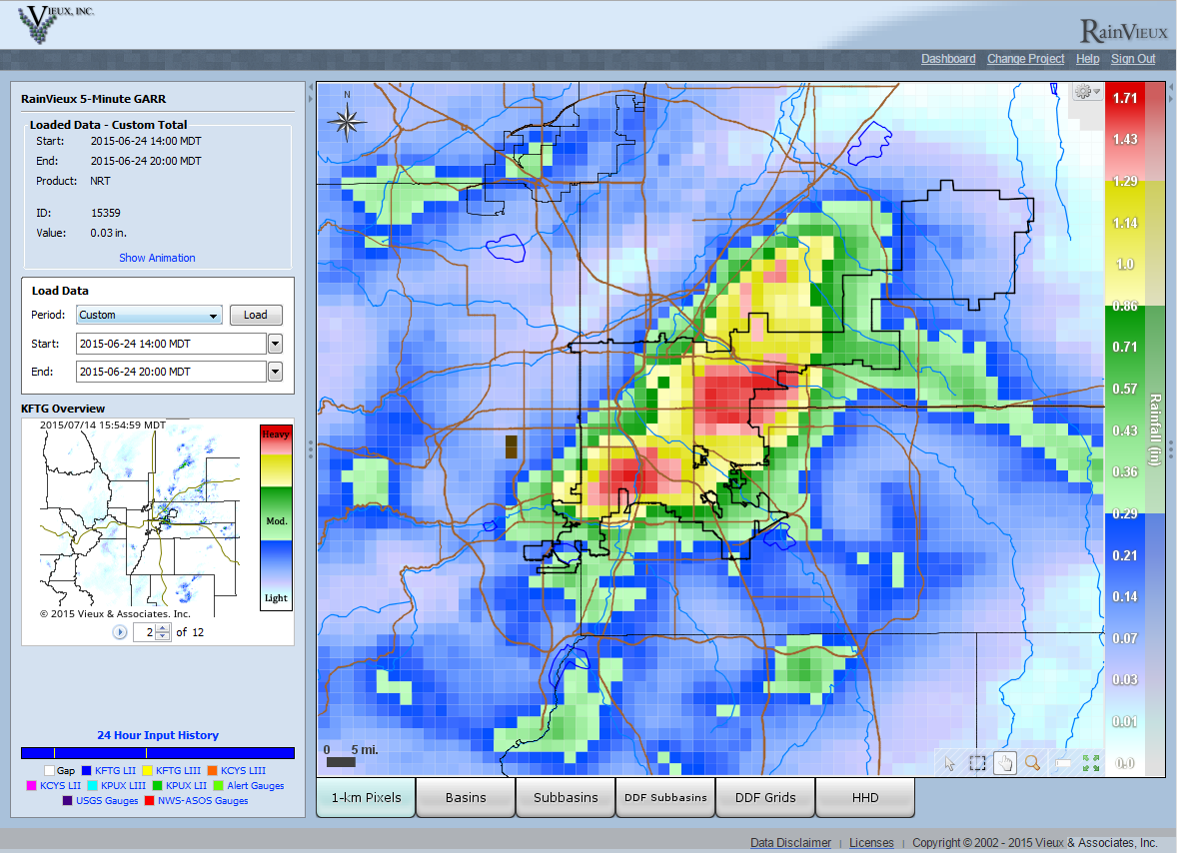
Gage-Adjusted Gridded Radar-Rainfall Estimate near 8th and Corona in Denver
X
for 6-hour period between 2PM and 8PM, June 24, 2015
‘X’ represents the approximate point of interest for AG inquiry.

Slide 12
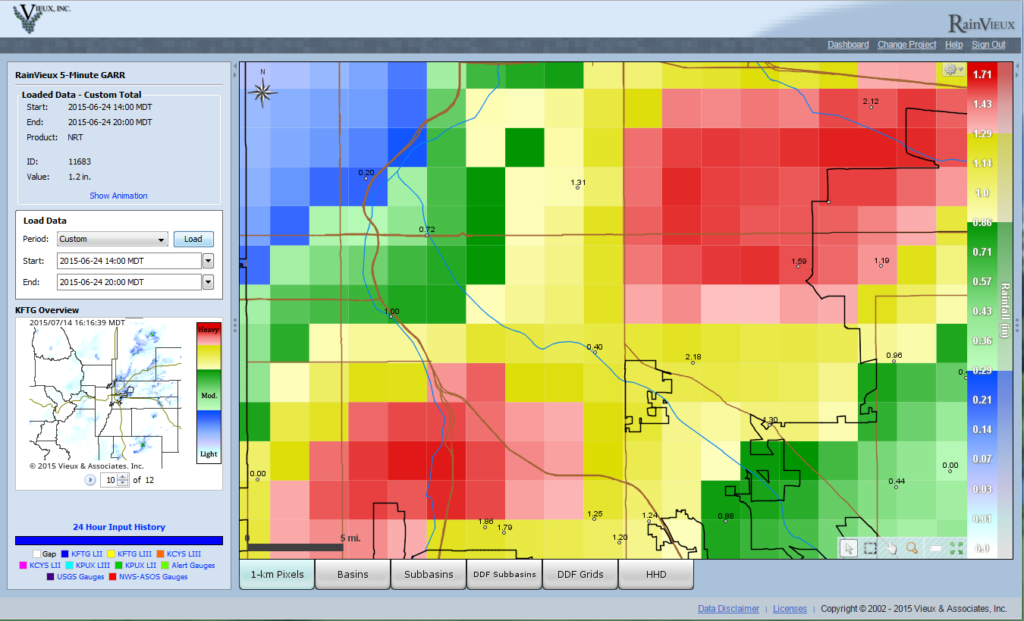
Gage-Adjusted Gridded Radar-Rainfall Estimate near 8th and Corona in Denver
X
for 6-hour period between 2PM and 8PM, June 24, 2015
‘X’ represents the approximate point of interest for AG inquiry.

Slide 13
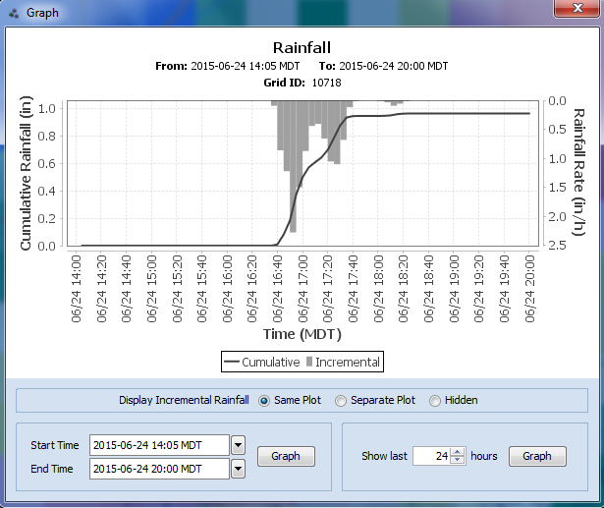
Gage-Adjusted Gridded Radar-Rainfall Estimate near 8th and Corona in Denver
6-hour plot between 2PM and 8PM, June 24, 2015

Slide 14
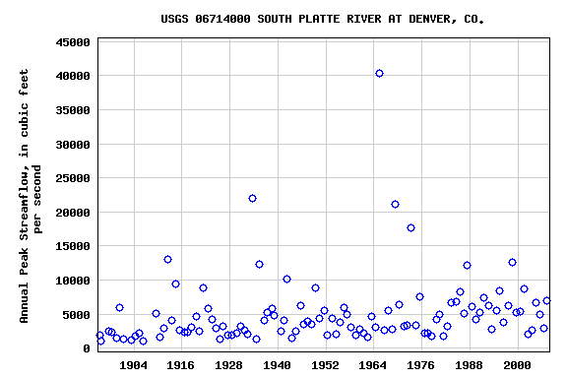
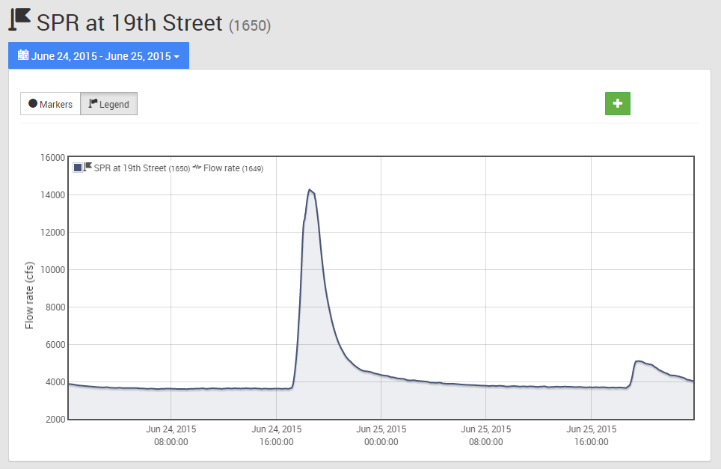
South Platte River at Denver Streamgage Hydrograph June 24, 2015 Event (14,700 cfs)
5th largest since 1895, exceeded only by the floods of 1933, 1965, 1969 & 1973

