Slide 1
Flooding in Cherry Hills Village
June 11-12, 2015

Slide 2
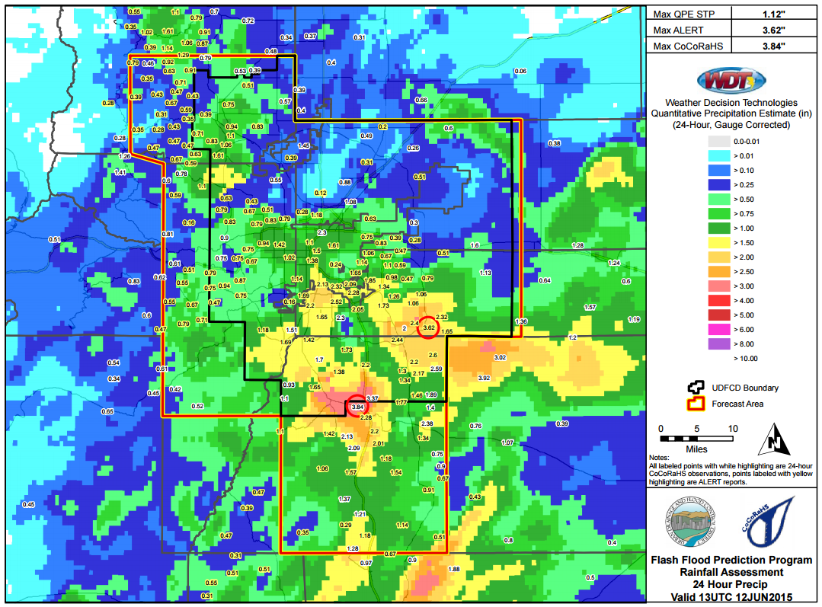
Message Day Summary

Slide 3
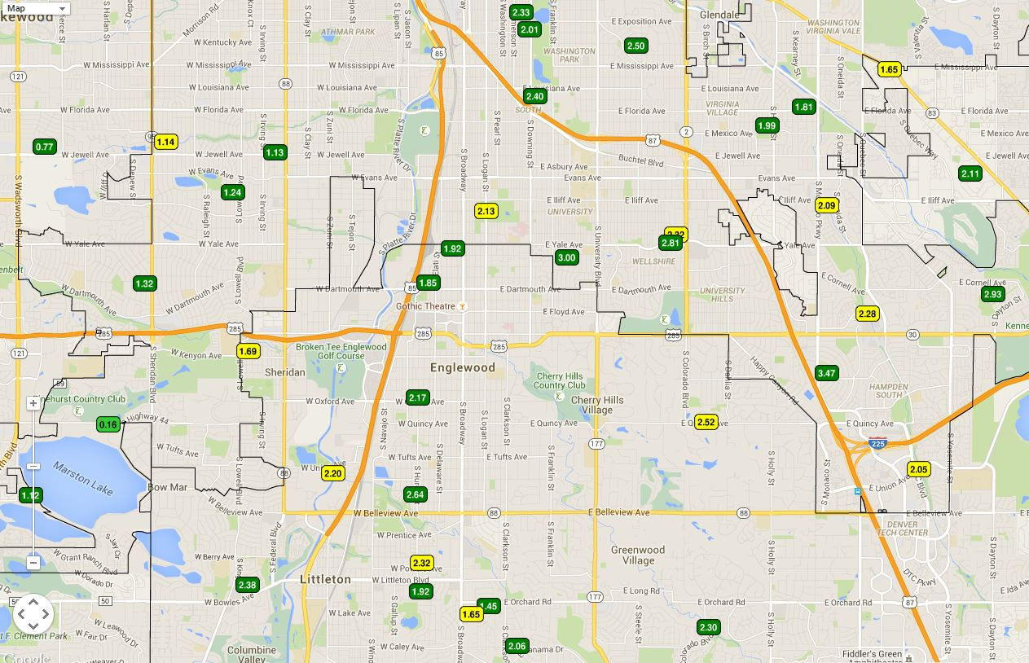
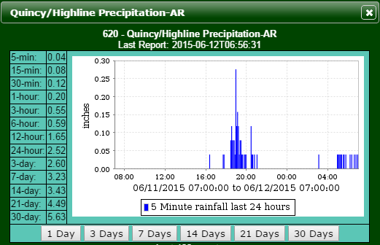
24-Hour ALERT/CoCoRaHS Rain Totals ending at 7AM on June 12, 2015

Slide 4
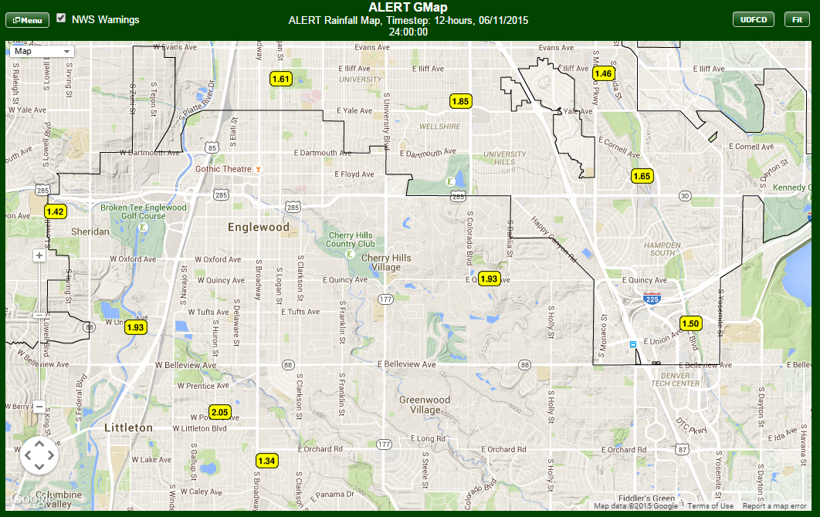
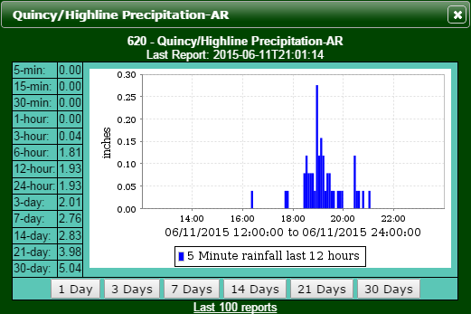
PM Rain Totals for June 11, 2015

Slide 5
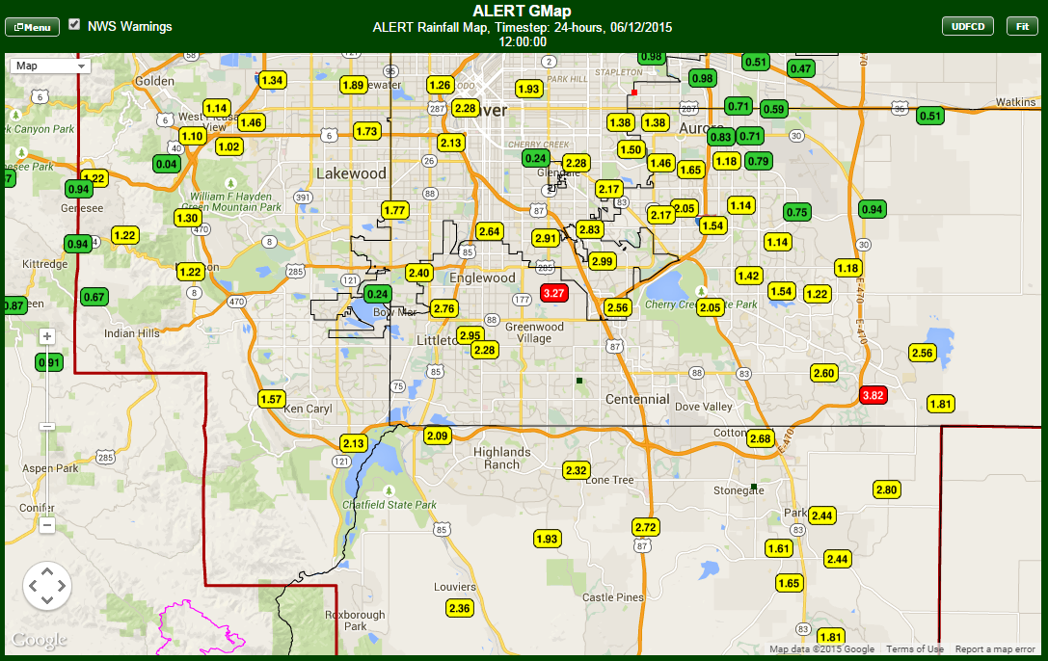
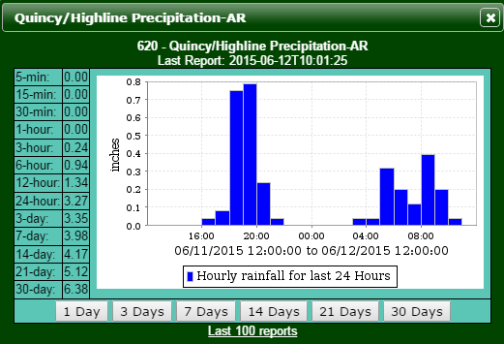
24-Hour ALERT Rain Totals ending at noon on June 12, 2015

Slide 6
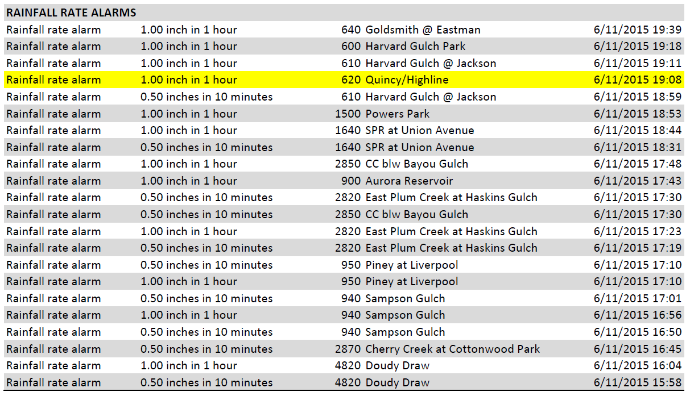
ALERT Rainfall Rate Alarms
June 11-12, 2015

Slide 7
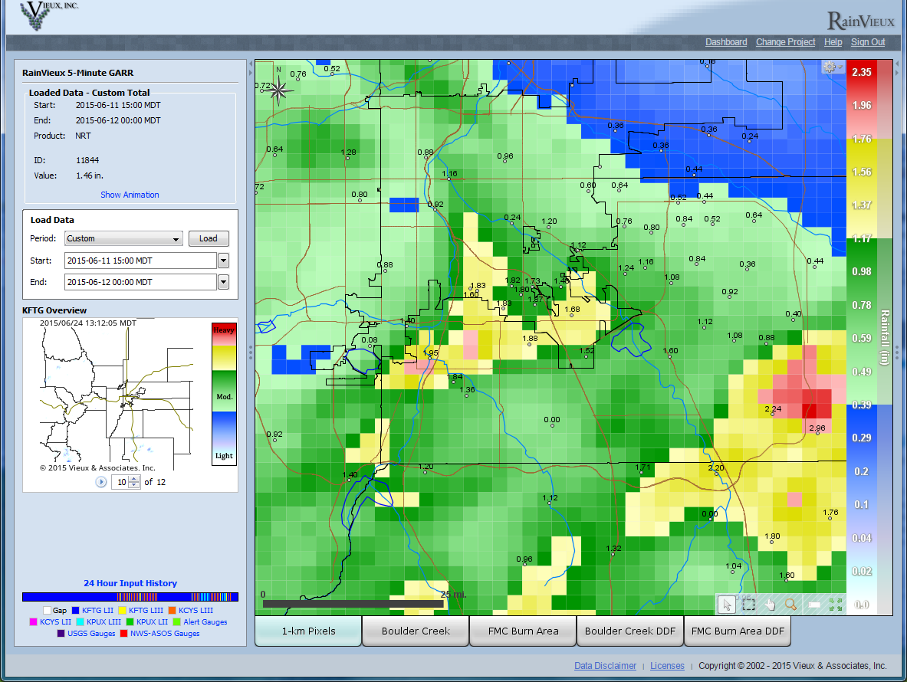
Radar-Estimated Rainfall
3PM to Midnight, June 11, 2015

Slide 8
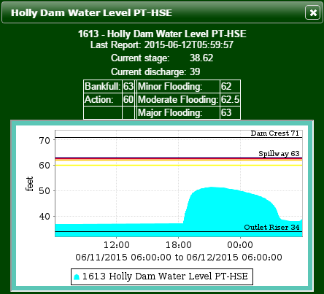
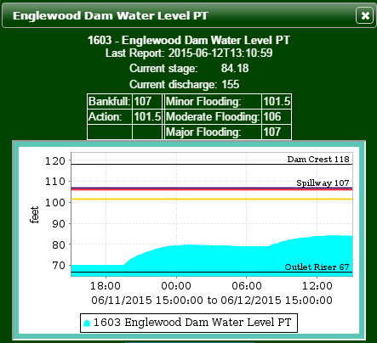
Englewood & Holly Dams

Slide 9
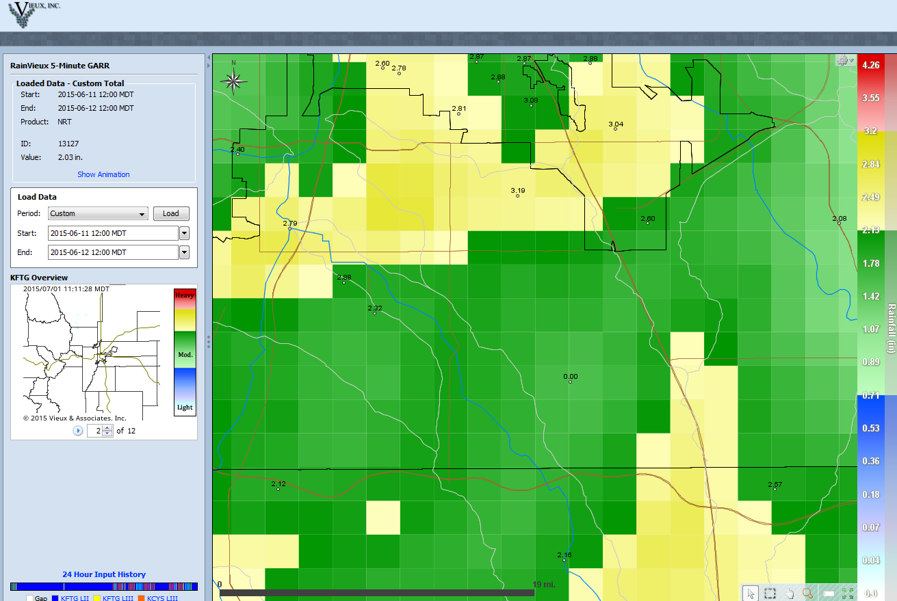
Radar-Rainfall Estimates and
Rain Gauge Measurements for 24-hour period ending at noon on June 12, 2015
Quincy and Colorado

Slide 10
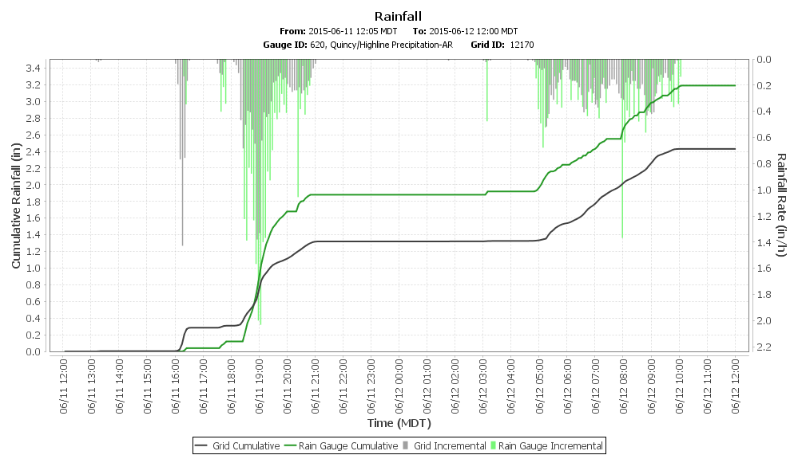
Radar-Rainfall Estimates and
Rain Gauge Measurements for 24-hour period
ending at noon on June 12, 2015

Slide 11
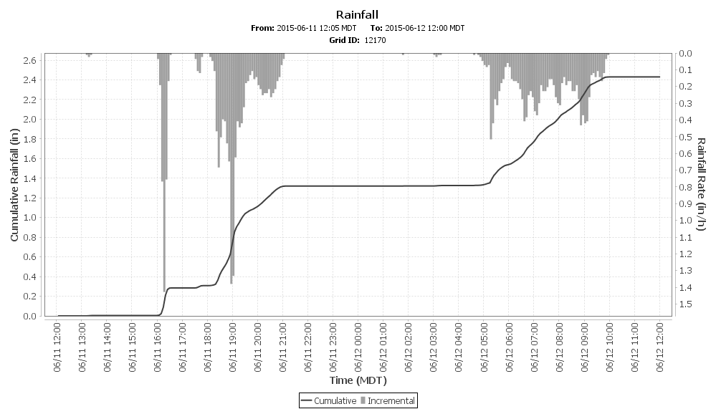
Radar-Rainfall Estimates and
Rain Gauge Measurements for 24-hour period
ending at noon on June 12, 2015

