Slide 1
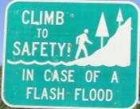
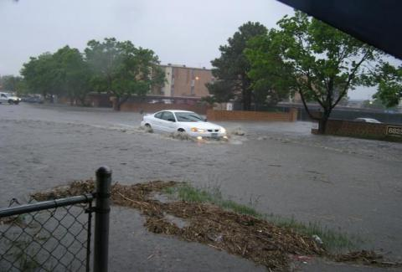
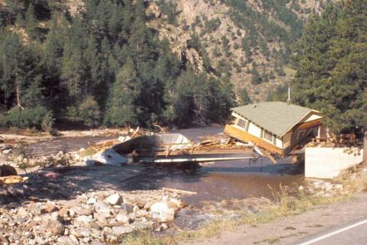
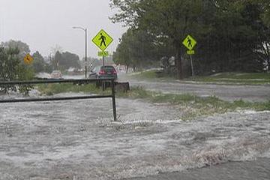
Urban Drainage & Flood Control District Flood Warning Program
A Federal/Regional/Local Early Warning Partnership
Paul A. Hindman, P.E.
Executive Director
Serving the greater Denver/Boulder metropolitan area since 1979 in cooperation with NOAA’s National Weather Service

Slide 2
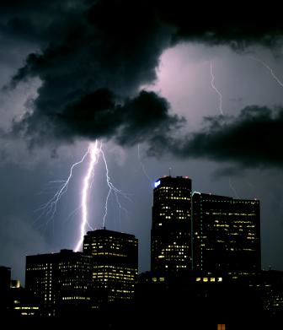
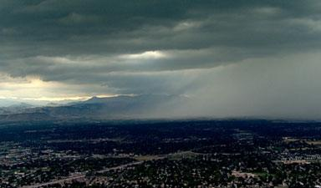
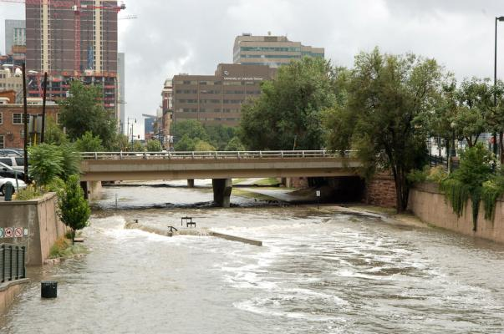
Flood Warning Program
Primary Mission
Provide local governments with early notifications of potential and imminent flood threats (primarily flash flood threats) in time to take appropriate defensive actions.
Saving lives and property

Slide 3
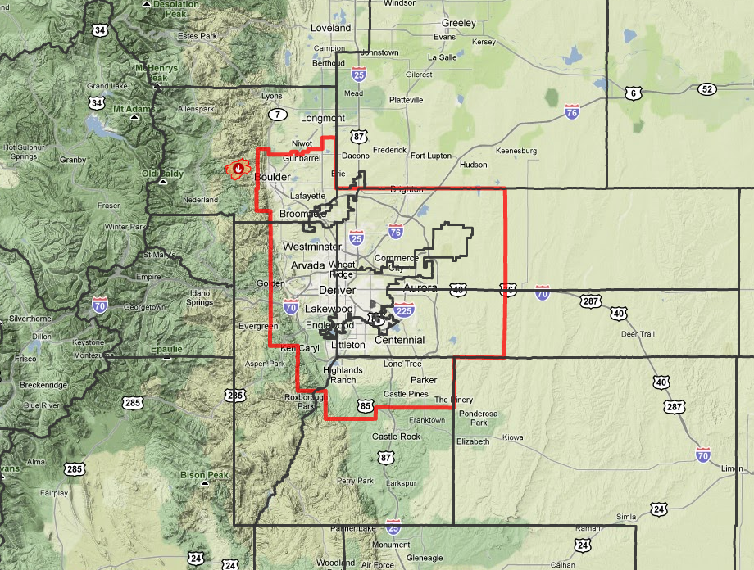
UDFCD Serving 39 Local Governments

Slide 4
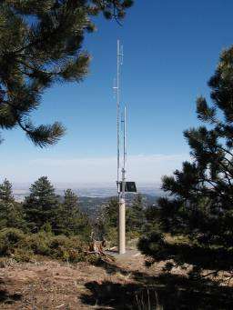
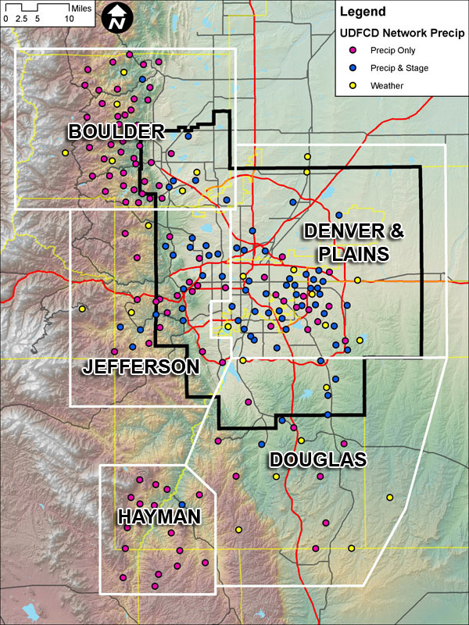
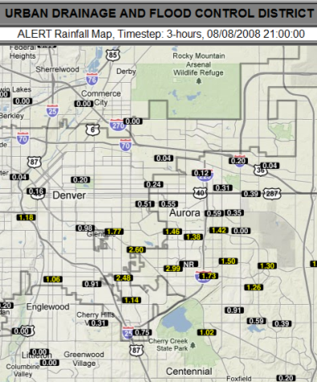
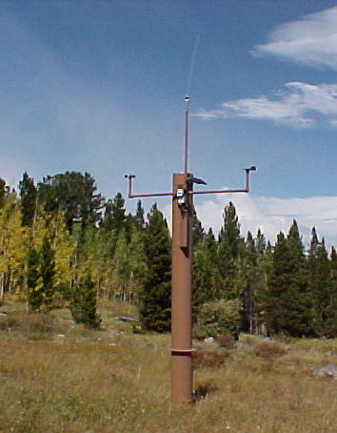
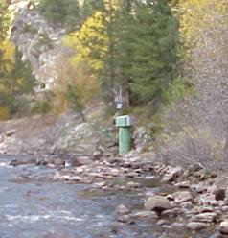
Early Flood Detection – The ALERT System
Notes:
4

Slide 5
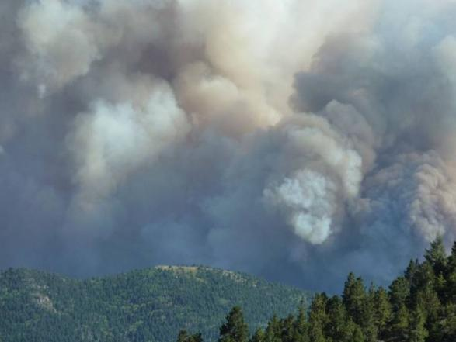
A NEW CHALLENGE
The Fourmile Canyon Fire
Labor Day
September 6, 2010

Slide 6
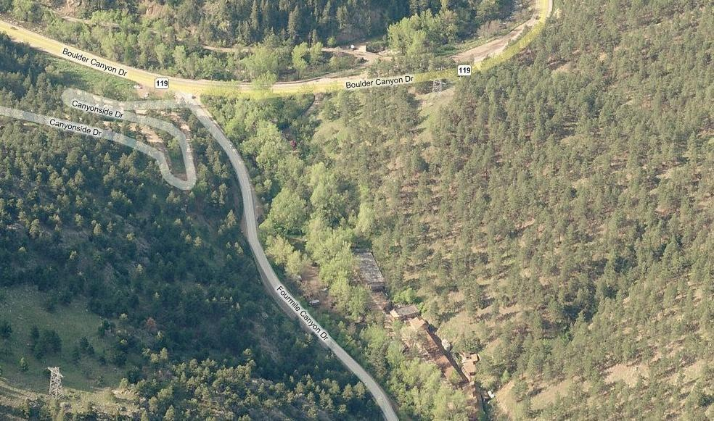
Fourmile creek flood risk assessment
Gold Hill…Summerville…Salina…Wallstreet... Logan Mill…Crisman…Betasso…Orodell…Boulder Mountain Lodge
Last update: 3-18-2011

Slide 8
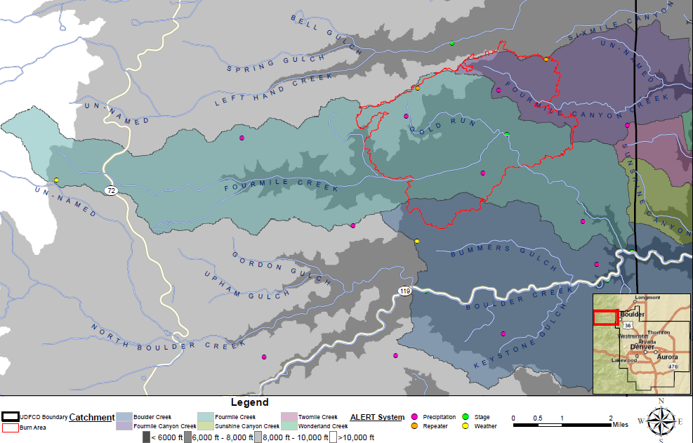
FMC Burn Area & Boulder Creek Watershed
1,145 ac
4,577 acres
389 ac

Slide 9
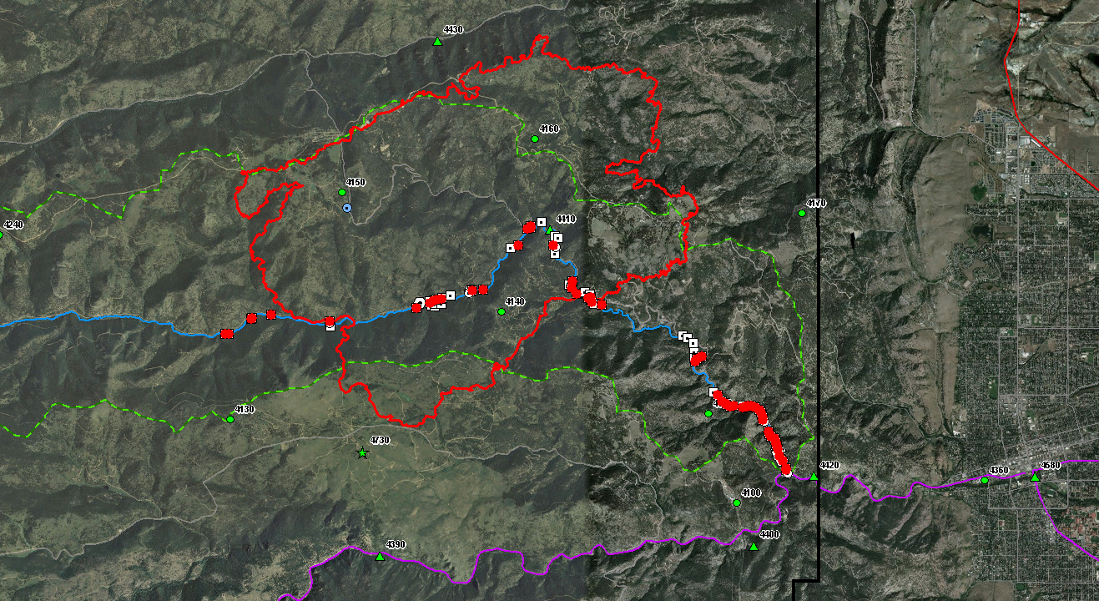
HIGH RISK TO PEOPLE, PROPERTY & INFRASTRUCTURE

Slide 10
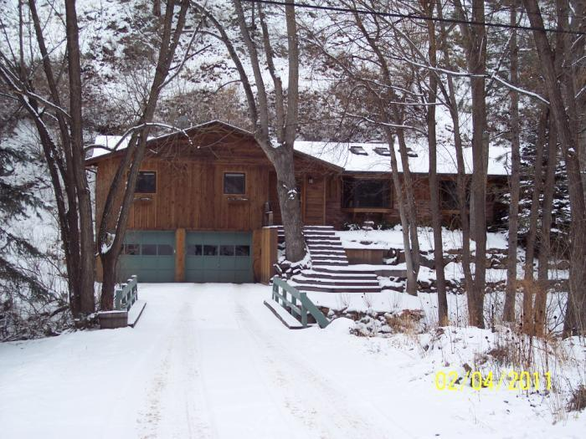
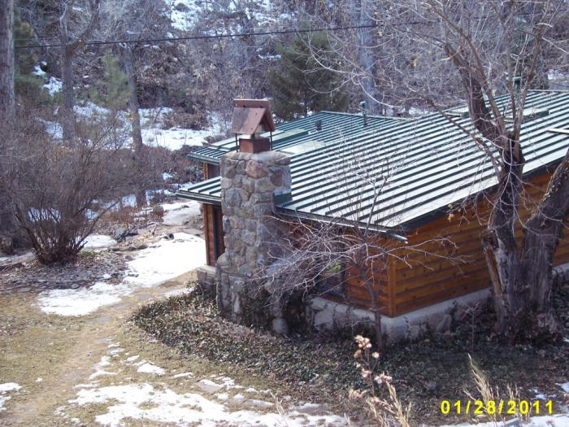
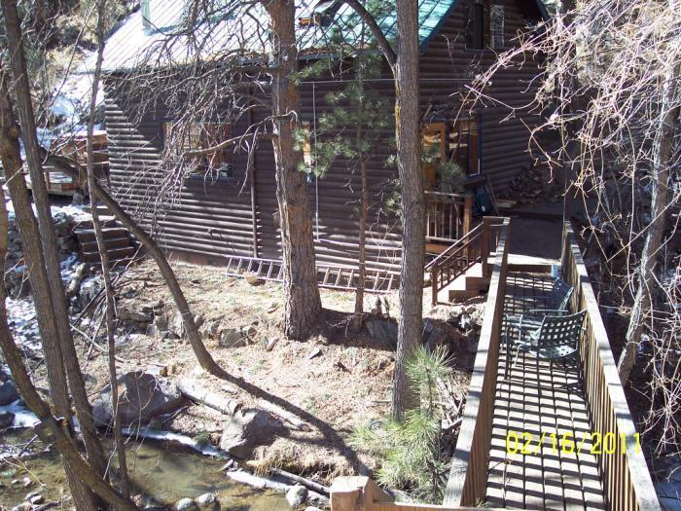
Twenty homes along Fourmile Creek are at risk from flood flows ranging from 500 to 1,500 cfs—a highly likely event. An additional 30 homes are at risk of flooding from larger floods (1,500 to 6,000 cfs) and 11 more from less likely, but possible events approaching 10,000 cfs. This brings the total to 61 homes threatened. An additional 10 to 15 homes adjacent to Gold Run are also at high risk from flooding and debris flows.

Slide 11
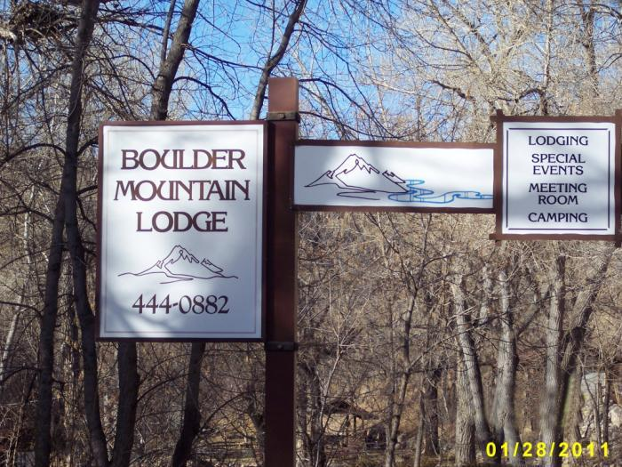
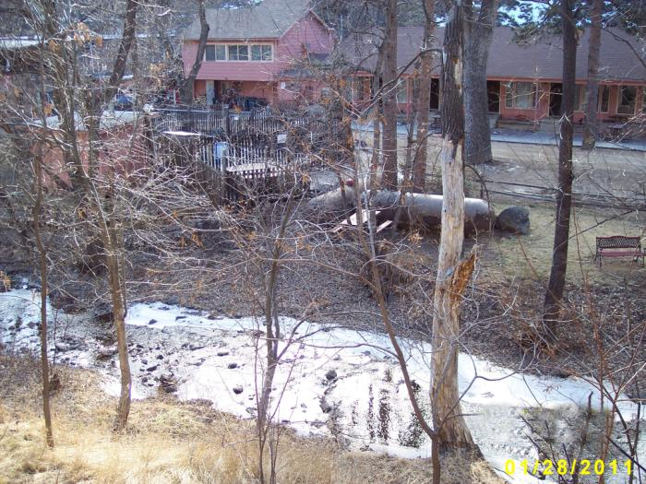
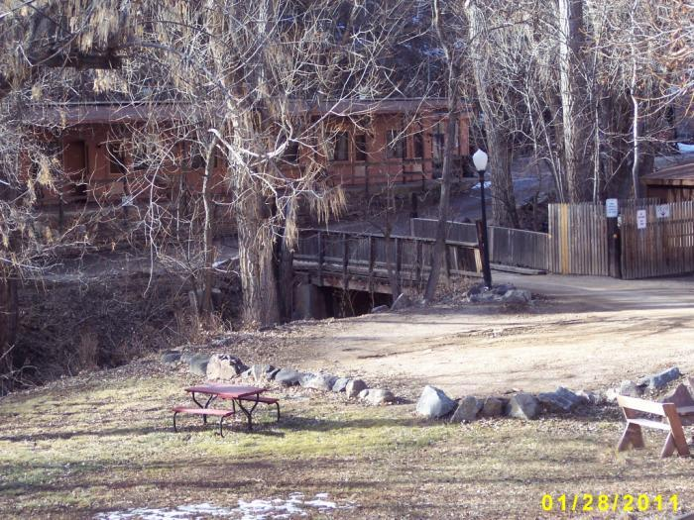
Three commercial properties along Fourmile Creek at risk from flood flows ranging from 500 to 6,000 cfs. The Boulder Mountain Lodge is the highest risk facility of the three.
Notes:
Boulder Mountain Lodge, 30 units, impacted by 10-year Q ~1,400 cfs
Assay Museum impacted by 25 to 100-year event, Q100~6,200 cfs
Fourmile Fire Station #3, impacted by 100-year, Q100~6,200 cfs

Slide 12
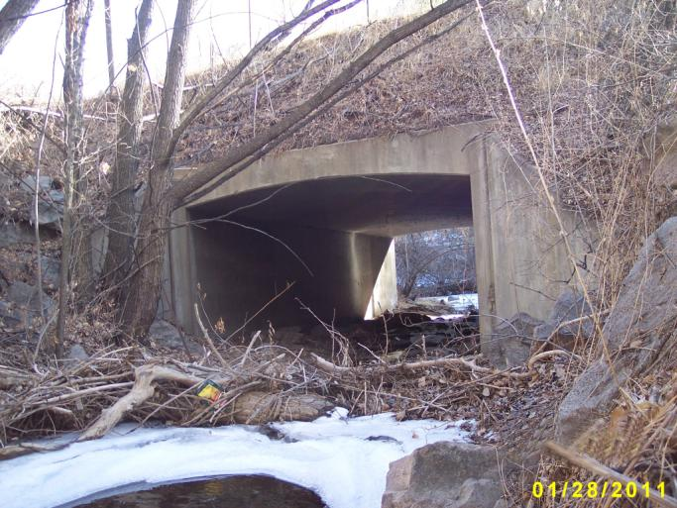
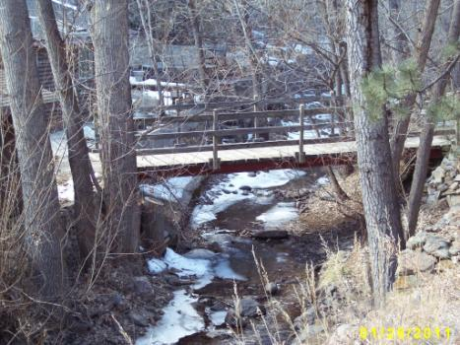
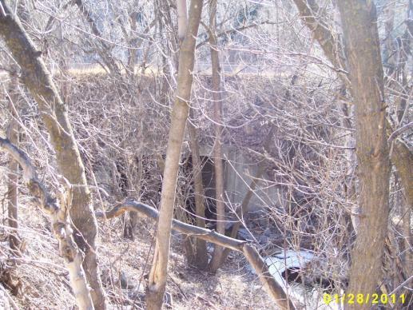
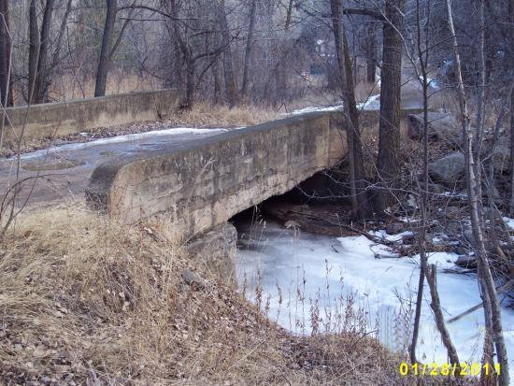
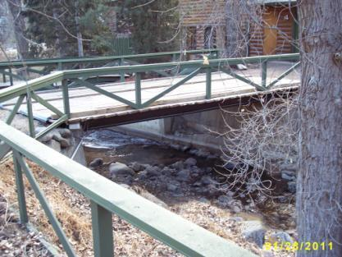
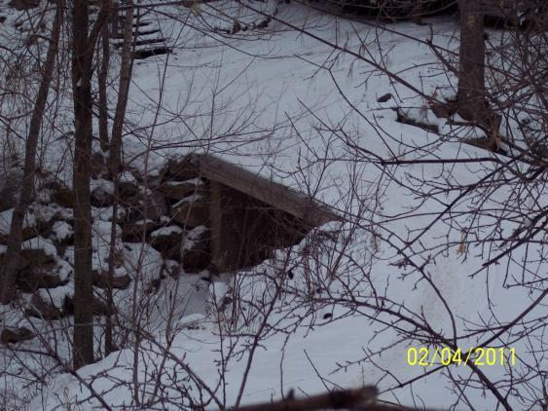
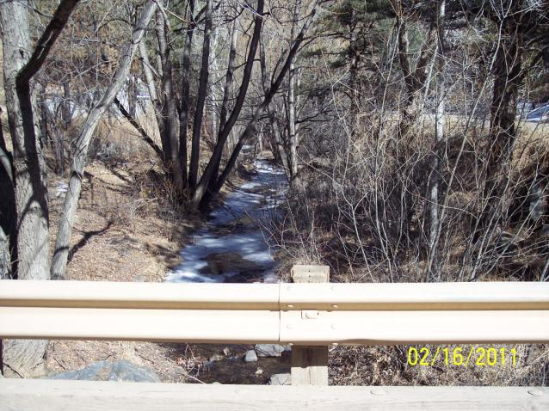
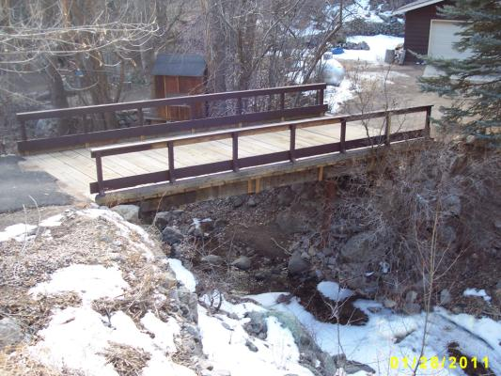
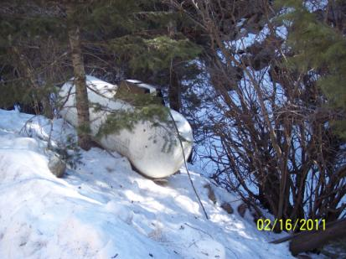
High debris flows will further increase flood risk by reducing the capacity of the channel and road crossings to convey floodwater.
ROAD CROSSINGS
Location | Qcap (cfs)
Colorado Hwy 119 | 1,700
Crisman Rd | 1,200
Logan Mill Rd | 1,500
Private at Salina | 2,000
many private drives | < 500

Slide 13
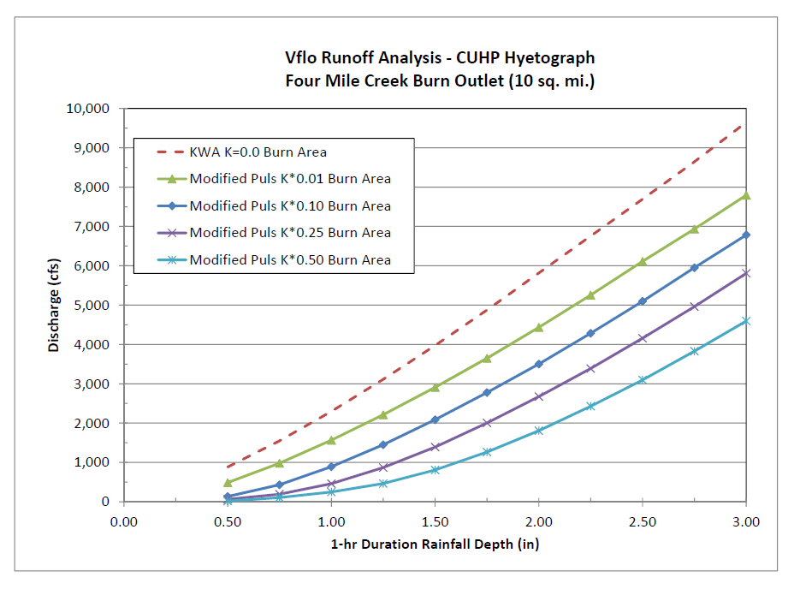
Hydrologic Models High flood threat from commonly occurring rainfall
BC 1894 Flood 12,000 cfs
BC Typical Annual Snowmelt Peaks 500 to 1,000 cfs
BC = Boulder Creek
FMC = Fourmile Creek
FMC-BA 100% saturated at start of rainfall
Boulder properties at risk
BC 1969 Flood
FFW for Boulder ??
FMC
FMC Typical Annual Peaks < 100 cfs
Pre-burn runoff experience

Slide 14
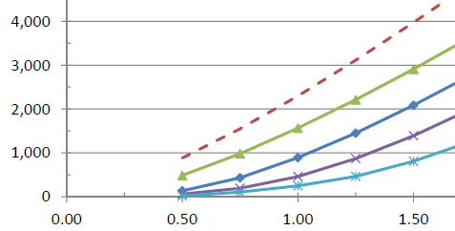
Significant damages and life-threatening conditions expected from flood peaks ranging for 500 to 1,000 cfs on Fourmile Cr.
Represents range of peaks from other models.
Other models assume average antecedent
watershed condition at start of rainfall.
FMC-BA 100% saturated at start of rainfall
Debris flow threat
per USGS
FFW for Fourmile Cr
FFA for FMC

Slide 15
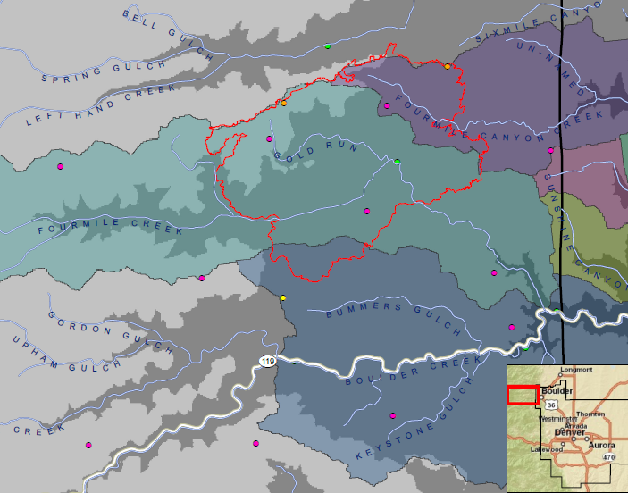
Fourmile Creek Peak Runoff Estimates
R.I. @ SH 119 | CWCB 1981
2-yr | 450
5-yr | 850
10-yr | 1,420
25-yr | 2,700
50-yr | 4,440
100-yr | 6,230
500-yr | 11,640
1-HR PCP | Vieux | LRE | WWE | UCD
0.5” | 880 | 150 | 200 | 550
0.75” | 1,600 | 460 | 470 | 900
1.0” | 2,400 | 890 | 820 | 1,400
1.25” | 3,300 | 1,400 | 1,200 | 1,800
1.5” | 4,300 | 2,000 | 1,800 | 2,200
1.75” | 5,300 | 2,600 | 2,800 | 2,700
2.0” | 6,300 | 3,300 | 3,800 | 3,200
2.5” | 8,400 | 4,600 | 5,900 | 4,300
3.0” | 10,500 | 6,100 | 7,500 | 5,600
1,700 cfs will overtop SH 119
NOTES:
Vieux peaks assume saturated BA at start of rain, i.e. worst case scenario
Burn area outfall located ~5 miles upstream from Boulder city limit (canyon mouth).
Fourmile Creek confluence w/Boulder Creek located ~2 miles upstream of Boulder.
Peak discharge estimates in cfs relate only to runoff from the FMC Burn Area.
Notes:
UDFCD Jan 31 peak discharge estimates based on unit peaks (cfs/acre) contained in WWE memo dated January 20, 2011. Drainage basin size used for calculation equals 60% of the portion of the FMC Burn Area tributary to Fourmile Creek, i.e. (0.6 * 4,577). All values rounded to nearest 100 cfs.
The 1,700 cfs overtopping flow rate for SH 119 assumes no blockage. Since blockage from debris is highly likely, SH 119 will be at risk of overtopping from lesser magnitude events.

Slide 16
Fourmile Creek Saturated Watershed – Worst Case
R.I. @ SH 119 | CWCB 1981
2-yr | 450
5-yr | 850
10-yr | 1,420
25-yr | 2,700
50-yr | 4,440
100-yr | 6,230
500-yr | 11,640
1-HR PCP | Vieux | LRE | WWE | UCD
0.5” | 880 | 520 | 170 | 550
0.75” | 1,600 | 1,100 | 880
1.0” | 2,400 | 1,800 | 1,700 | 1,300
1.25” | 3,300 | 2,500 | 2,600
1.5” | 4,300 | 3,200 | 3,600 | 2,200
1.75” | 5,300 | 4,000 | 4,700
2.0” | 6,300 | 4,800 | 5,800 | 3,400
2.5” | 8,400 | 6,400 | 8,500 | 4,600
3.0” | 10,500 | 8,200 | 11,500 | 6,000
1,700 cfs will overtop SH 119
NOTES:
All models assume saturated BA at start of rain, i.e. worst case scenario
WWE adjusted slightly to best fit data plot.
Burn area outfall near Crisman located ~5 miles upstream from Boulder city limit (canyon mouth).
Fourmile Creek confluence w/Boulder Creek located ~2 miles upstream of Boulder.
Peak discharge estimates in cfs relate only to runoff from the FMC Burn Area.
Last update: 3/18/2011
Notes:
UDFCD Jan 31 peak discharge estimates based on unit peaks (cfs/acre) contained in WWE memo dated January 20, 2011. Drainage basin size used for calculation equals 60% of the portion of the FMC Burn Area tributary to Fourmile Creek, i.e. (0.6 * 4,577). All values rounded to nearest 100 cfs.
The 1,700 cfs overtopping flow rate for SH 119 assumes no blockage. Since blockage from debris is highly likely, SH 119 will be at risk of overtopping from lesser magnitude events.

Slide 17
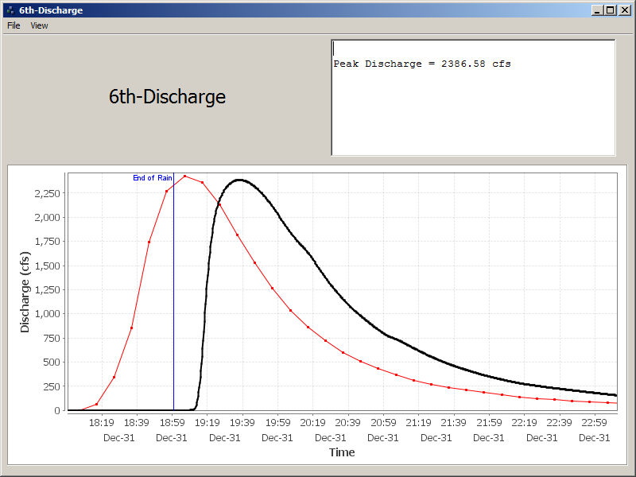
Short Travel Time/Minimal Attenuation
Flood hydrograph routed to
6th Street in Boulder
Approximate magnitude of 1969 flood on Boulder Creek
Hydrograph routed 5 miles from FMC-BA to western Boulder city limit (Boulder Creek canyon mouth).
1 hour

Slide 18
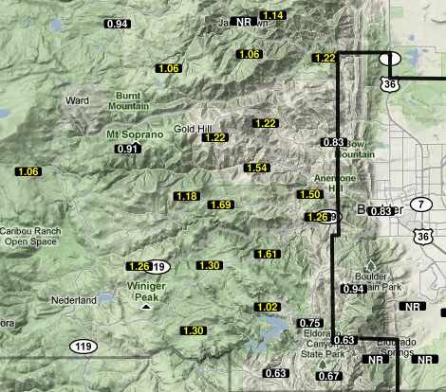
Rainfall history
June 3, 2002

Slide 19
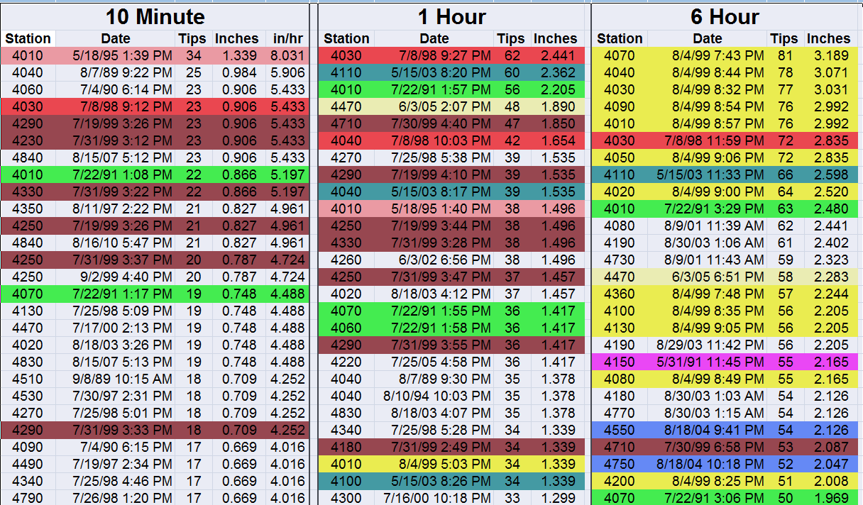
Intense Rain Events in Boulder County 1990-2010
Notes:
Analysis by Water & Earth Technologies, Inc. of Fort Collins.

Slide 20
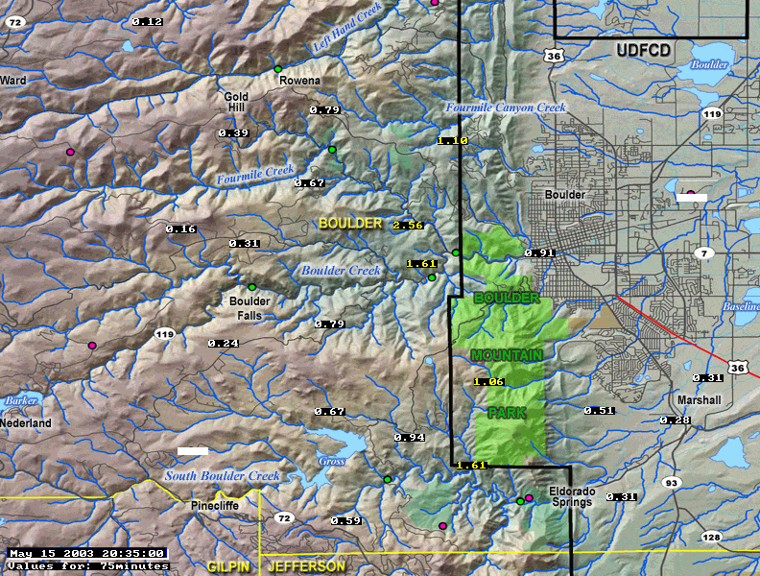
Most intense rainfall measurement 1990 – 2010 (21 years)
May 15, 2003
75-minute rainfall totals ending at 8:35 PM
Peak 1-hour at Betasso 2.35”
Boulder Creek at Bridge

Slide 21
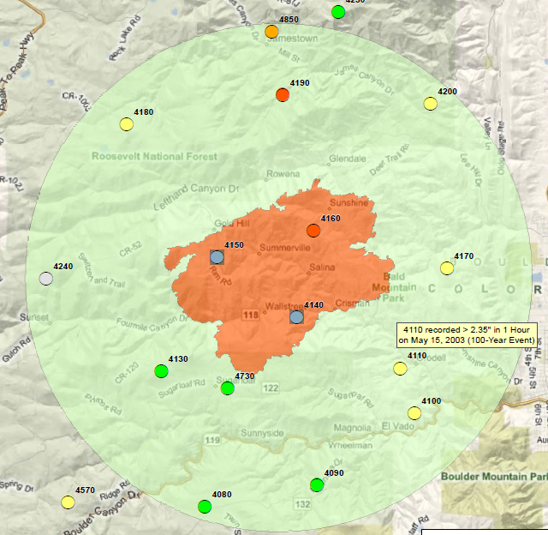
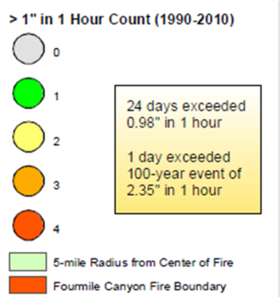
ALERT System
Rainfall Record
Analysis
by
Water & Earth
Technologies, Inc.

Slide 22
Measured Rainfall Events > 0.9” in 1-hour 37 days between 1990 & 2010
YEAR | DATES & TIMES
1990 | Jul-4@1828, Aug-17@1300
1991 | May-31@2101, Jun-1@1413, Jul-22@1358, Aug-3@1051
1996 | Jul-28@1918, Sep-14@1834
1997 | Jun-6@1548, Jul-30@1559
1998 | Jul-8@2352, Jul-24@1915, Jul-25@1814
1999 | Jul-19@1556, Jul-28@1738, Jul-30@1618, Jul-31@1536, Aug-4@1614, Aug-7@1531, Aug-27@1449
2000 | Jul-16@2101
2001 | Aug-9@1931, Aug-30@1912
2002 | Jun-3@1954
2003 | May-15@2047, Jun-18@2328, Jul-29@1352, Aug-29@2146
2004 | Jul-16@1431, Aug-18@1617
2005 | Jul-25@1708
2006 | Jun-24@1841, Jul-20@1544, Aug-14@1510
2007 | Jul-26@2316, Jul-29@1559
2010 | Jul-4@2032
2 days in May
5 days in June
20 days in July
9 days in August
1 day in September

Slide 23
Measured Rainfall >0.5” & < 0.9” in 1-hr 151 days between 1990 & 2010
15 days in April
18 days in May
29 days in June
31 days in July
34 days in August
24 days in September
YEAR | DATES | YEAR | DATES
1990 | 5-28,30 7-11,16,19,20 8-5,11,16 9-2,5,6 | 2000 | 8-16
1991 | 5-15,16,22 6-13 7-25,26 9-9,11 | 2001 | 4-11 7-8,11 8-5,7,8,11,15
1992 | 6-27 9-24,29 | 2002 | 5-24 8-5 9-10,12
1993 | 4-22 6-7,11,17 7-13 9-14,17 | 2003 | 4-24 6-17,19 7-27 8-30
1994 | 4-30 5-11 6-2,18,20,21 7-31 8-10,11,13 9-13 | 2004 | 4-4,5 5-1 6-8,9,27,29 7-19,23,28 9-19,30
1995 | 5-18,29 6-17 7-14 8-19,24 9-14 | 2005 | 4-11 6-3 8-10,22,23 9-14
1996 | 4-8, 5-23, 6-12,16,21 7-9 9-18 | 2006 | 4-26 7-2,25 8-13
1997 | 4-13,25 6-7,10,12,13 8-3,4,5 9-11 | 2007 | 5-5,6 6-12 7-7,27,30 8-15,17,24 9-5,24
1998 | 4-3,26 7-22,26,30 8-1,4 | 2008 | 8-6,9
1999 | 5-11,20,24 7-8,16,17,24,29 8-5,10 9-2,24,29 | 2009 | 4-19 5-23 6-24,26 7-27 9-8
 |  | 2010 | 4-21 5-14 6-23,26 7-7 8-6,9

Slide 24
Some Facts & Opinions
One-hour rainfall measurements from the ALERT System exceeded 0.9” on 37 days in the past 21 years at one or more locations within a 6-mile radius from the center of the FMC-BA.
0.75” to 1.25” of rainfall over the FMC-BA is capable of producing flood peaks on Fourmile Creek that could overtop SH 119 (Qcap ~1,700 cfs unobstructed)
As little as 500 cfs will threaten existing private drive crossings along Fourmile Creek, which is highly likely from 1-hour rainfalls exceeding 0.5”
The number of private homes and other habitable structures at risk from flooding in the FMC-BA and along Fourmile Creek downstream is large (60-75).
The Boulder Mountain Lodge is at very high risk of inundation due to its location being a short distance upstream of SH 119, which can backup floodwaters to a depth of 19-feet or more when flow rates exceed 1,000 cfs.
Liquid propane tanks pose a significant threat that could impact Boulder.
The May 30, 1995 estimated peak flow of 400-500 cfs on Fourmile Creek was likely the largest in recent memory.
The May 15, 2003 storm...a 100-year rainfall at the Betasso…produced an estimated peak flow of only 400 cfs in Fourmile Creek. That would look much different today.

Slide 25
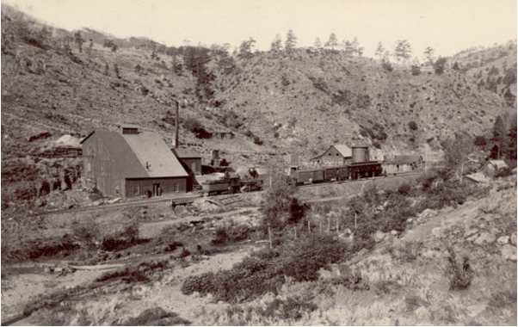
Crisman, Colorado 1891-1893

