Slide 1
The National Hydrologic Warning Council …programs, services and opportunities for you…
ALERT Users Group
23rd Flood Warning Systems Training Conference and Exposition
Hilton Hotel, Palm Springs, California
May 4-7, 2010
Kevin G. Stewart, P.E.
Manager, Information Services & Flood Warning Program
Urban Drainage and Flood Control District
Denver, Colorado

Slide 2
Before we get started, your expertise is needed.
A teaching moment dedicated to the life and passions of the “Father of ALERT” Bob Burnash

Slide 3
THE PREDICAMENT
The recent census for the town of West Tincup, CA has revealed that their population now exceeds 100,000. Concerned about complying with NPDES requirements, the town council and public works department have decided to hold a Stormwater Summit in the Urban Drainage and Flood Control District (1,600 mi² Denver metro area) sometime between now and Labor Day this year. The mayor wants to experience a 5-year or greater rainfall during their stay to see BMP’s in action and they are willing to stay as long as it takes.
What should we tell the Mayor?

Slide 4
Some facts to consider:
There are 186 rain gages in the District’s ALERT System.
In 2009, 155 rainfall rate alarms occurred on 32 days at 97 locations.
The lowest rainfall rate alarm threshold exceeds the 2-year frequency.
In 2009 the maximum measured 5-minute rainfall intensity was 10.9 in/hr.
Larger events have been measured larger events in the past.
Is it possible that large rainfall events happen far more frequently than we might normally expect?

Slide 5
1993 Dallas
1999 San Diego
2005 Sacramento
2007 Savannah

Slide 6
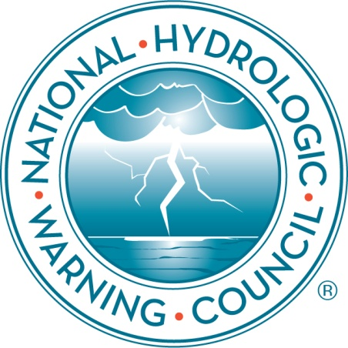
Mission
Become the trusted leader of the hydrologic warning community providing training, guidance and standards.
Vision
Timely, reliable hydrologic information being used to protect lives, property, and the environment.

Slide 7
Goals
Institutional Sustainability
Ensure financial integrity and membership growth
Expand services to enhance value to members
Maintain effective leadership and management
Strategic Goals
Promote collaboration among a diverse HWS community of local, state, and federal agencies as well as academia and the private sector.
Educate decision makers and operators to raise awareness, increase knowledge, and escalate the use of real-time hydrologic information.
Provide guidance and standards for HWS design, implementation, maintenance, and operations based on the latest technical and scientific information.

Slide 8
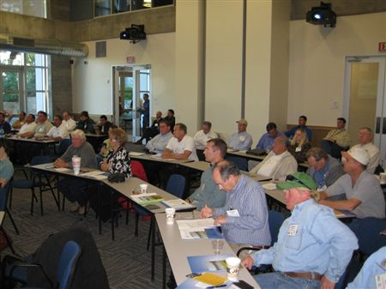
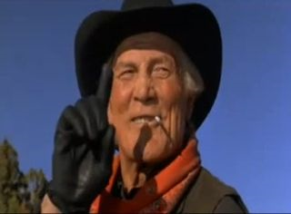
High value placed on training.
The secret of life

Slide 9
SERVE ON A COMMITTEE A great way for you to get involved.
NHWC Executive Program Committee Brian McCallum, Chair epc@hydrologicwarning.org CURRENT ACTIVITIES Conferences Data Collection Guidance & Standards Hydrology, Modeling & Analysis Training & Professional Development Hazard Communication & Public Awareness

Slide 10
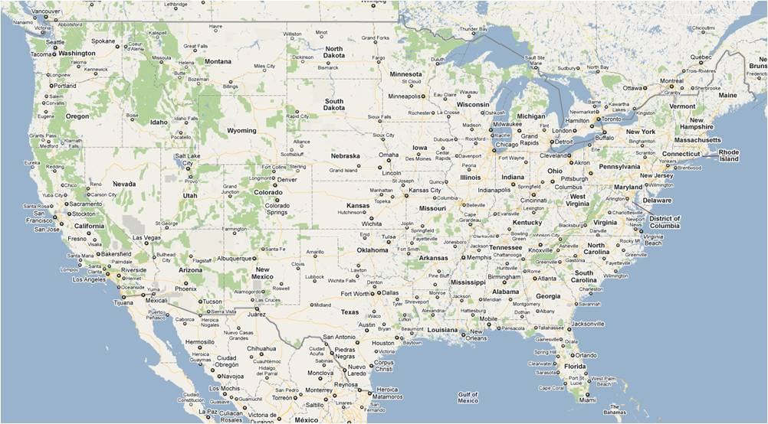
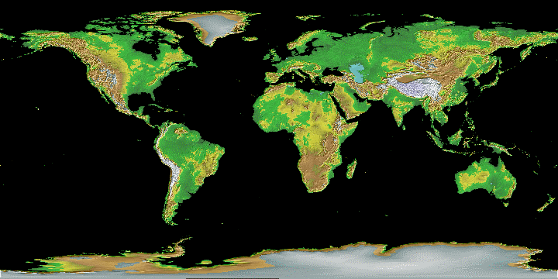
Leadership from mountains to seashore and coast-to-coast
& worldwide

Slide 11
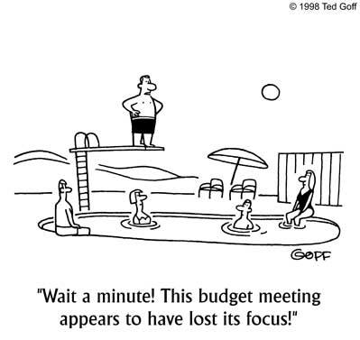
People you should meet:
BOARD MEMBERS
Kevin Stewart (P) | Denver, CO
Steve Fitzgerald (VP) | Houston, TX
Rand Allan (S) | San Diego, CA
Chris Crompton (T) | Orange County, CA
Isle Gayl | Longmont, CO
Frank Gutierrez | Fort Worth, TX
David Haynes | Asheville, NC
Josh McSwain | Charlotte, NC
George Wilkins | San Diego, CA
ADMINISTRATION & PROGRAMS
Glenn Austin | Raleigh, NC
Brian McCallum | Atlanta, GA
Gene Stallings | Bel Air, MD

Slide 12
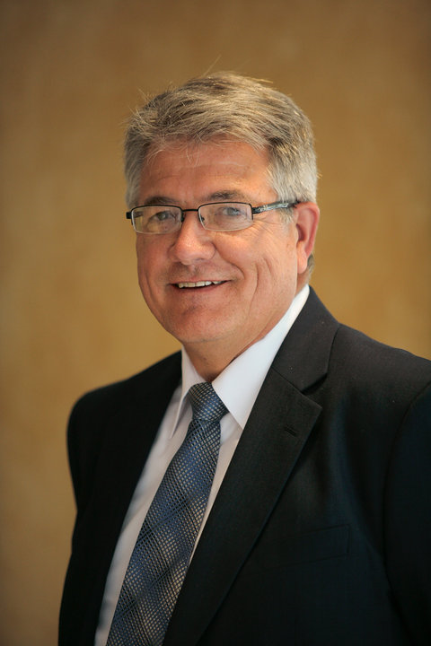
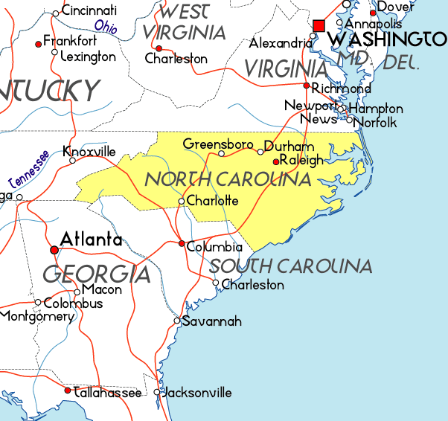
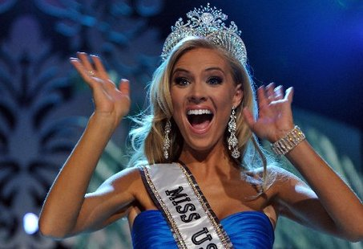
NHWC Executive Director Glenn Austin
Notes:
Kristen Dalton, Miss USA 2009

Slide 13
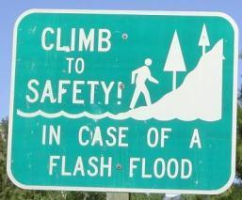
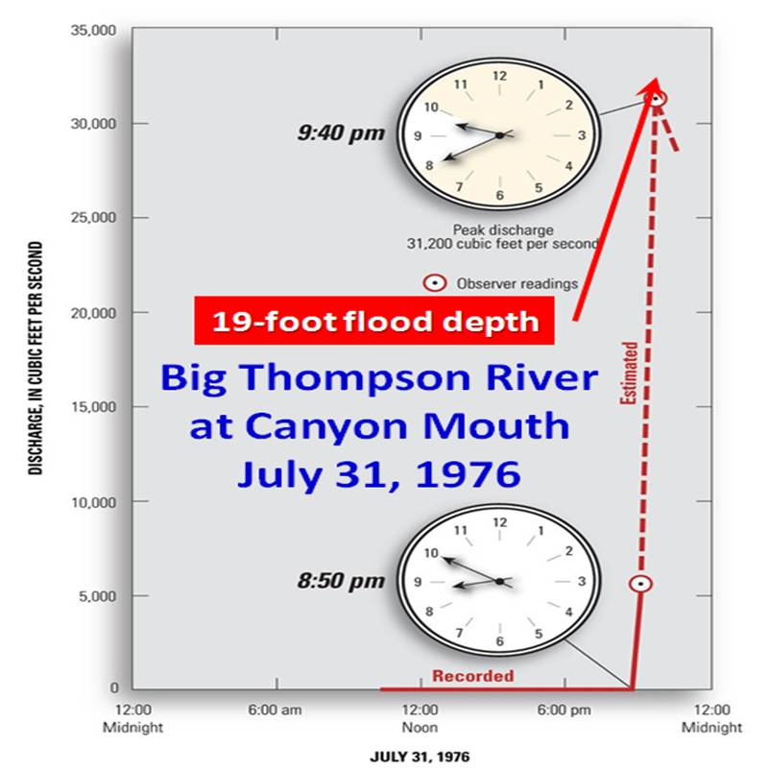
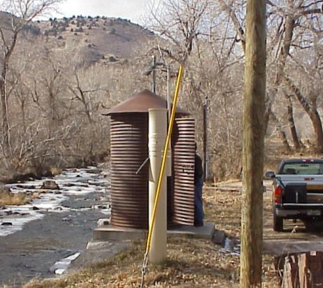
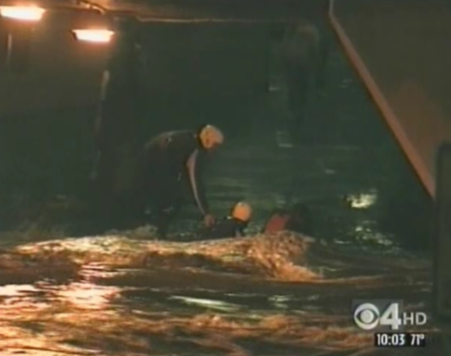
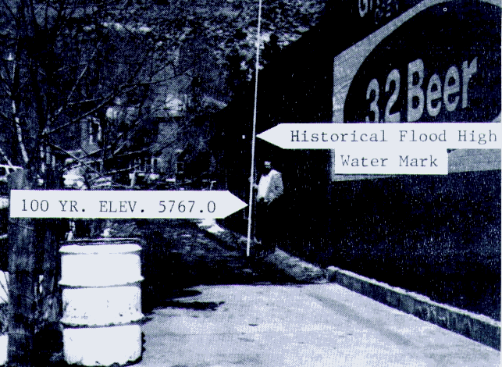
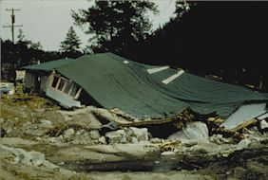
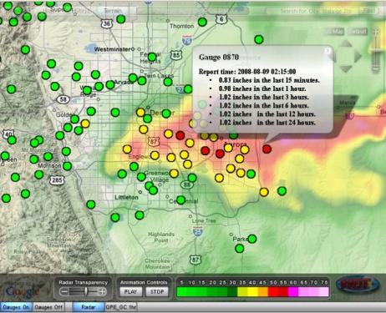
http://hydrologicwarning.org

Slide 14
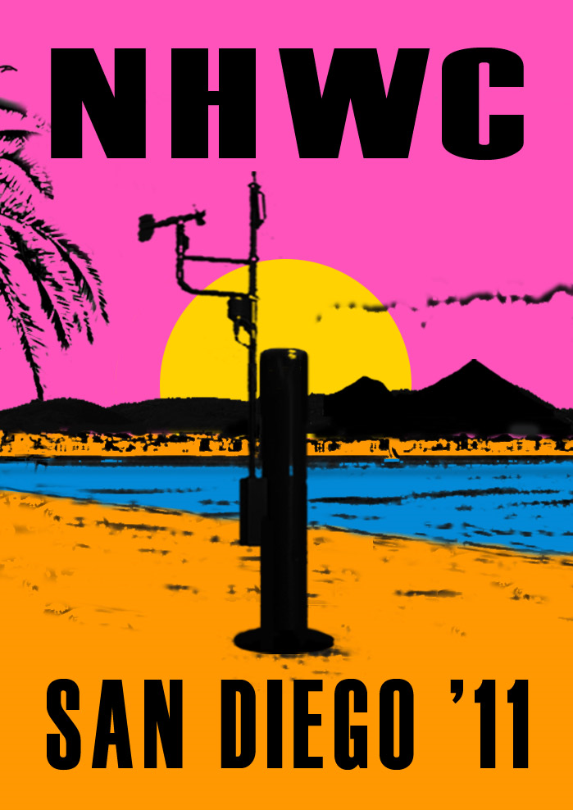
You won’t want to miss this one, so mark your calendars now for the week of May 9-12, 2011. 9th National Conference & Exposition of the National Hydrologic Warning Council

